Slide 1

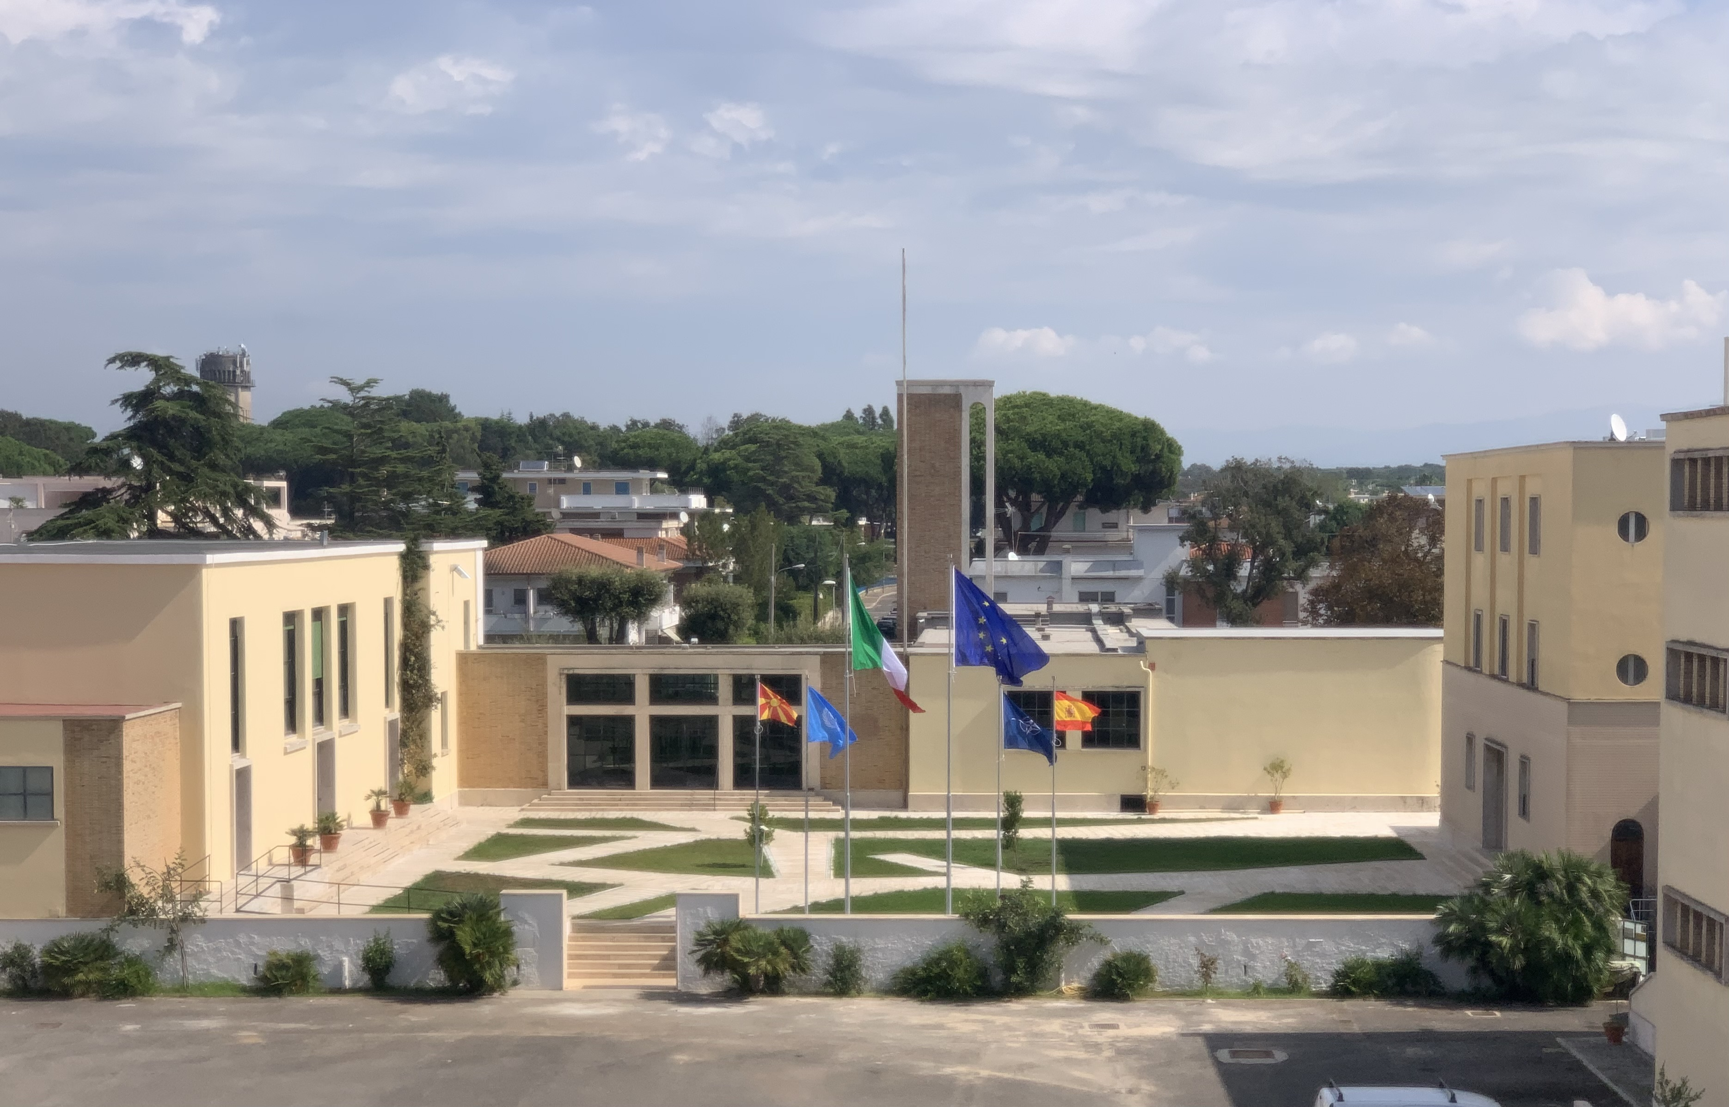

Center of Excellence for Environmental Protection
28th IAPTC Annual Conference
Islamabad, 4-8 November 2024

Slide 2



Center of Excellence for Environmental Protection
TABLE OF CONTENTS
INTRODUCTION
ENVIRONMENT PROTECTION ACTIVITIES
Center of Excellence for Environmental Protection
TRAINING ACTIVITIES
TRAINING MODULES

Slide 3

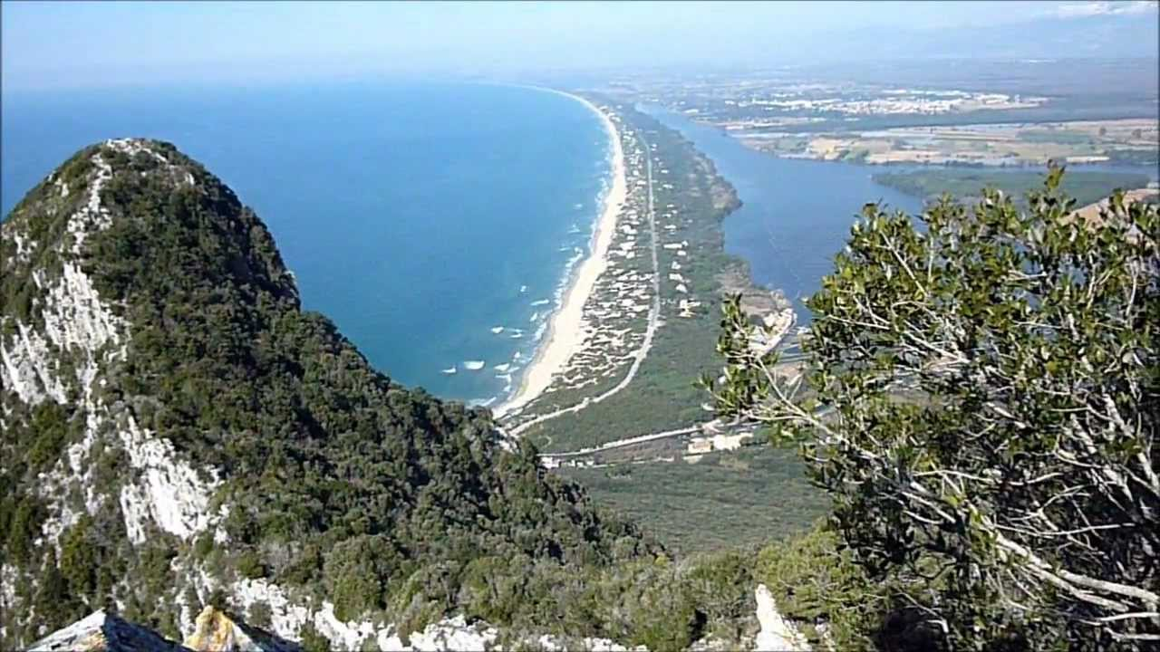
Center of Excellence for Environmental Protection
Sabaudia is located on the Tyrrhenian side of the Apennine chain, 100 kilometres south-east of Rome. It is the one and only Italian town dipped in the nature of a National Park.

Slide 4
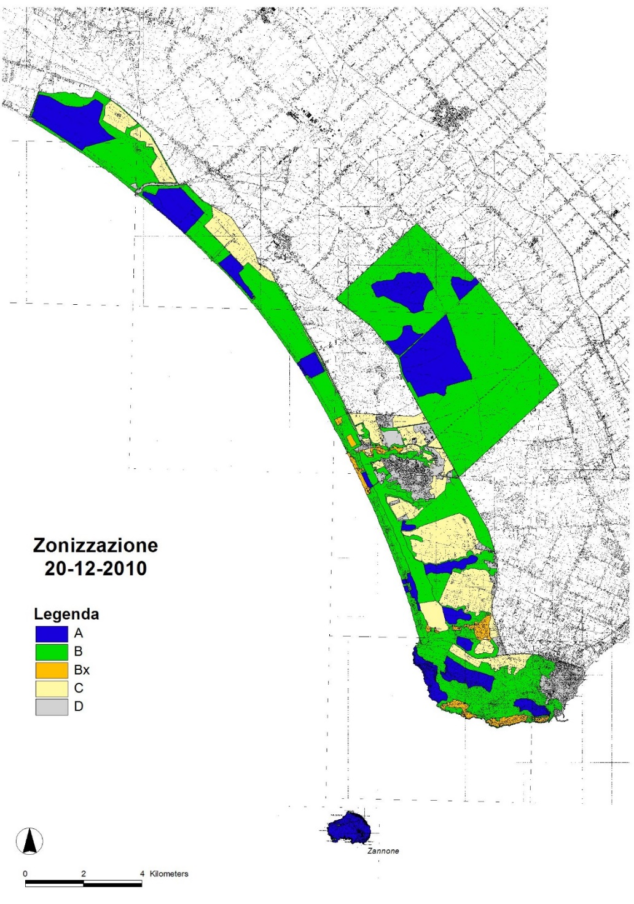
Center of Excellence for Environmental Protection
The Circeo National Park was founded in 1934 and includes 4 Integral Nature Reserves since the 1970s. Its State-owned forest is a UNESCO Biosphere Reserve since 1977. The lakes and wetlands were designated in 1978 to be of international importance under the Ramsar Convention, a UNESCO intergovernmental environmental treaty. The Park is included in the Natura 2000 EU Network as a Special Area of Conservation (SAC) and several of its sites are Special Protected Areas (SPA).

Slide 5
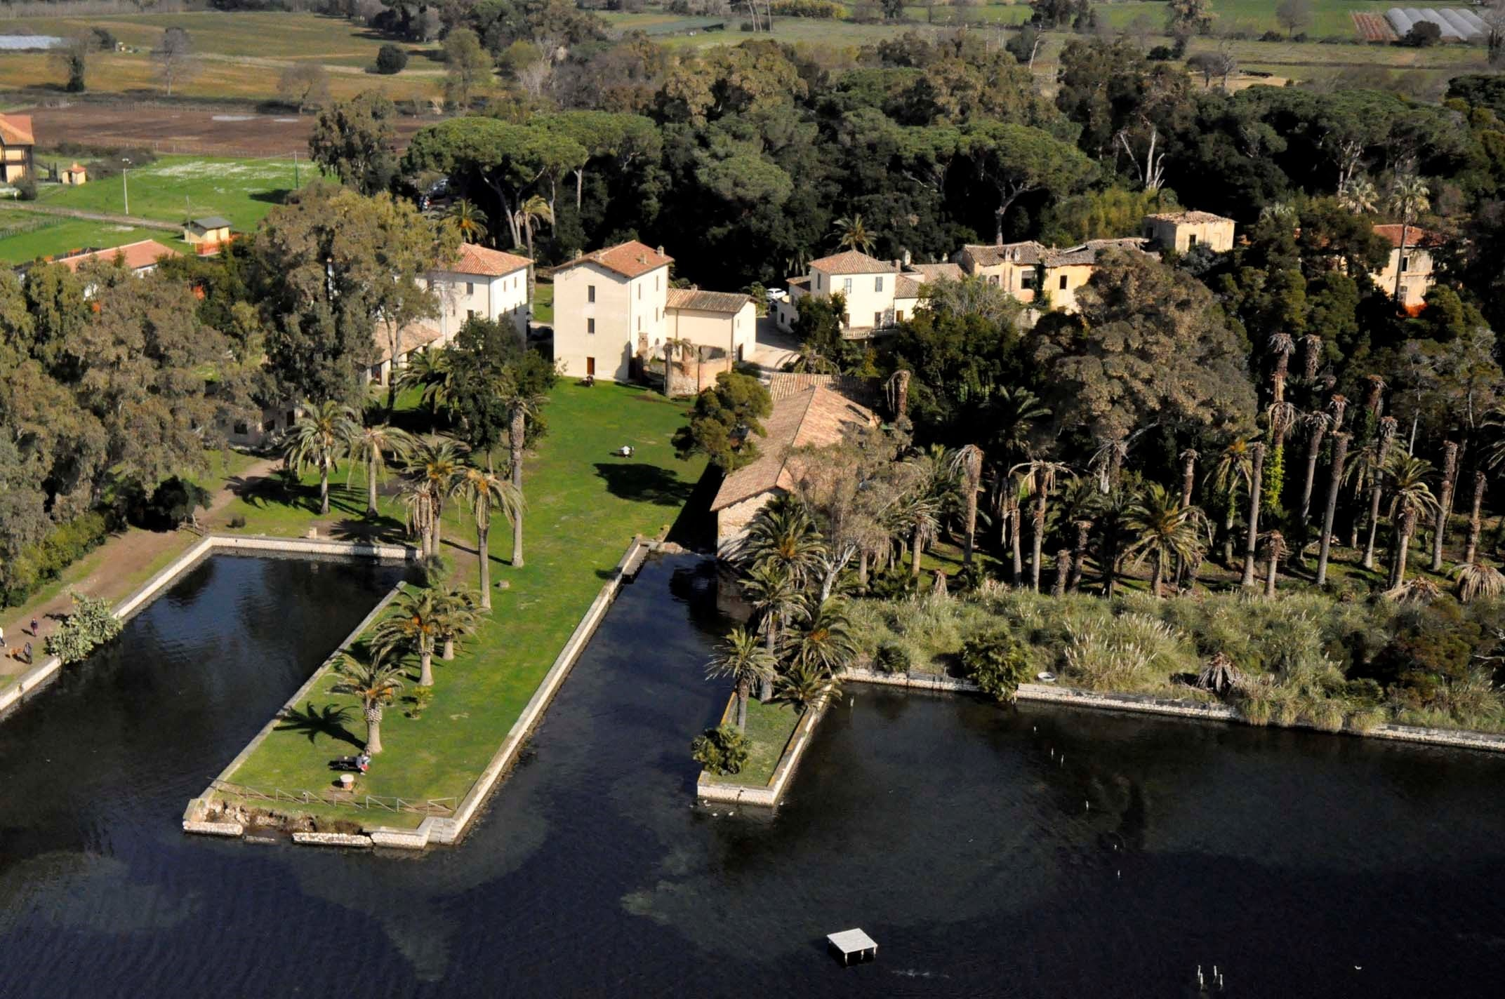
Center of Excellence for Environmental Protection
Close to Sabaudia, there is Fogliano National Reserve, managed by a Carabinieri Biodiversity Center, with a botanical garden, a wild animals rescue center and an amazing conference hall.

Slide 6
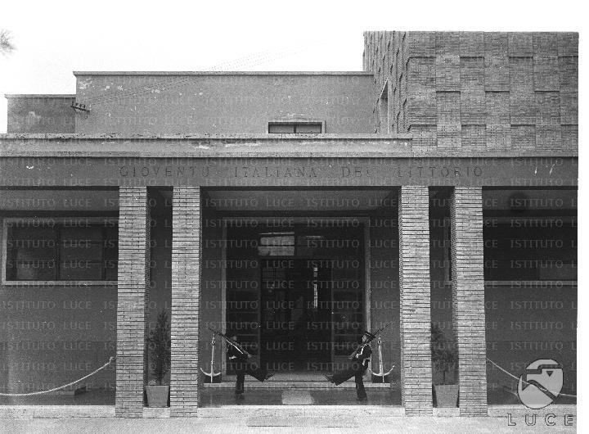
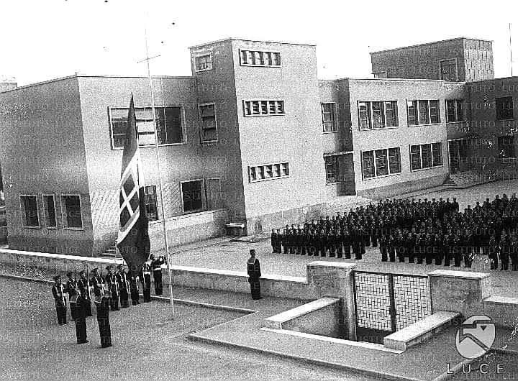
Center of Excellence for Environmental Protection
The building was developed in the Thirties of the last century and it is a clever example of Italian Rationalist Architecture. Born as a college hosting very young cadects of the Italian Royal Navy…

Slide 7
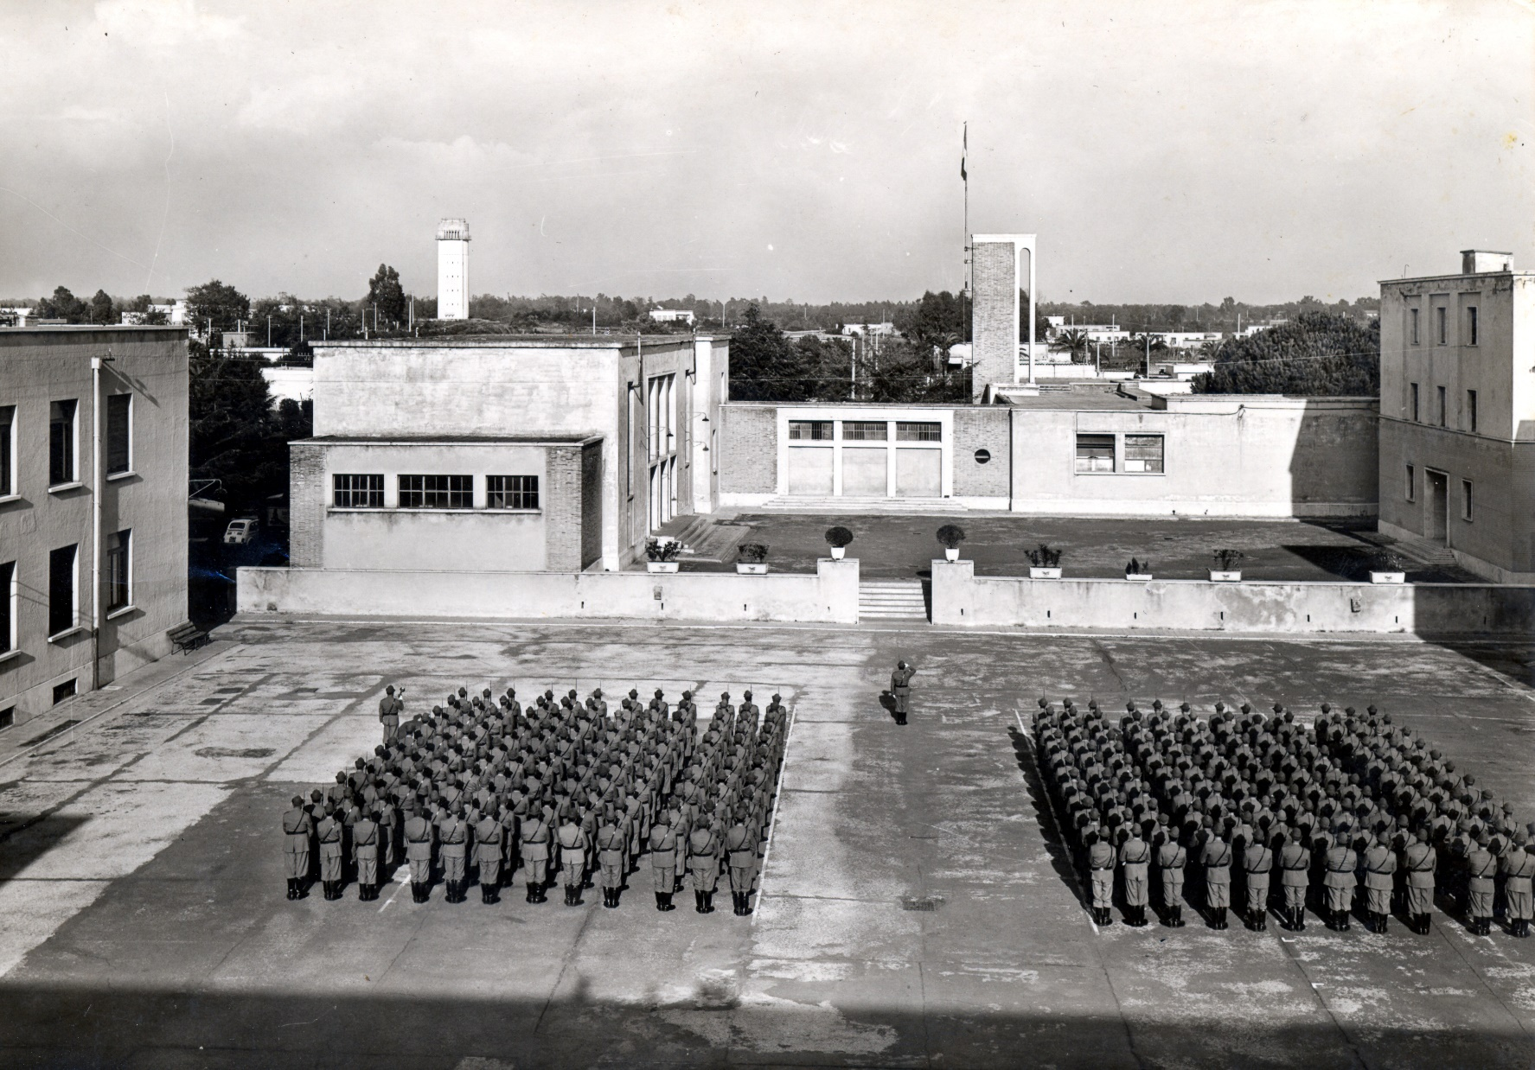
Center of Excellence for Environmental Protection
…it became a School of the Italian Forestry Corps in 1962, untill 2017.

Slide 8
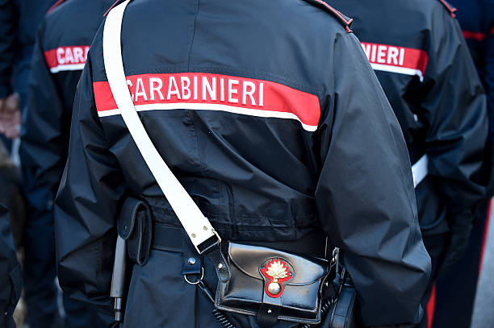
Center of Excellence for Environmental Protection
The Arma dei Carabinieri is a military status police force with general competencies, a territorial mission and an international projection
With more than 5,000 stations, throughout the whole national territory, Carabinieri are capable of responding, with immediate effectiveness, to the citizens security needs.
The protection of the environment, biodiversity and ecosystems is one of the main sectors of commitment.
Carabinieri engagement in environmental protection dates back to 1986 and was strengthened in 2017 with the establishment of the Organisation for Forestry, Environmental and Food Protection, employing over 7,000 qualified personnel in the control and care of territory, preventing and combating biodiversity and ecosystem damage, as well as supervising legal food production.

Slide 9
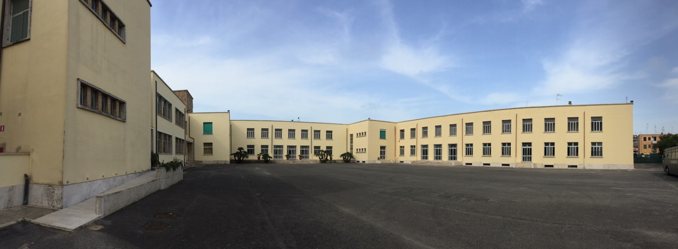
Center of Excellence for Environmental Protection
The CoEEP project
The Carabinieri Center of Excellence for Environmental Protection – CoEEP in Sabaudia boasts an historic tradition of excellence for the training of operators to environmental, biodiversity and ecosystems protection and control.
Arma dei Carabinieri offers the international community the possibility of joining the Carabinieri Centre of Excellence for Environmental Protection in Sabaudia.
For this reason, in December 2021, the Ministries of Foreign Affairs and International Cooperation, Defence, Agricultural, Food and Forestry Policies and Ecological Transition signed a MoU regarding the international cooperation for a sustainable development.
In May 2023, the UN and Carabinieri signed a letter og intent to collaborate to jointly develop training programs on environmental protection.

Slide 10
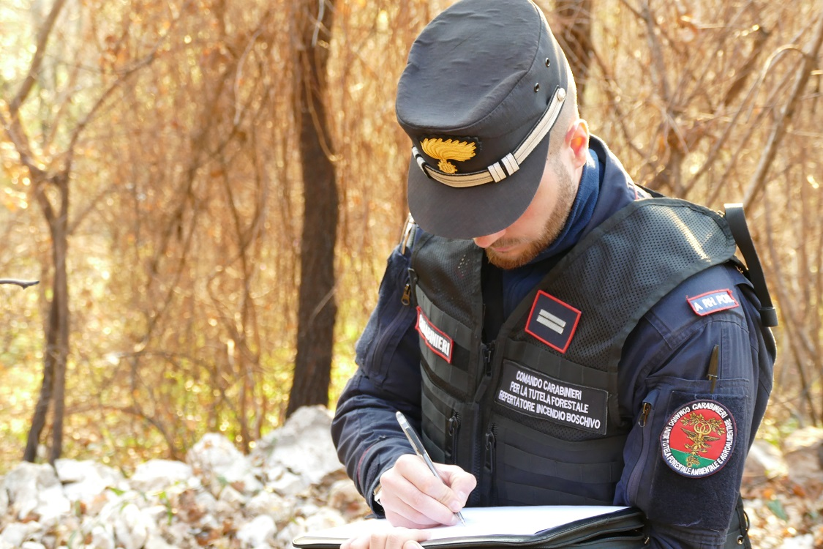
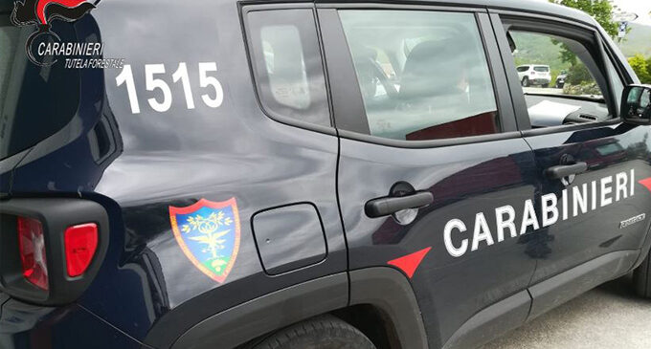
Center of Excellence for Environmental Protection
The Sabaudia Centre of Excellence project
The Centre can represent a key to inject environmental governance elements in countries where there is a need of specialised skills and experiences, to develop a sustainable economy at an ecological level.
The main idea is to
seek partnership with UN Agencies, Ministries and Authorities engaged in environmental issues, to promote annual operation plans and calls for applicants, mainly coming from developing countries.
Notes:
All the topics dealt with find direct correspondence in the activities carried out every day by the Arma dei Carabinieri within the 150 Public Forests and State Nature Reserves it manages.
For example:
1. Renaturalization of wooded areas and degraded habitats is implemented in the 3 National Centers for the Study and Conservation of Biodiversity, in which forest genotypes are studied and conserved;
2. First aid, treatment, rehabilitation and, if possible, the subsequent reintroduction into nature of injured or in distressed wildlife specimens, recovered by the Carabinieri or by citizens, are ensured in the CTTAC, Territorial Reception Centers for confiscated animals (one of them is located in Foglian Carabinieri Biodiversity Center, next to the Center of Excellence).

Slide 11
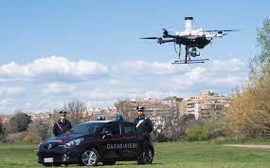
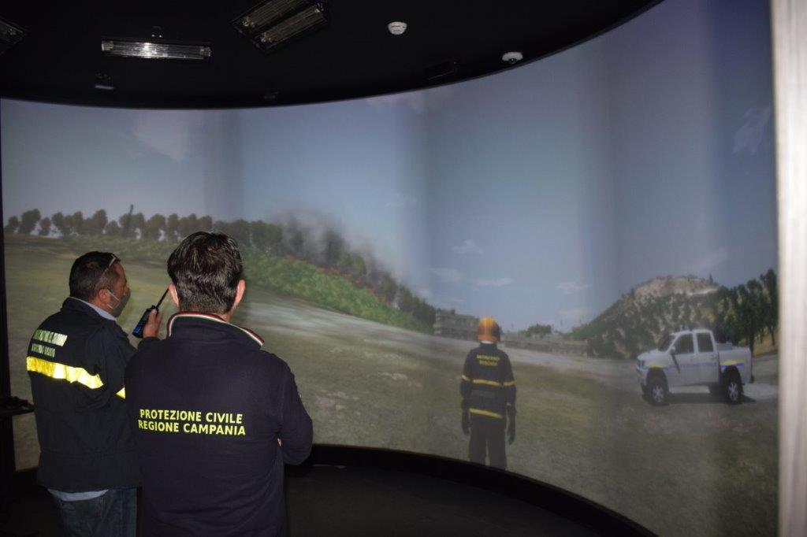
Carabineri Forestry School
Center of Excellence for Environmental Protection
The CoEEP project
The activities will be oriented to the conservation techniques of territory and biodiversity and to the control activities, aimed by innovative technology (remotely piloted aircrafts, satellite systems and advanced photo interpretation software).
Enhanced exercises for the defence of forest ecosystems from wildfires can be performed with the interactive digital simulator FFAS (Forest Fire Area Simulator), located at the nearby Carabinieri Training Centre of Castel Volturno, will be also available.

Slide 12
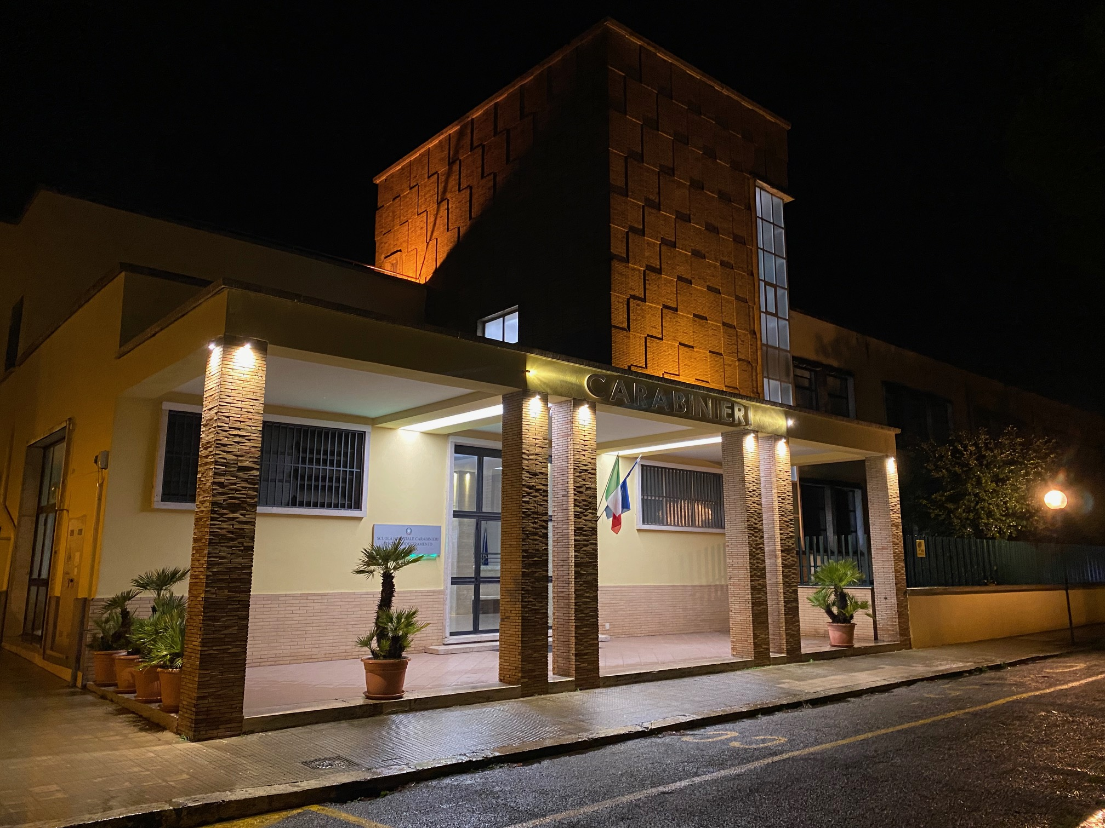
Center of Excellence for Environmental Protection
The Sabaudia Centre of Excellence has:
1 lecture hall with 144 seats and equipped for simultaneous translation.
2 spacious and bright computer classrooms and a multifunctional room.
Double and triple rooms, able to accommodate about 60 trainees at the same time.
A wide range of facilities including a canteen, a gym and a recreation room, as well as a guesthouse area, with double and single rooms, for up to 16 guests.
Notes:
12

Slide 13
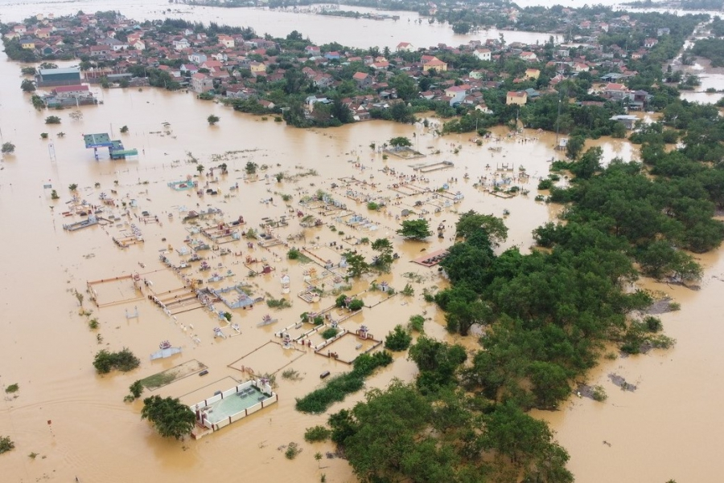

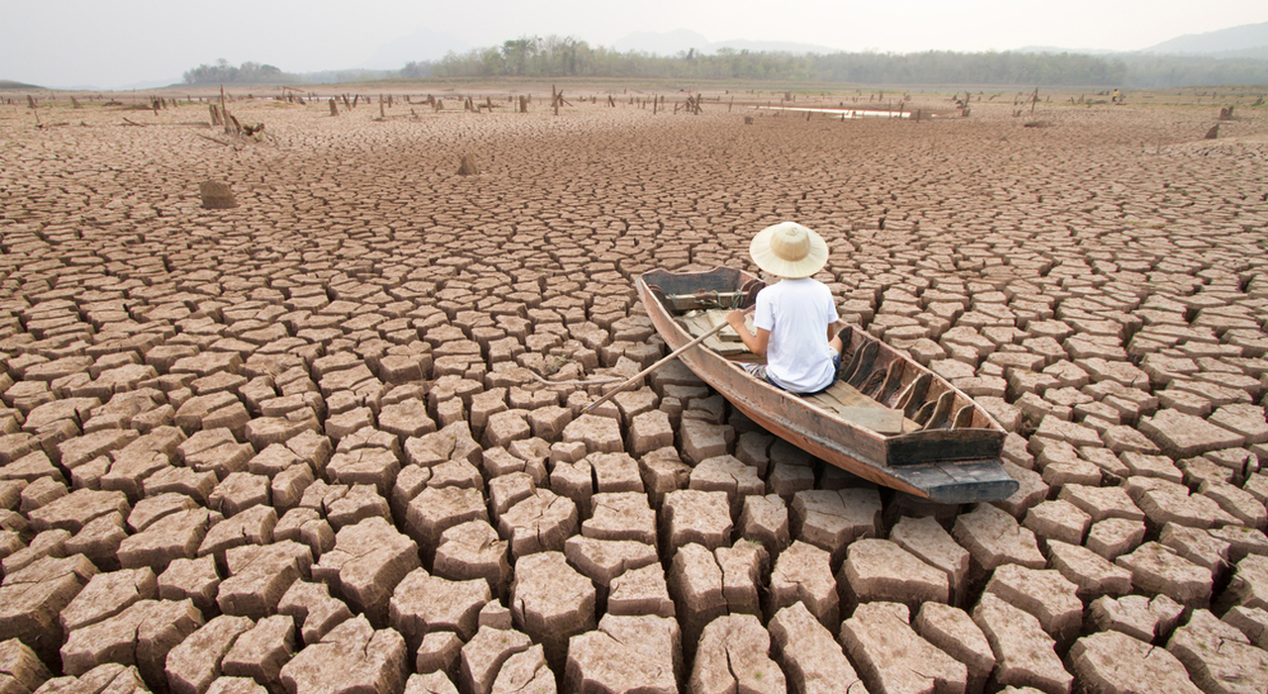
Center of Excellence for Environmental Protection
Skills to Fight against climate change: Peace keeping operations
In developing countries the climate change is strictly connected with a lot of dramatic and bloody conflicts.
Loss of soil fertility, decrease of water availability, drought, floods.

Slide 14
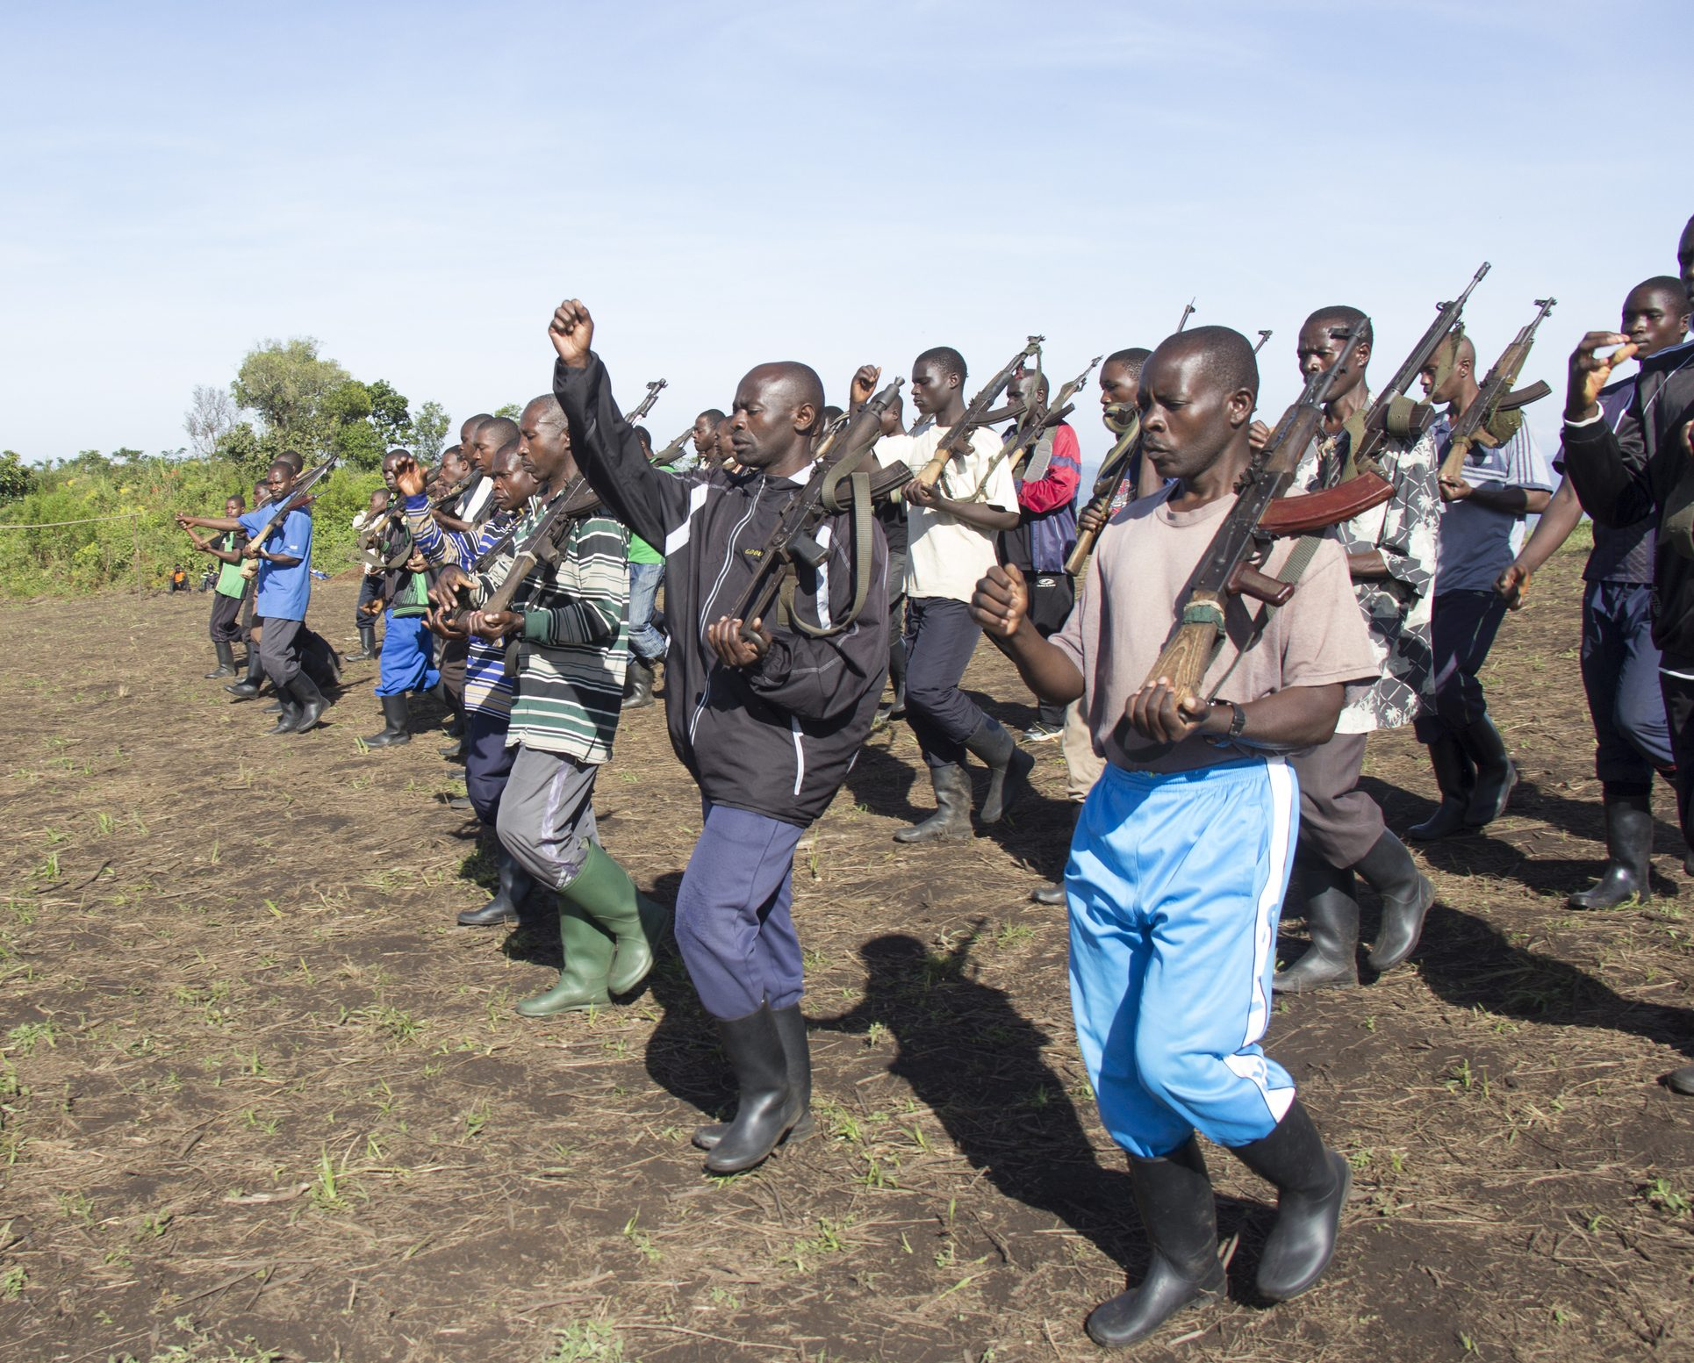
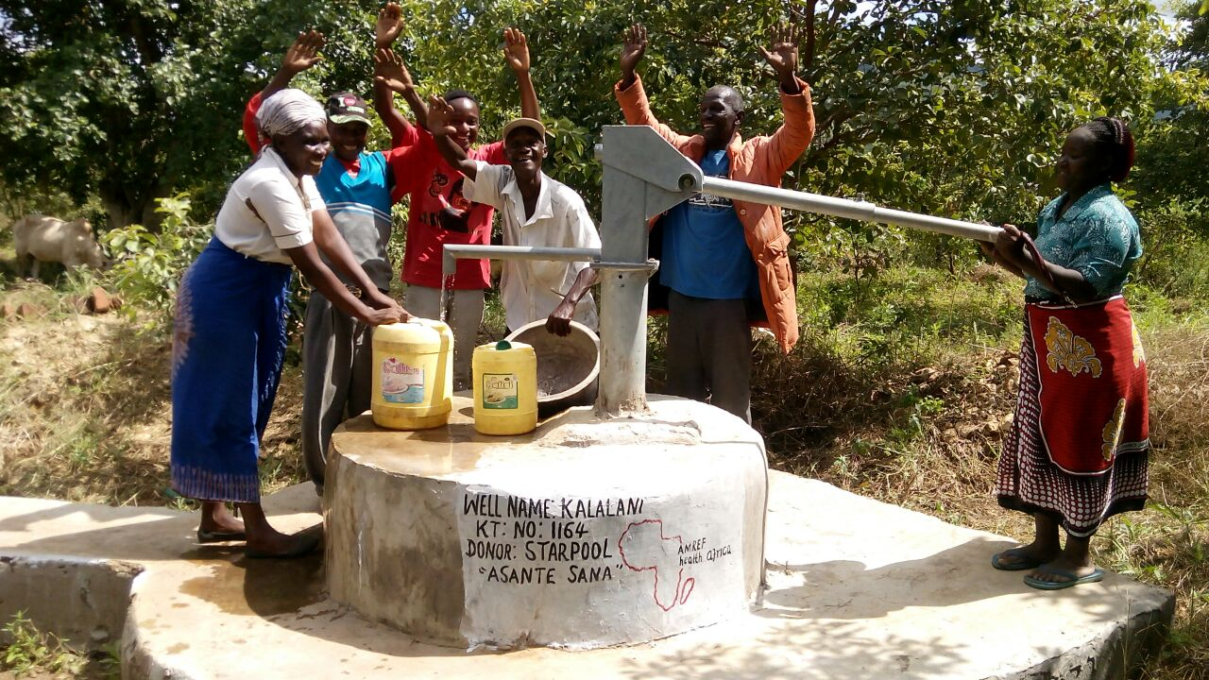
Center of Excellence for Environmental Protection
Skill to Fight against climate change: Peace keeping operations
Increase the aggressiveness of a lot of countries because of people necessity to survive.
Therefor trainings, courses and meetings, are useful to obtain theoretical and practical skills to fight against climate change and can be also considered very important for peace keeping operations.

Slide 15
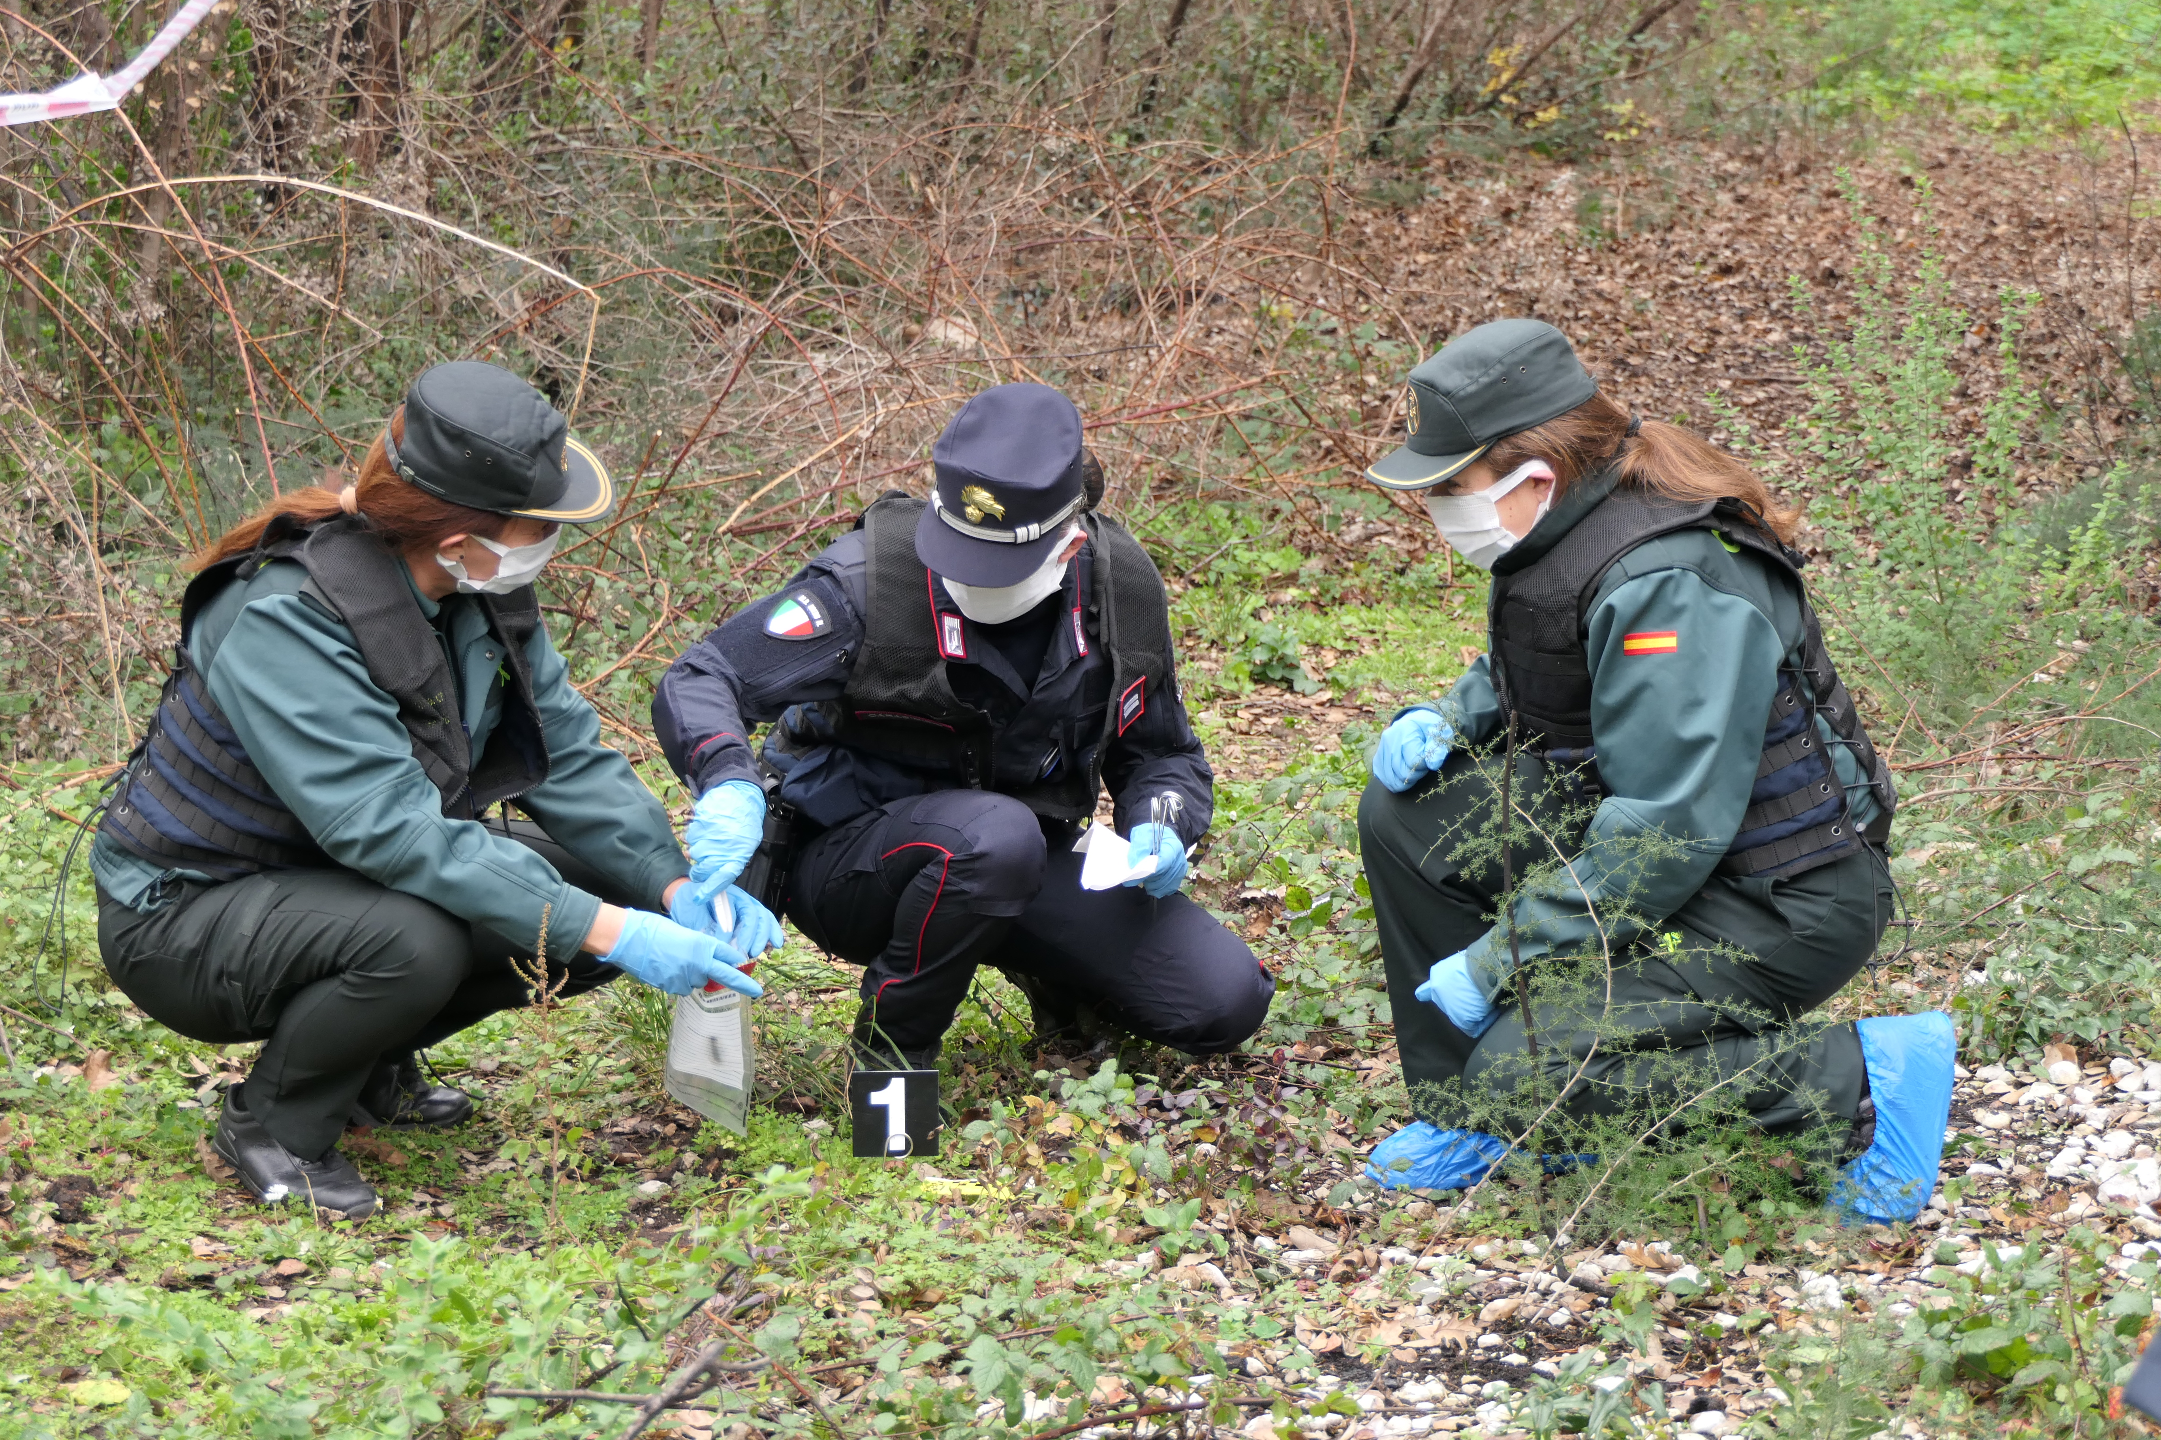
Center of Excellence for Environmental Protection
The CoEEP training
cv
14 training modules with a minimum duration of 5 days have been developed, creating an interdisciplinary thematic path that can be validated and shared in different international contexts.
The teaching will be carried out, in both English and French languages, by experts from the Forestry, Environmental and Food Organisation of the Carabinieri, Officials of the Ministries, as well as magistrates and professionals from the academic world and the private sector.
Notes:
These fourteen modules offer an overview of the Carabinieri’s expertise in the entire environmental sector (nature protection, management, prevention and the pursuit of environmental crimes).
In addition, the Center of Excellence remodels the courses, to adapt the subjects to the contest and to the needs of the trainees, in accordance with their Nations and Organisations.
For example, the Center is providing a course for Africa Nations that lasts three weeks, covering a range of environmental subjects, such as biodiversity protection, hydrogeological instability, wildlife protection forest fires and crime-scene investigation, naturalistic engineering and soil restoration, environmental education to promote awareness.
The training includes always open field training and activities, aimed by innovative technology (remotely piloted aircrafts, satellite systems and advanced photo interpretation software) and performed with the interactive digital Forest Fire Area Simulator, located in Castel Volturno Carabinieri Training Center.

Slide 16
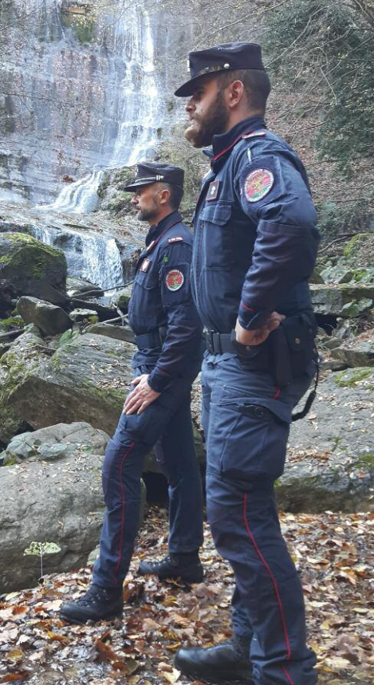
Center of Excellence for Environmental Protection
The CoEEP training
The Centre is able to deploy Mobile Training Teams (MTT), composed of instructors and experts, with three distinct functions:
providing pre-deployment training sessions in beneficiary countries (on request);
validating that trained units correctly form their units according to established standards;
ensuring that units continue to maintain their prerogatives.

Slide 17
Center of Excellence for Environmental Protection
The CoEEP training modules
1 | ENVIRONMENTAL PROTECTION AND CLIMATE CHANGE ASSESSMENT
2 | BEST PRACTICES FOR THE IMPLEMENTATION OF AN INTEGRATED PROJECT FOR THE ENVIRONMENTAL RESTORATION OF FIRE-AFFECTED AREAS
3 | PROTECTION, MANAGEMENT AND REHABILITATION OF PRIORITY HABITATS AT HIGH RISK OF DISAPPEARANCE
4 | NETWORK OF PROTECTED NATURAL AREAS, AS A SOURCE OF GOOD PRACTICES ON ENVIRONMENTAL CONSERVATION AND AS A STIMULUS TO INCREASE THE DIALOGUE WITH LOCAL COMMUNITIES FOR THE DEVELOPMENT OF ECONOMIC ENVIRONMENTALLY FRIENDLY ACTIVITIES
5 | SOIL LOSS AND NATURALISTIC ENGINEERING. INTERVENTIONS OF REGULATION, CONSOLIDATION, DEFENCE AND HABITAT RESTORATION
6 | PROTECTION AND CONSERVATION OF BIODIVERSITY: HERITAGE FOR LIFE, DEVELOPMENT AND HEALTH
7 | MONITORING IMPACT OF AIR POLLUTION ON TERRESTRIAL ECOSYSTEMS: THE CON.ECO.FOR. AND NEC NETWORKS
8 | THE NATIONAL INVENTORY OF FORESTS AND CARBON SINKS (INFC): THE ITALIAN EXPERIENCE OF PERIODIC CENSUS OF FOREST RESOURCES AND THE STOCK OF CO2 ABSORBED
9 | CLIMATE NEUTRALITY OF FIELD ACTIVITIES: STRATEGIES TO REDUCE CO2 EMISSIONS
10 | FOREST FIRES: TECHNIQUES OF SCIENTIFIC TECHNICAL COLLECTION ON STANDS TOPSOIL CROSSED BY FIRES FOR THE DETECTION OF THE CAUSES OF IGNITION – BASIC COURSE
11 | FOREST FIRES: TECHNIQUES OF SCIENTIFIC TECHNICAL COLLECTION ON STANDS TOPSOIL CROSSED BY FIRES FOR THE DETECTION OF THE CAUSES OF IGNITION –ADVANCED COURSE
12 | BEST PRACTICES TO COMBAT POLLUTION AND EVIRONMENTAL DISASTERS
13 | THE ENVIRONMENTAL POLICE WITH PARTICULAR REFERENCE TO THE ACTIVITIES ORGANISED FOR NATIONAL AND TRANSBOUNDARY ILLICIT WASTE TRAFFIC
14 | THE ENVIRONMENTAL POLICE WITH PARTICULAR REFERENCE TO THE SO CALLED CEMENT CYCLE

Slide 18
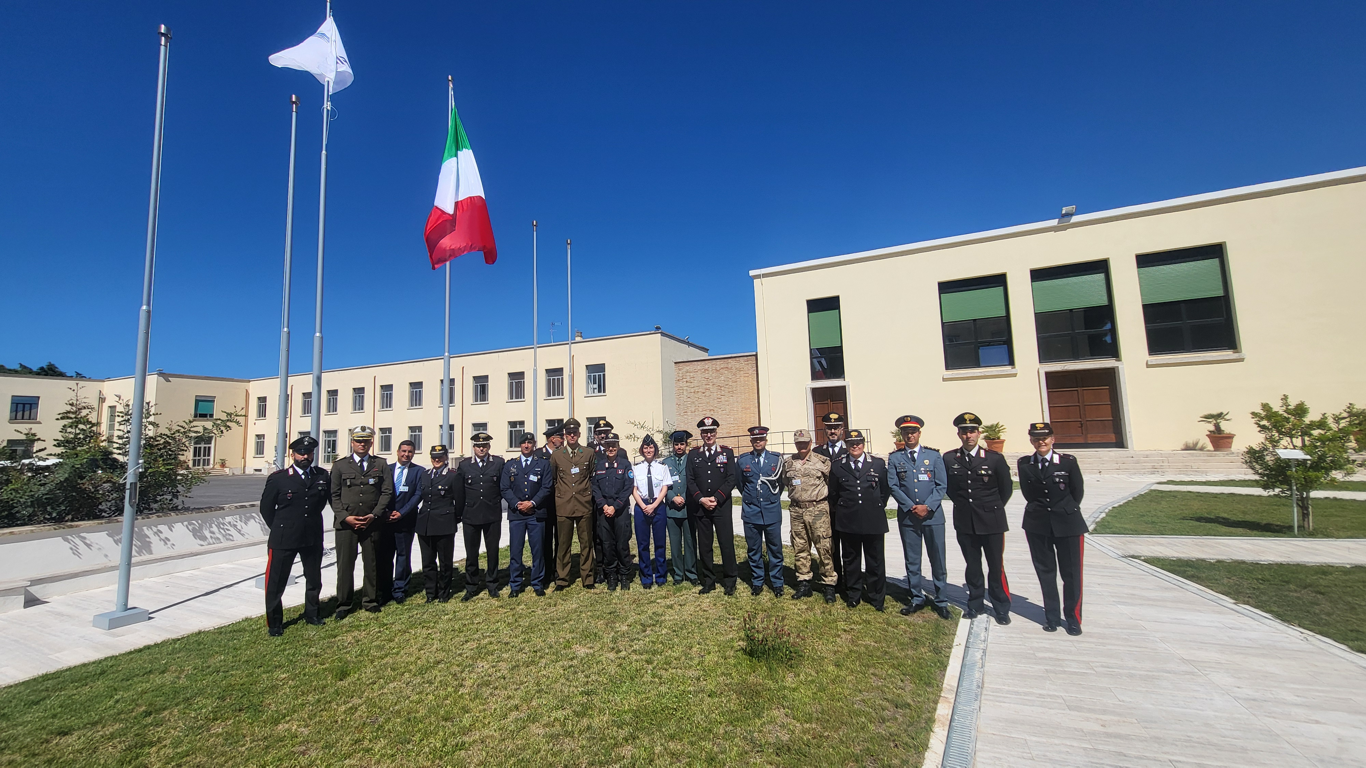
Center of Excellence for Environmental Protection
This is our Project
In our opinion, it will be useful to start new collaboration with more and more countries.
We have already started and held numerous courses on the subject of forest fires, waste trafficking and protection of biodiversity both for representatives of other European, South American, African countries.
For the next future we already have numerous training activities planned, as well as meeting, to agree on new training programs and start new and useful collaborations.

Slide 19
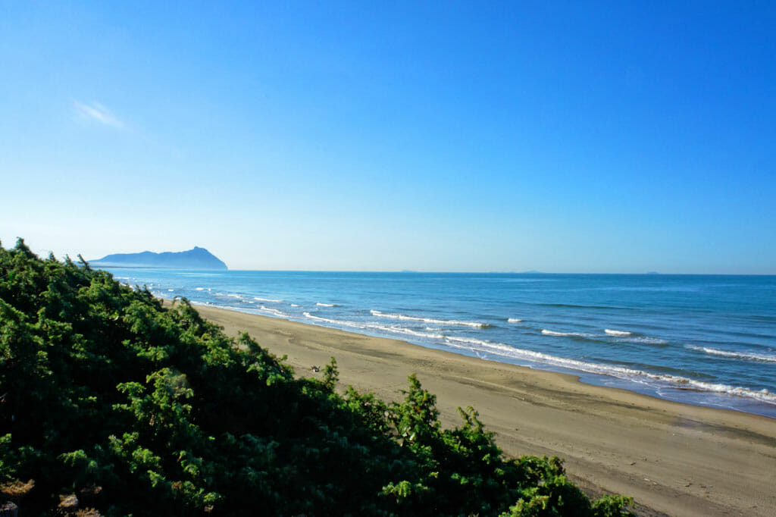
Center of Excellence for Environmental Protection
Thank you for your kind attention
Col Arrigo GAREFFI
International Institute for Stability Policing Studies
Director
CoESPU

