Slide 1



Addressing Mis/Disinformation in Peacekeeping Settings
Addressing MDMH* in Peacekeeping settings
By David Haeri
Director - Division of Policy, Evaluation, and Training (DPO)
November 2024
MDMH* = misinformation, disinformation, malinformation, hate speech.
UNITED NATIONS | Department of Peace Operations (DPO)
UNITED NATIONS | DPO
‹#›

Slide 2
Addressing Mis/Disinformation in Peacekeeping Settings
OUTLINE
1. TRENDS.
2. IMPACTS.
3. OUR APPROACH.
UNITED NATIONS | DPO

Slide 3
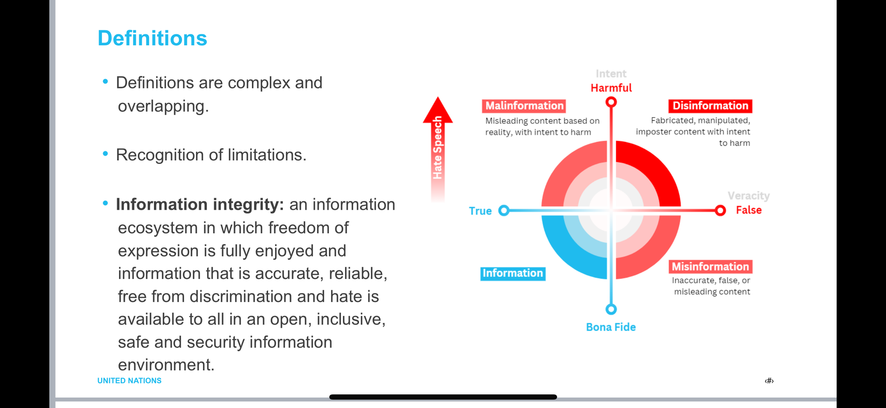
Addressing Mis/Disinformation in Peacekeeping Settings
What is MDMH?
UNITED NATIONS | DPO

Slide 4

Addressing Mis/Disinformation in Peacekeeping Settings
OUTLINE
1. TRENDS
UNITED NATIONS | DPO

Slide 5
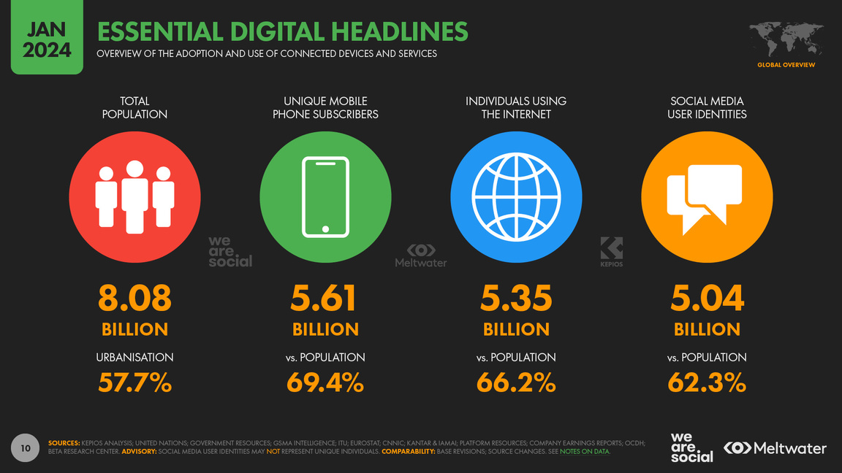
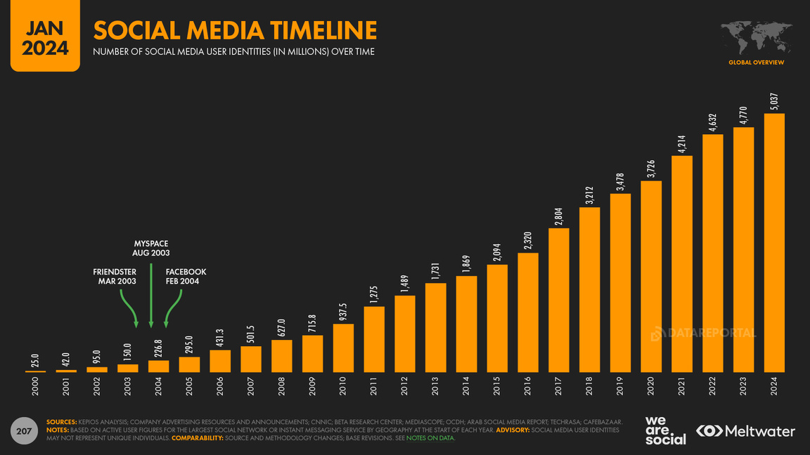
Addressing Mis/Disinformation in Peacekeeping Settings
TREND 1: A MORE “SOCIAL” WORLD
UNITED NATIONS | DPO

Slide 6
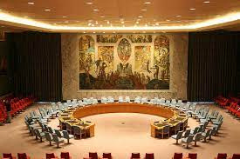
Addressing Mis/Disinformation in Peacekeeping Settings
TREND 2: SHIFTING GEOPOLITICAL LANDSCAPES
UNITED NATIONS | DPO

Slide 7
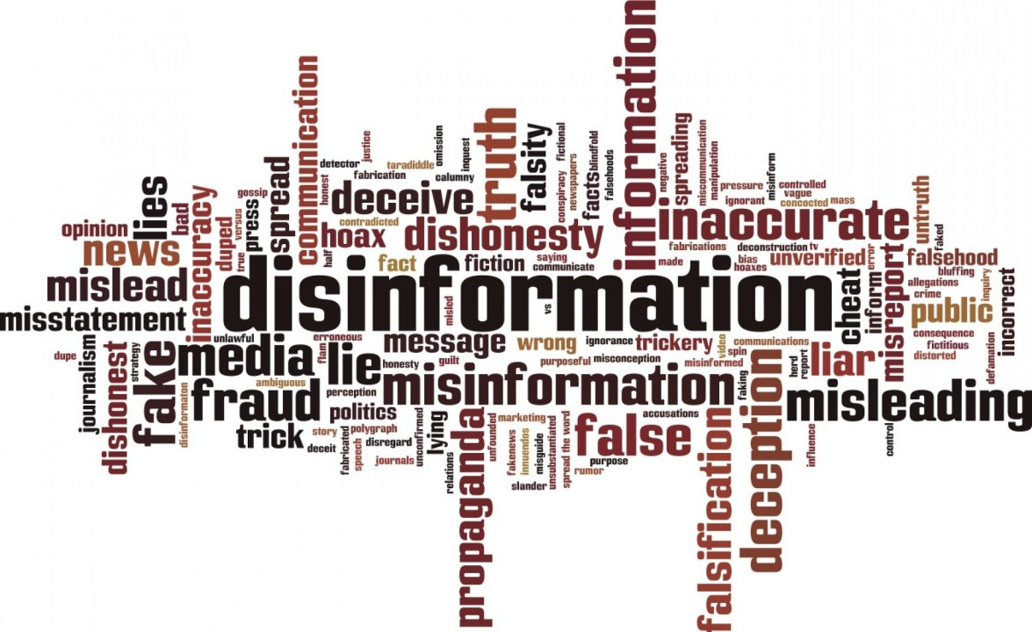
Addressing Mis/Disinformation in Peacekeeping Settings
TREND 3: CHALLENGES TO INFORMATION INTEGRITY
UNITED NATIONS | DPO

Slide 8

Addressing Mis/Disinformation in Peacekeeping Settings
OUTLINE
2. IMPACTS
UNITED NATIONS | DPO

Slide 9
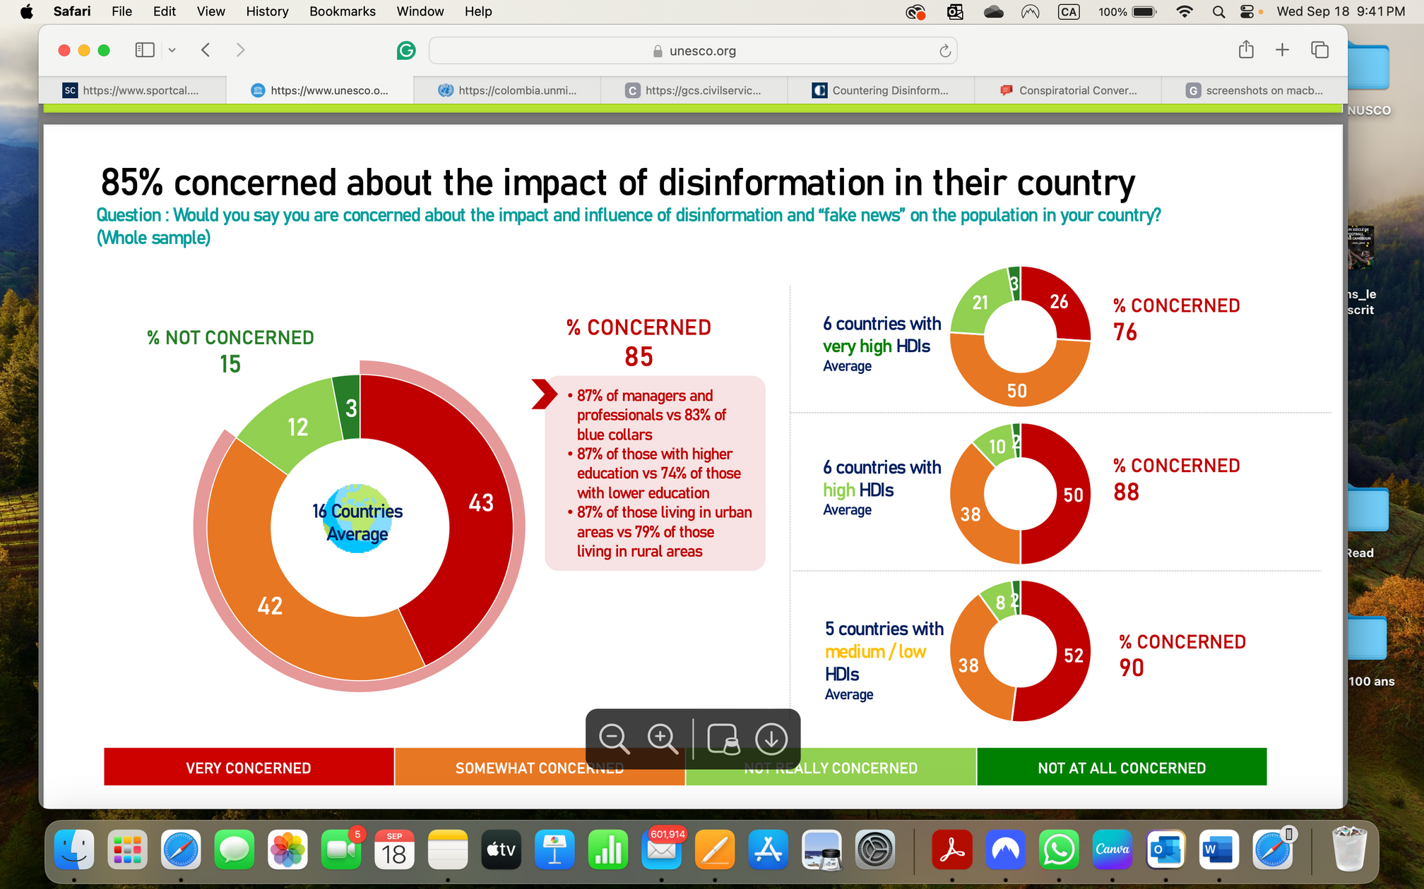
Addressing Mis/Disinformation in Peacekeeping Settings
UNITED NATIONS | DPO

Slide 10
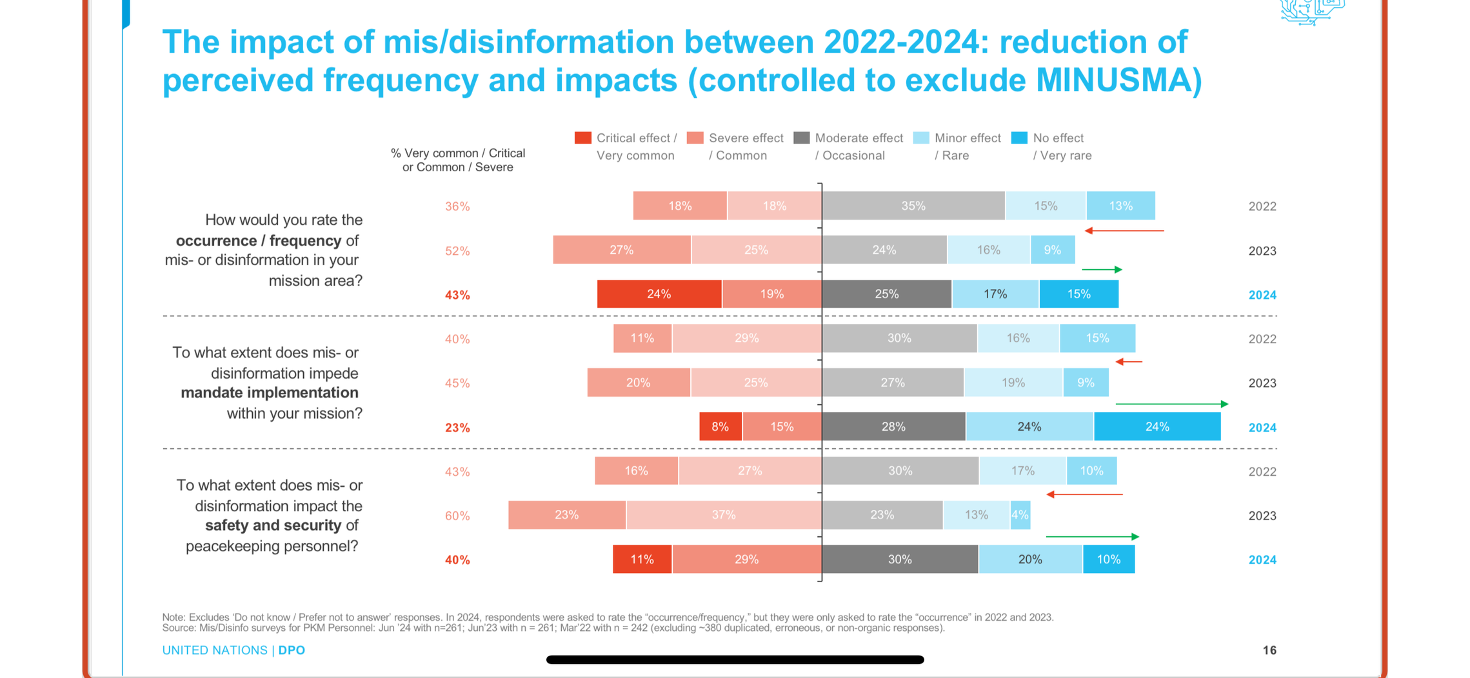
Addressing Mis/Disinformation in Peacekeeping Settings
The negative impact of MDMH persists...
From 2024 survey to missions’ personnel
UNITED NATIONS | DPO
‹#›

Slide 11
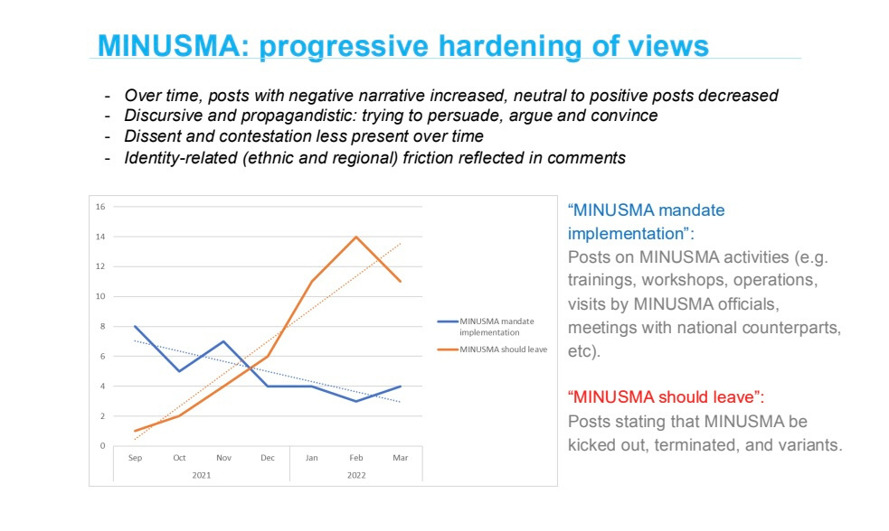
Addressing Mis/Disinformation in Peacekeeping Settings
UNITED NATIONS | DPO

Slide 12




Addressing Mis/Disinformation in Peacekeeping Settings
KEY NARRATIVES
UN peacekeepers
are
useless !!!
exploiters!
looters!
UN peacekeepers are
sex offenders !!
tourists!
UN peacekeepers support
armed groups, foreign interests
and perpetuate conflicts !!!
UNITED NATIONS | DPO

Slide 13



Addressing Mis/Disinformation in Peacekeeping Settings
Compromised
safety & security
Erosion of
trust
Challenges to
mandates
UNITED NATIONS | DPO

Slide 14

Addressing Mis/Disinformation in Peacekeeping Settings
OUTLINE
3. OUR APPROACH.
UNITED NATIONS | DPO

Slide 15






Addressing Mis/Disinformation in Peacekeeping Settings
One approach, three steps
Working groups; support...
Training: skills and tools.
Normative: Policy, guidelines....
UNITED NATIONS | DPO
‹#›
Notes:
18

Slide 16


Addressing Mis/Disinformation in Peacekeeping Settings
Step 1: Policy, guidelines and best practices
MULTIDISCIPLINARY
INTEGRATED
PROACTIVE
PEOPLE CENTERED
GENDER AND AGE SENSITIVE
NON-CLANDESTINE
RESPECT DATA PROTECTION AND PRIVACY
UNITED NATIONS | DPO
‹#›
Notes:
18

Slide 17


Addressing Mis/Disinformation in Peacekeeping Settings
Step 2: Training
Training modules, part of the RTP package.
Includes specialized modules ranging from OSINT techniques to data analysi
UNITED NATIONS | DPO
‹#›
Notes:
18

Slide 18


Addressing Mis/Disinformation in Peacekeeping Settings
Step 3: Working groups on MDMH and hands-on support
Led by a focal point
Multidisciplinary
Central hub for the MDMH cycle
UNITED NATIONS | DPO
‹#›
Notes:
18

Slide 19
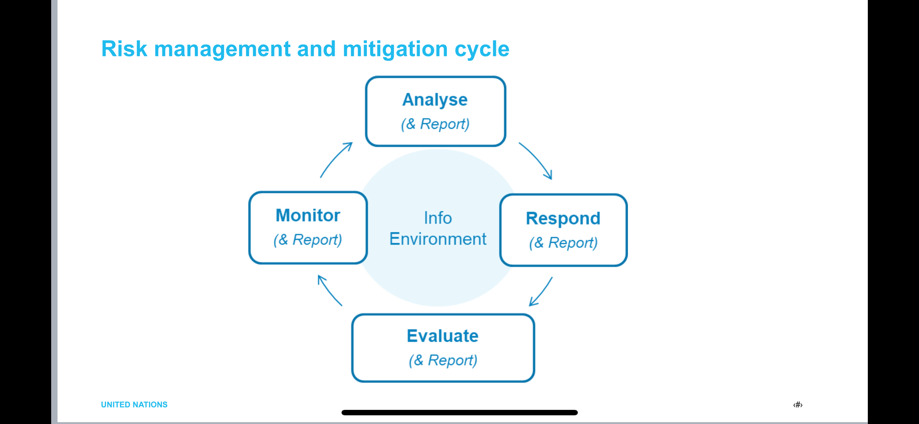
Addressing Mis/Disinformation in Peacekeeping Settings
The MDMH Cycle (in missions)
For Prevention, Risk Mitigation and Management
UNITED NATIONS | DPO
Notes:
2

Slide 20
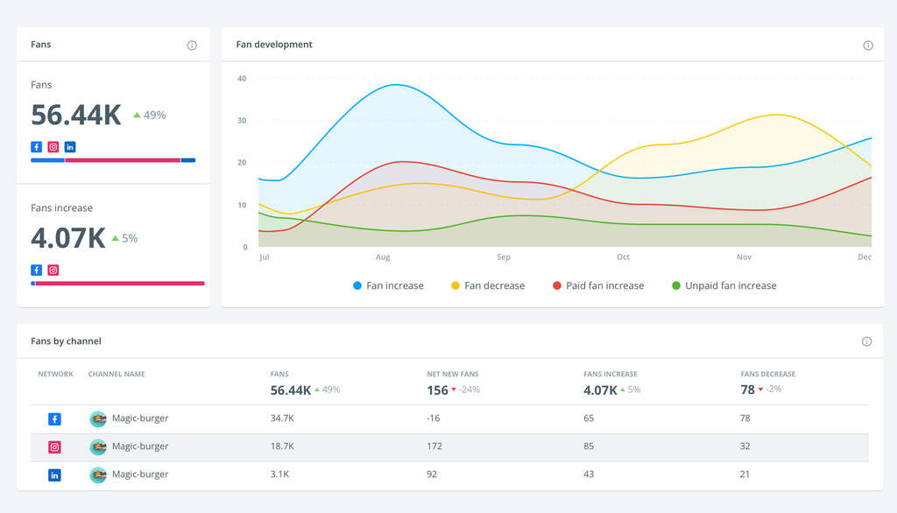
Addressing Mis/Disinformation in Peacekeeping Settings
The MDMH Cycle in action: MONUSCO
ONLINE
OFFLINE
Use social/media monitoring & listening tool to track conversations
Gather information on rumors and suspicious narratives to identify patterns, sources, comparison points with online narratives, and potential impact...
Use data analysis & insights to process vast amounts of social data, identify key influencers, understand audience demographics, and track campaign performance.
UNITED NATIONS | DPO
‹#›
Notes:
18

Slide 21
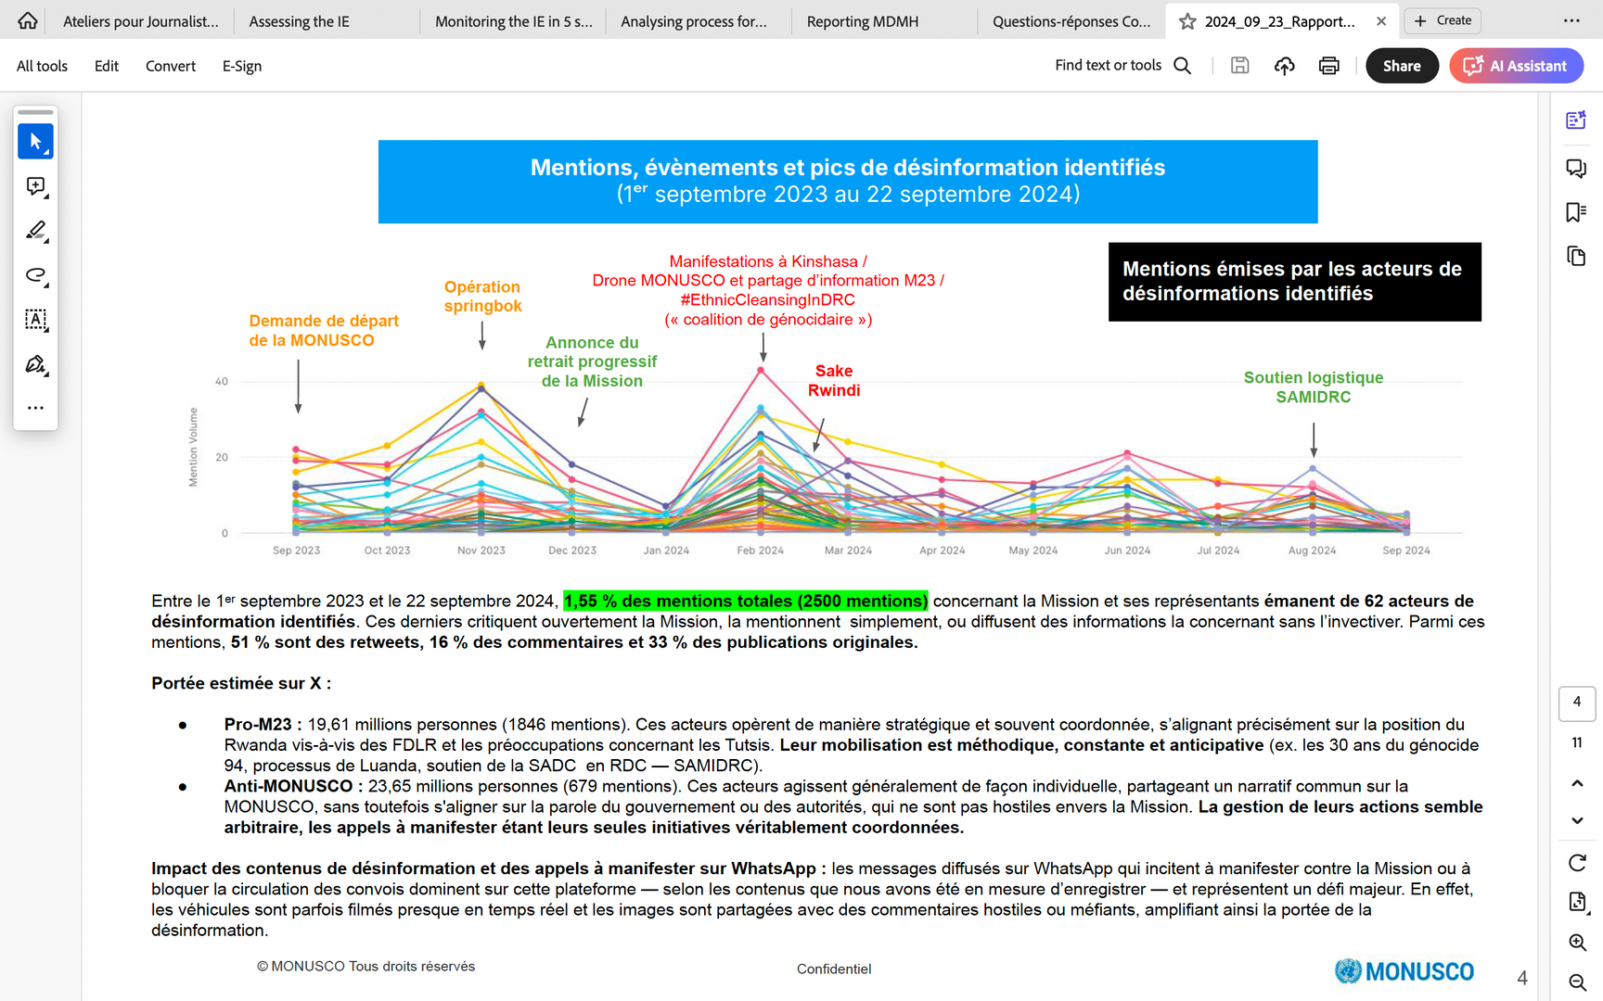
Addressing Mis/Disinformation in Peacekeeping Settings
Illustration of the MDMH Cycle: MONUSCO (2)
UNITED NATIONS | DPO
‹#›
Notes:
18

Slide 22



Addressing Mis/Disinformation in Peacekeeping Settings
Thank you.
UNITED NATIONS | Department of Peace Operations (DPO)
UNITED NATIONS | DPO
‹#›

