Slide 1
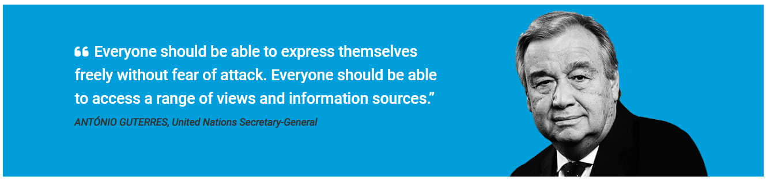
BUILDING TRUST AND RESILIENCE IN THE DIGITAL INFORMATION AGE

Slide 2
UNDERSTANADING INFORMATION INTEGRITY
Ensuring accuracy, reliability, and trustworthiness in information​
Supports informed decisions and social cohesion

Slide 3
CHALLENGES OF MISINFORMATION & DISINFORMATION
Social Media's Role
Amplifies both true and false news rapidly
Fake News Impact
Weakens public trust in institutions and media
Case Example
False COVID-19 info spread panic globally

Slide 4

SIGNIFICANCE OF MEDIA LITERACY IN COMBATING MISINFORMATION
Media Literacy Methods CRAAP, RADAR, and SIFT used to identify reliable sources
Purpose
Equips individuals with tools to discern real from fake news
Essential Skill
Strengthens societal resilience against misinformation

Slide 5
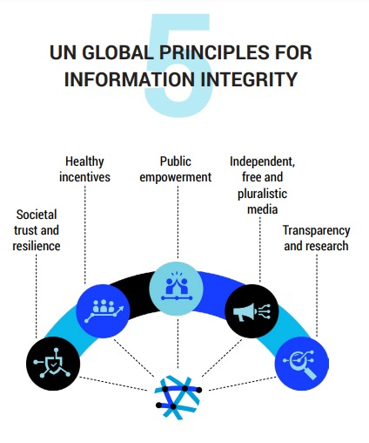
UN PRINCIPLES FOR INFORMATION INTEGRITY
Transparency and Accountability
Independent and Pluralistic Media
Public Empowerment through Media Literacy

Slide 6
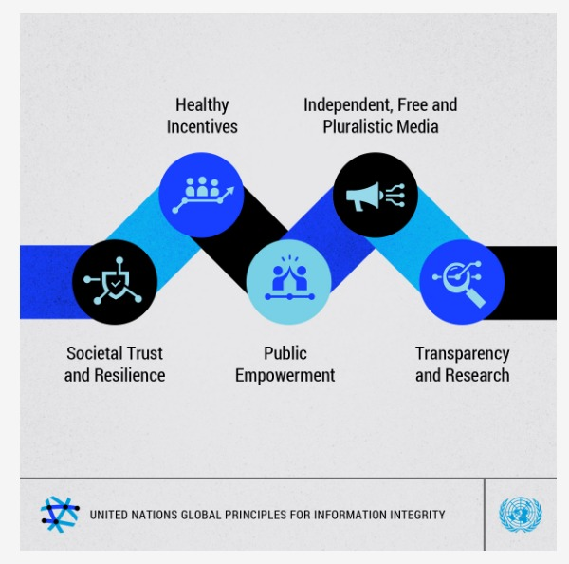
UN PRINCIPLES FOR INFORMATION INTEGRITY

Slide 7

THE ROLE OF MEDIA IN SOCIETY
Media Responsibility: Inform public, hold power accountable
Independent Media: Crucial for democracy, unbiased information

Slide 8

EMPOWERING THE PUBLIC
Educational Initiatives: Workshops and digital literacy programs
Critical Evaluation Skills: Helps individuals discern credible sources

Slide 9

SUPPORT FOR INDEPENDENT MEDIA
Challenges
Financial pressures, political interference, journalist safety
Support Mechanism
Legal protections, financial support, safety measures

Slide 10

TECHNOLOGY, AI, AND INFORMATION INTEGRITY
Dual Role of AI: Facilitates information but can amplify falsehoods
Ethical Standards: Need for algorithm transparency and accountability
Collaborative Efforts: Among tech firms, civil society, and governments

Slide 11
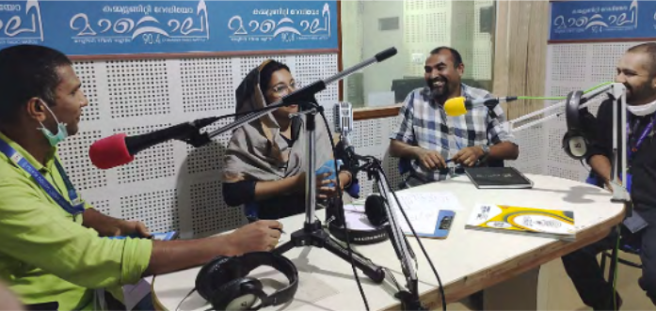
CASE STUDIES AND BEST PRACTICES (COMMUNITY RADIO IN RWANDA)
Community-driven media fostering unity
Outcome:
Reduced hate speech, strengthened social cohesion

Slide 12

CALL TO ACTION
Commitment Needed: From governments, civil society, media for trustworthy information
Public Involvement: Support media literacy and independent media initiatives
Final Note: Collaborative effort is key to a resilient, well-informed society

Slide 13

CONCLUSION
The principles include recommendations for key stakeholders, such as:
Governments to provide timely access to information and protect journalists, researchers, and civil society
Tech companies to ensure safety and privacy by design, and to apply policies consistently across countries and languages
AI actors to design, deploy, and use AI applications safely, securely, responsibly, and ethically

