Slide 1
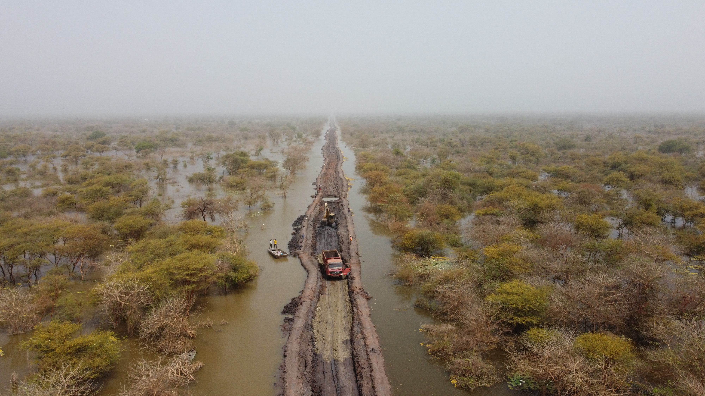

A UN Mission Approach in Preparation, Preventing and Acting on Environment and Climate Change Challenges
Ratia Tekenet
Climate, Peace, and Security Expert
UN Mission in South Sudan (UNMISS)
November 2024

Slide 2
Outline
Context and Climate Change in South Sudan
Future Climate Projections
Consequences of Climate disruption
Climate, Peace, and Security in the UNMISS Mandate
Operationalization of the Mandate

Slide 3
1. Context and Climate Change in South Sudan
Notes:
Over 70% of natural disasters in South Sudan have been attributed to climate related events which cause challenges for agriculture and food security because the country has a variety of livelihood systems including pastoral, agro-pastoral and pure farming societies.

Slide 4
Context
High vulnerability to climate impacts in South Sudan following the predominance of in climate sensitive livelihoods sectors, highly exposed on the landscape.
The climate niche supporting humanity and current production systems of crops and livestock is shrinking and projected to shift even more over the next 50 years under business-as-usual (Xu et. al.2020)
The is tendency to escape the disruption of climate impacts in the form of migration unless measures for adaptation are in put in place.
The most affected regions are among the poorest in where adaptive capacity is low.
Enhancing human development in those areas should be a priority alongside climate mitigation.

Slide 5

How the climate has changed in South Sudan
Average temperatures have increased by approximately 1-1.5°C
Large inter-annual variability in rainfall with over +/- 50% shift from the total rainfall in a year
Erratic rainfall patterns with unpredictable onset and end of the rainy season
Drought is more frequent and widespread
USAID 2019. South Sudan Climate Vulnerability Profile: Sector-and Location-specific Climate Risks and Resilience Recommendation.
Notes:
Current change in climate of South Sudan shows that average temperatures have increased by approximately 1 -1.5C. There are large inter-annual variability in rainfall that goes up to 50% shift from the total rainfall in a year. Similarly, there are erratic rainfall patterns with unpredictable onset and end of the rainy season. Drought is also more frequent and widespread.

Slide 6
2. Future climate projections
- more severe and recurrent local impacts likely to trigger more conflicts and displacements
Notes:
It is important therefore to start looking diligently on the climate and security risks that surround UNMISS peace operations.

Slide 7
3. Consequences of climate disruptions

Slide 8
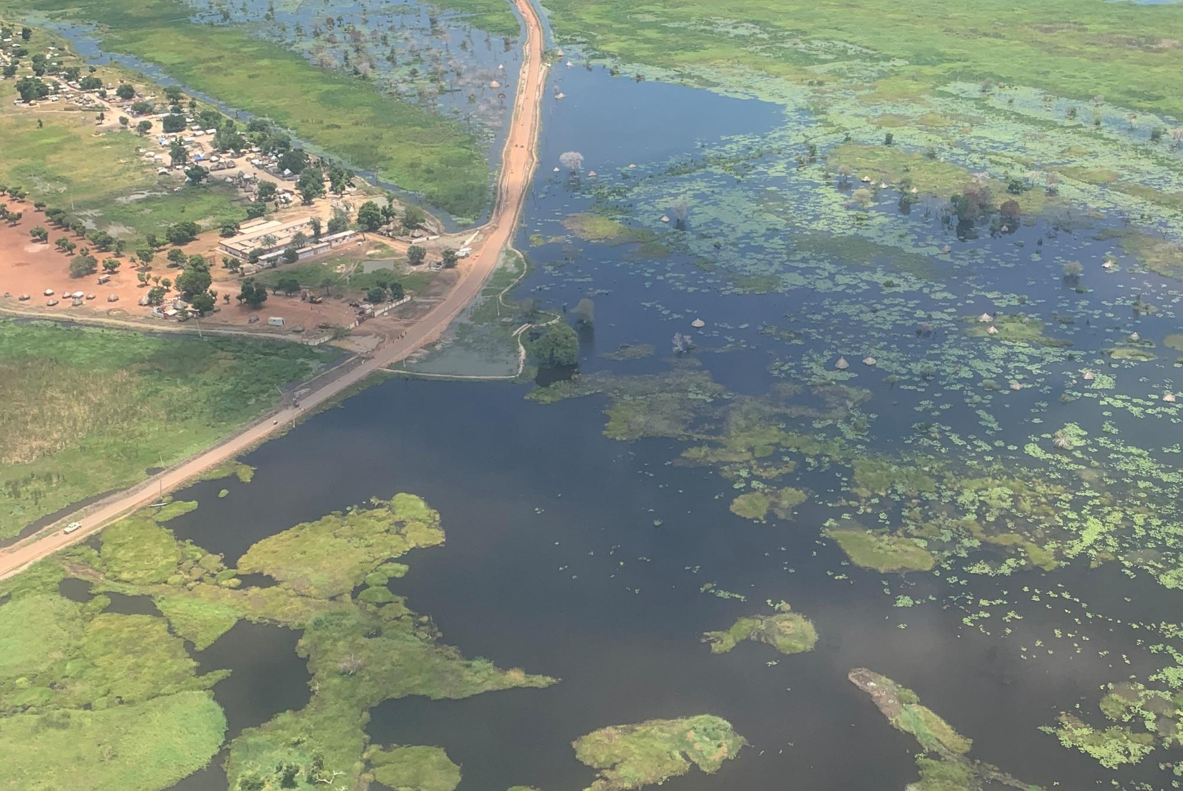
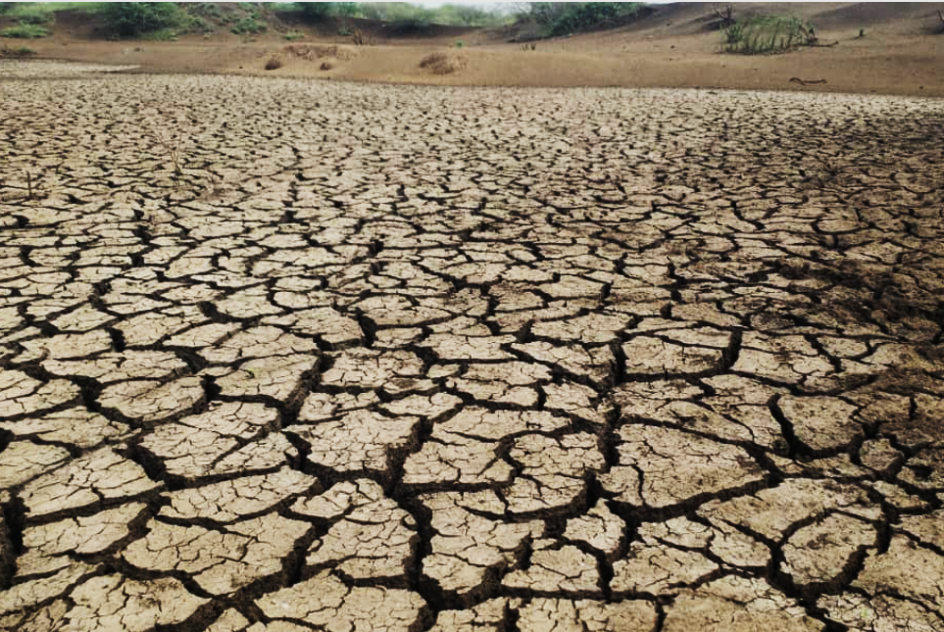
Contrasting Hydrological expressions concurrently
FLOOD
DROUGHT
Notes:
South Sudan is microcosm to look at the direct impacts of climate change simultaneously – How it stretches human and productive systems to the brim

Slide 9
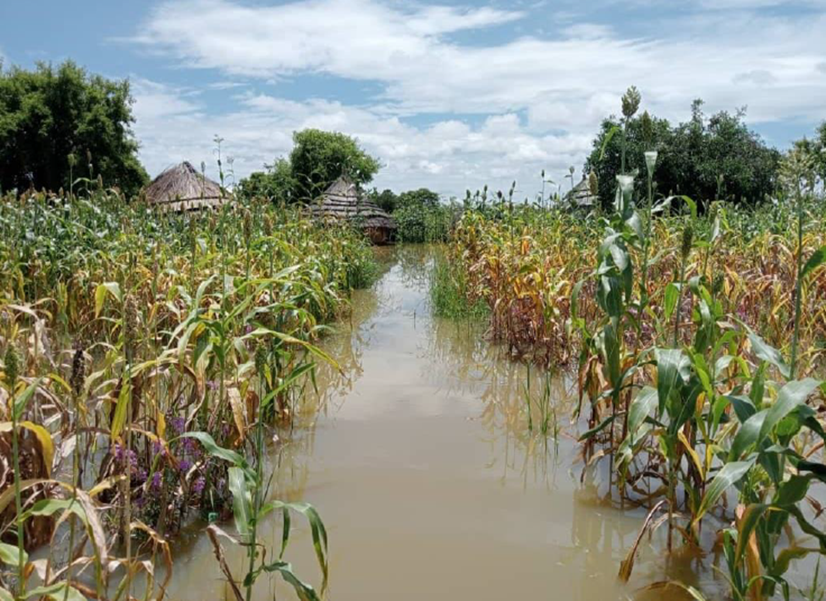
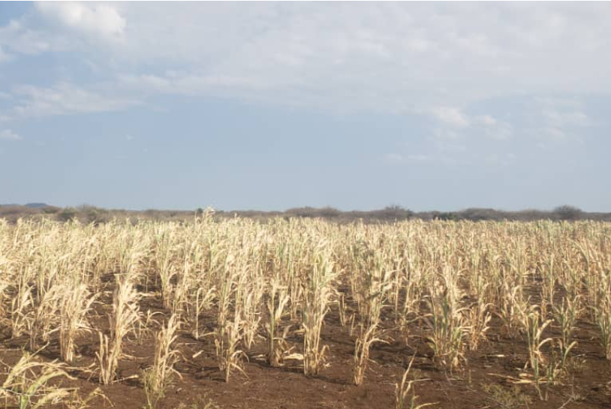
Implications on food systems
TOTAL CROP FAILURE IN BOTH CASES

Slide 10
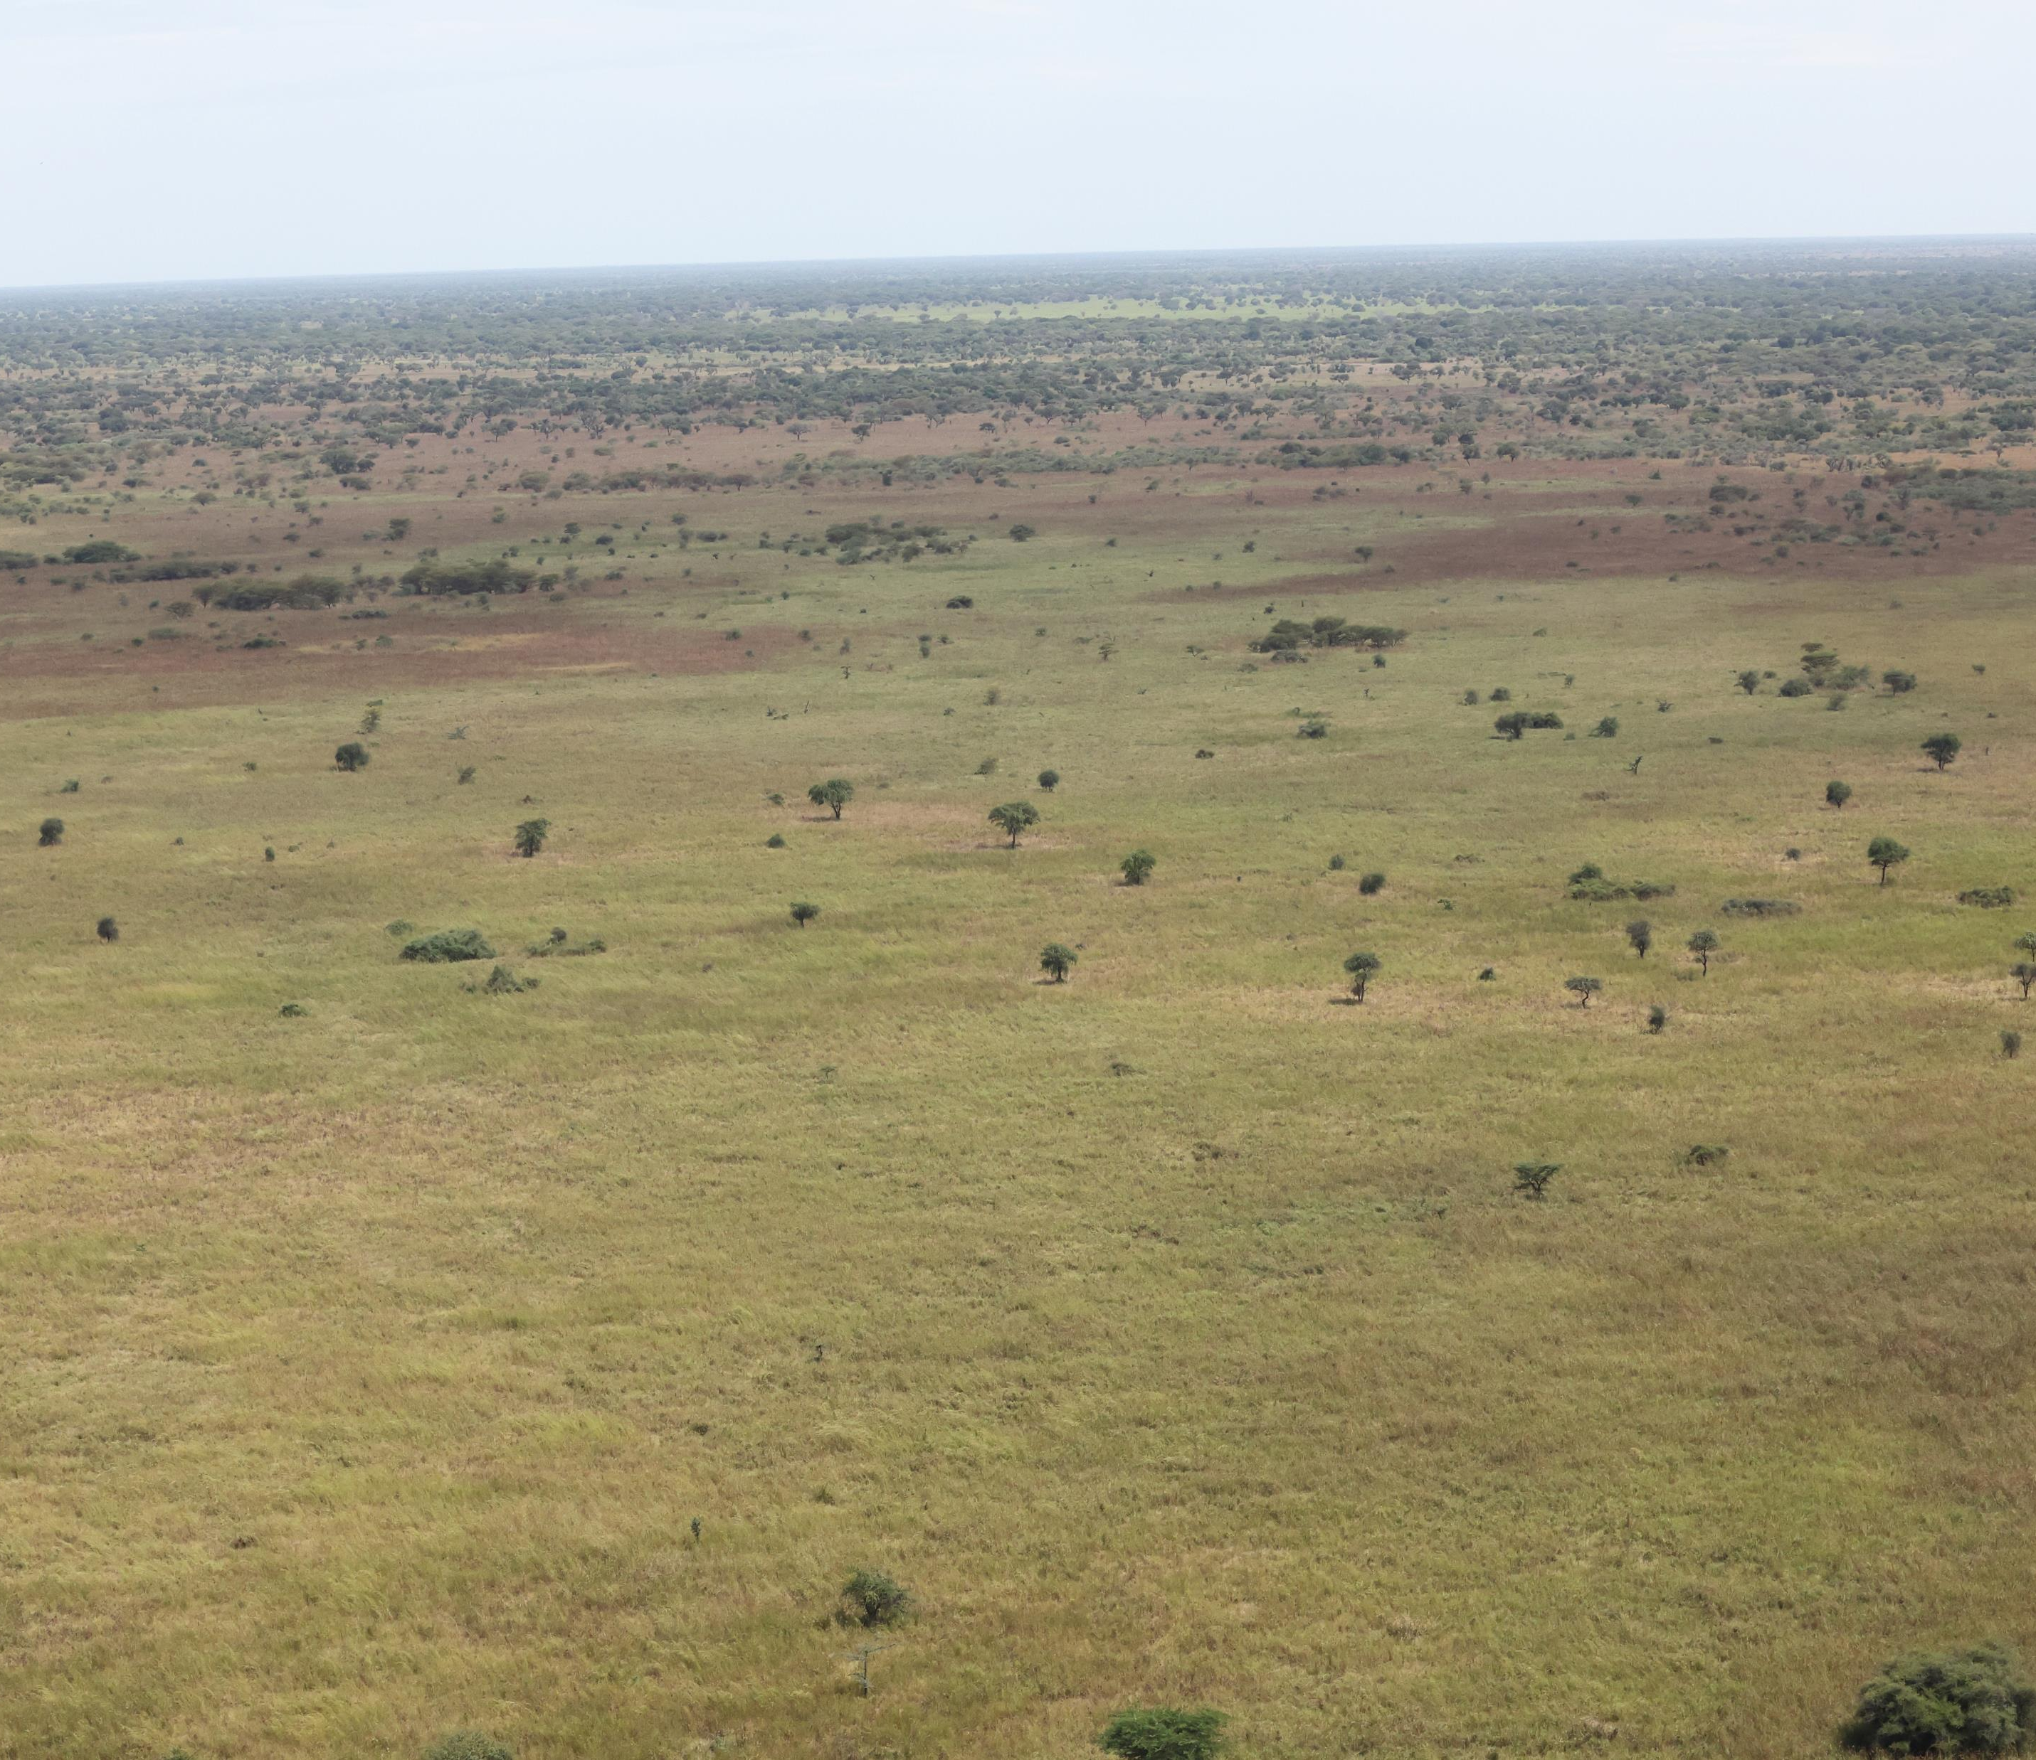
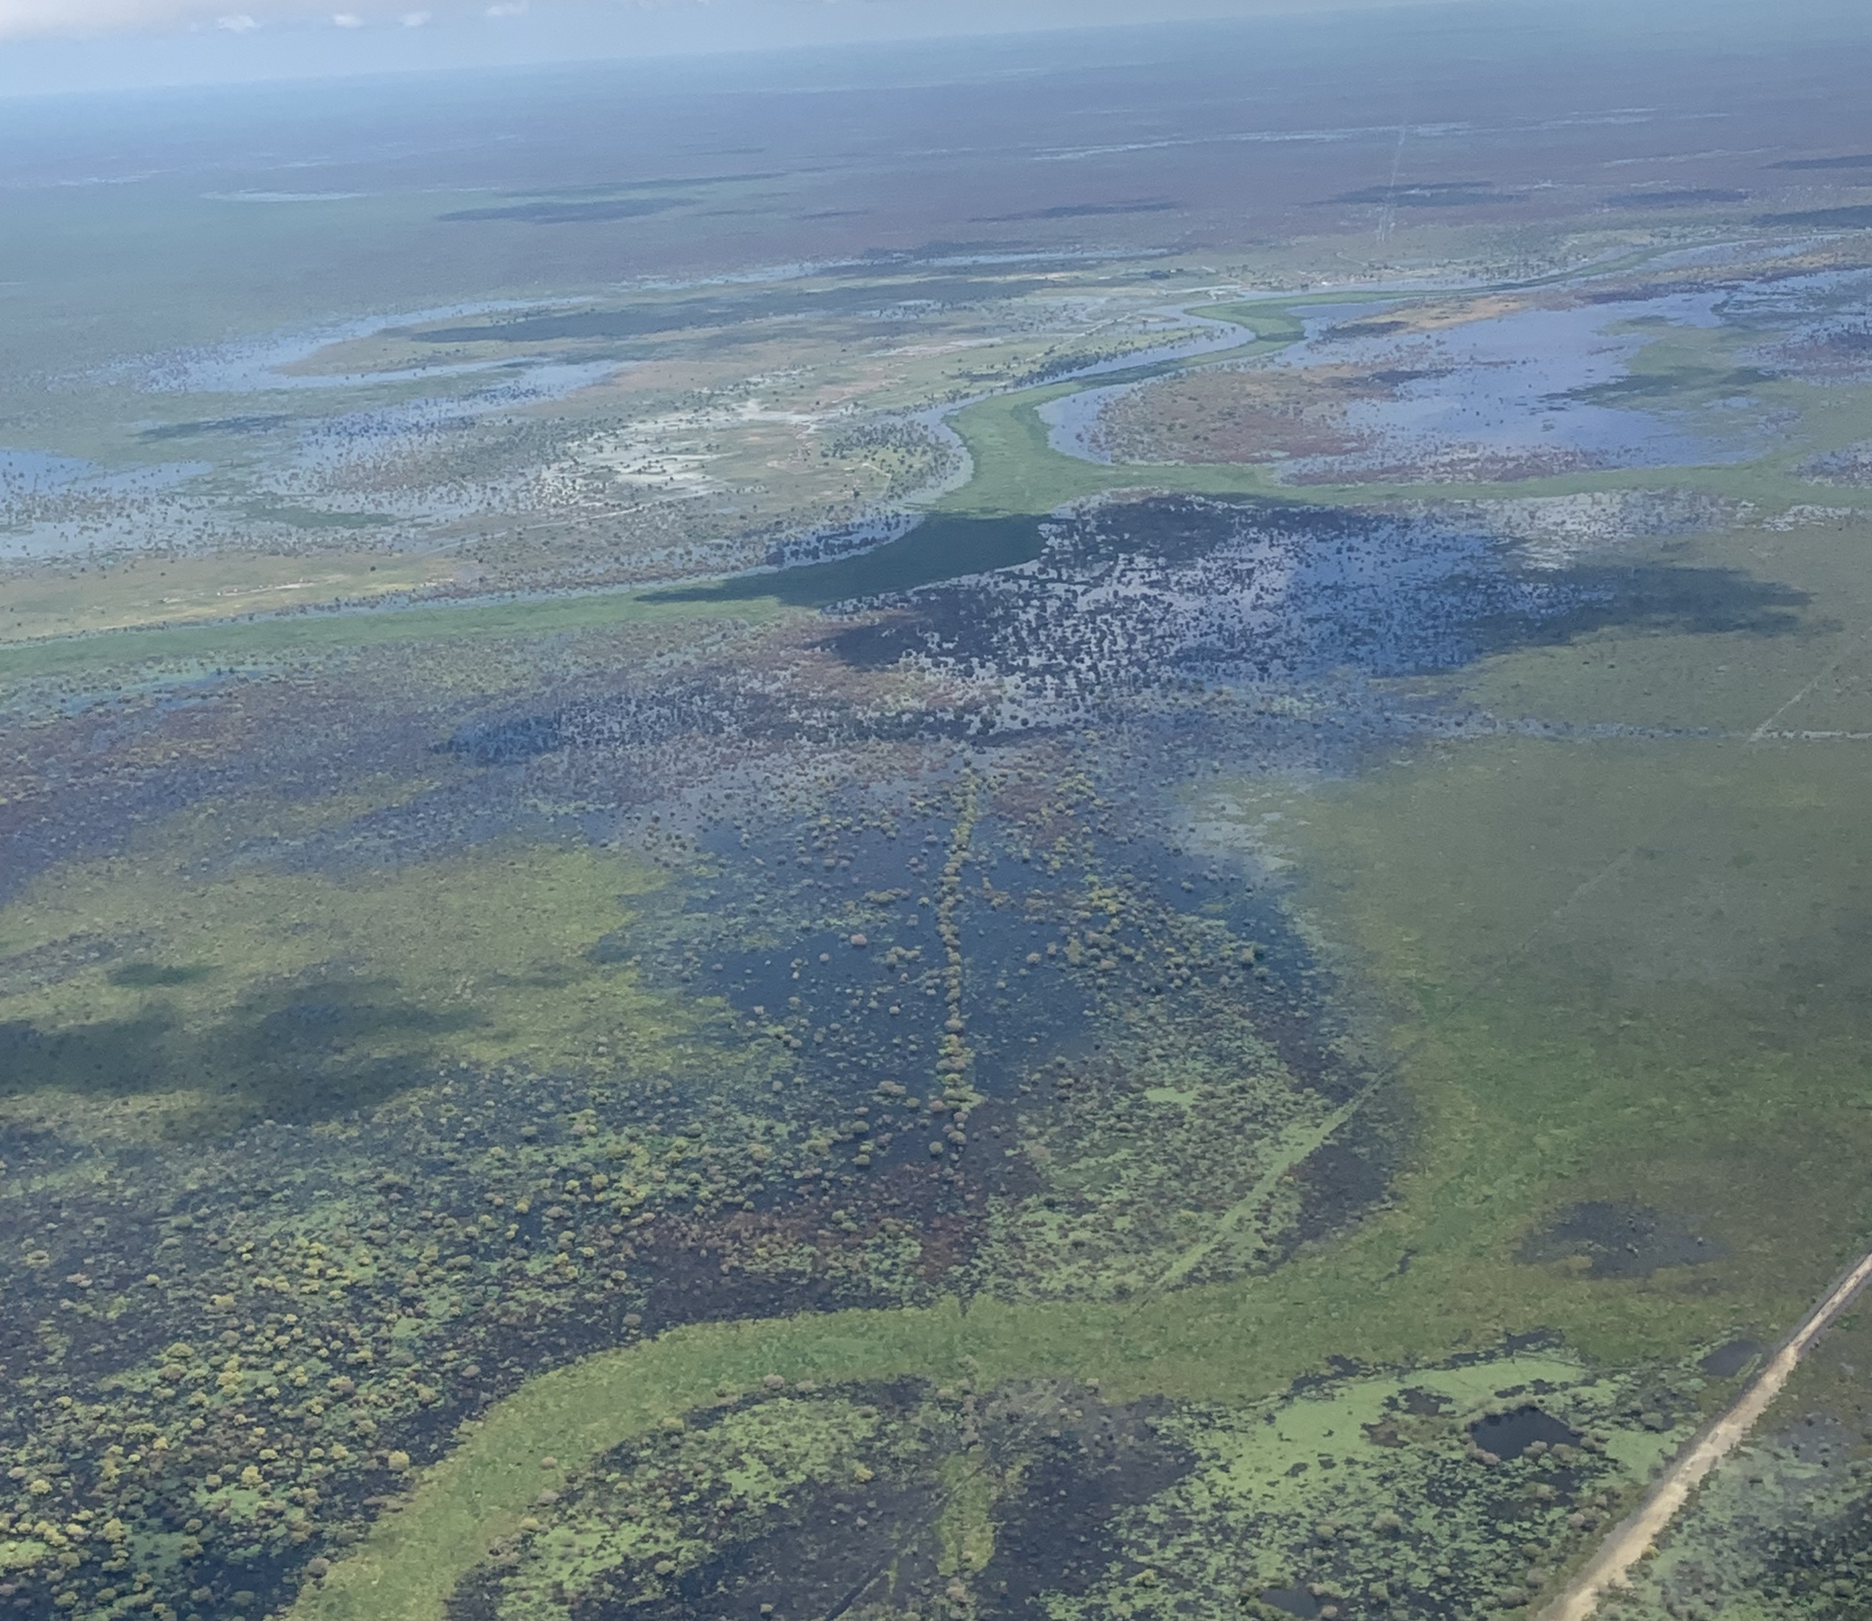
Natural Ecosystems are also affected

Slide 11
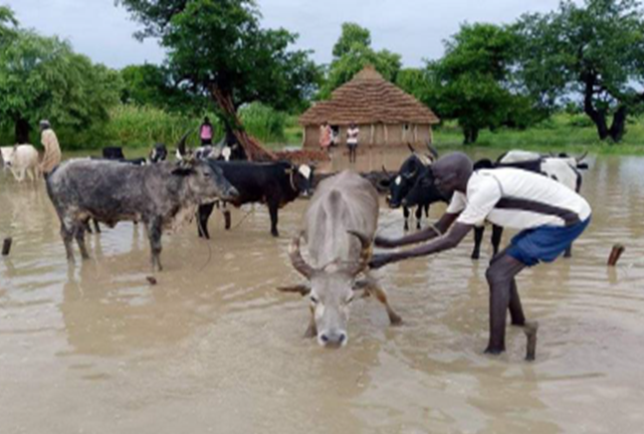
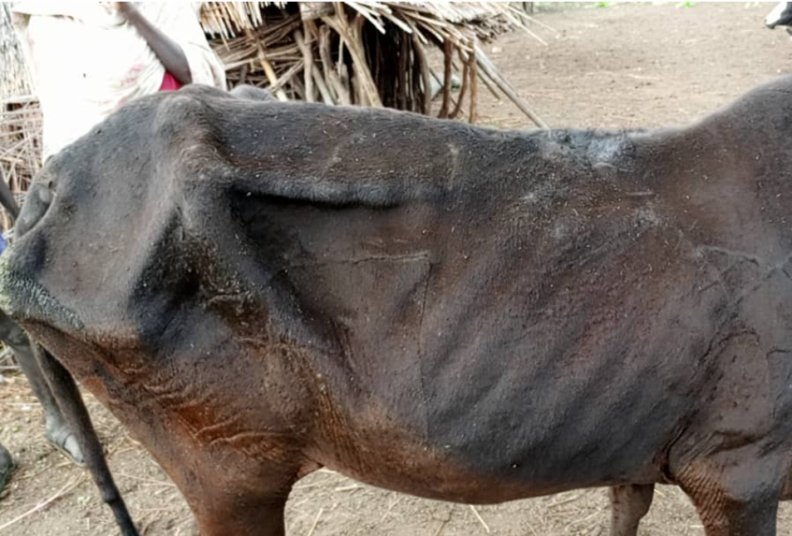
Cattle Migration – Last Option
It might be too late to move – the dichotomy between slow and sudden onset events
Notes:
Consequences of Slow-onset events like drought, and Sudden on-set events like flood. It might be too late to move

Slide 12
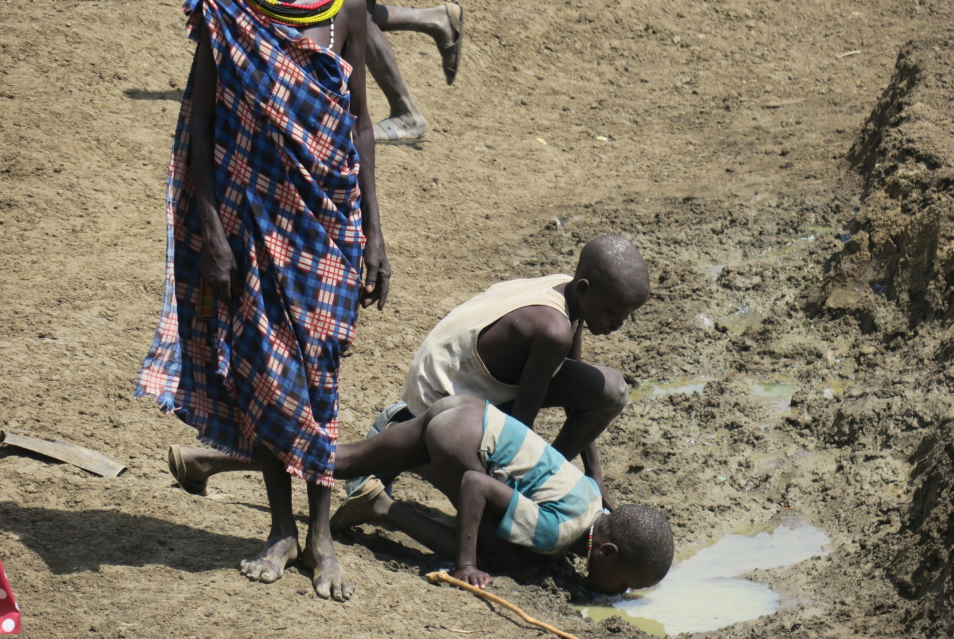
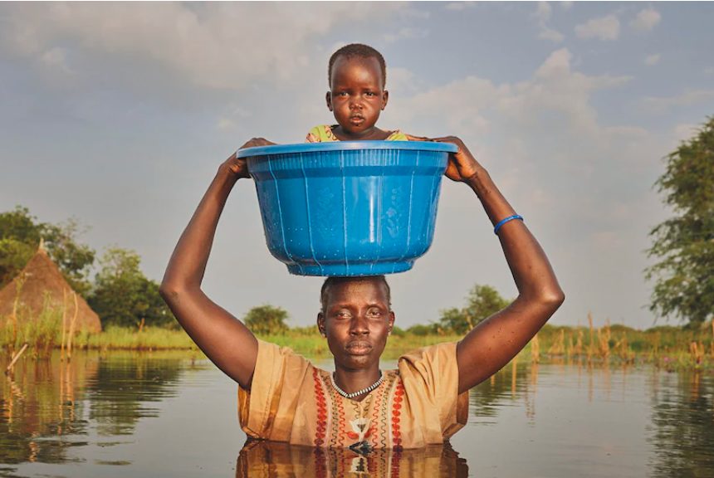
The human face of the crises in the same country
Notes:
This picture from South Sudan that appeared in the Telegraph on 31 January 2023, tells the story of survival and endurance to the flooding in South Sudan. This mother left everything behind desperately trying to safe her baby from the flood.

Slide 13
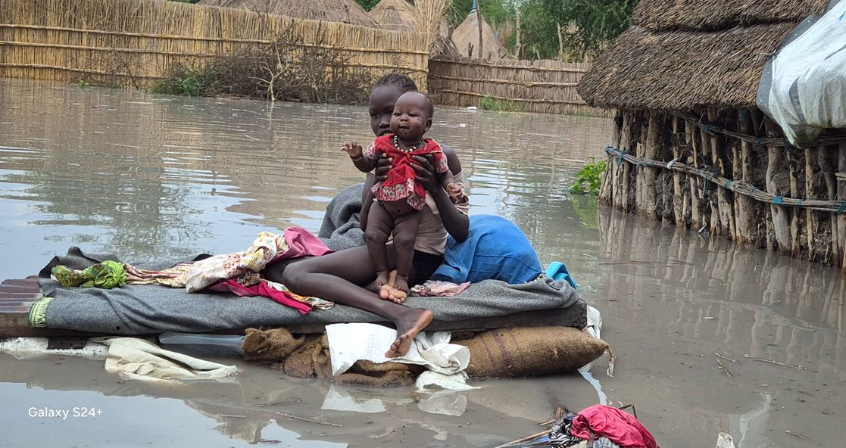
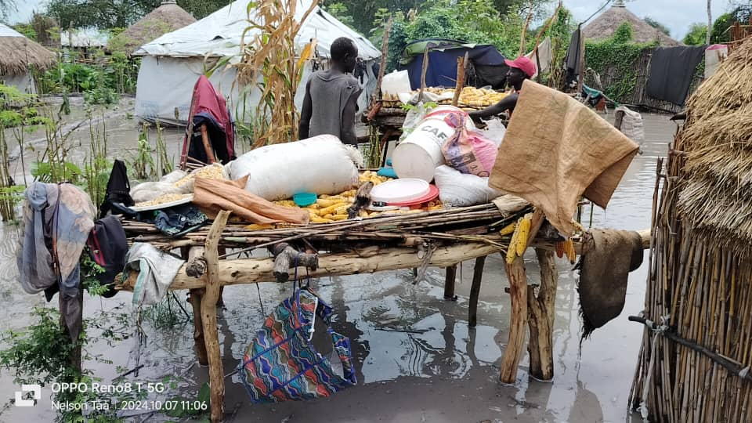
Desperate situation for women and children
Families affected by floods in Canal/Pigi County, Jonglei State State. Photo: County Authorities
Flood-displaced children in Chotbora boma, Fangak County in Jonglei State. Photo: ACF South Sudan

Slide 14
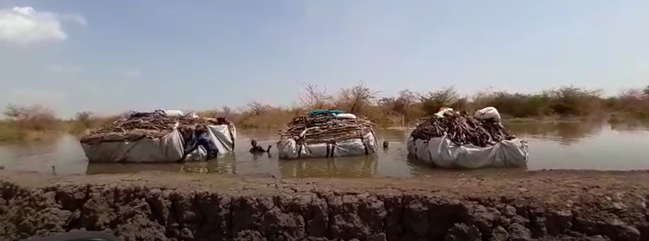
What it takes for women to collect fuelwood for cooking
~99% of the population of depends on forests as their source of energy (South Sudan: 2018)

Slide 15
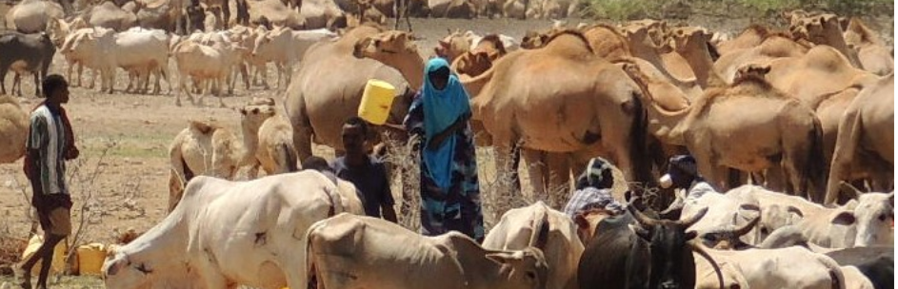
A woman competing with livestock for the same water point as the watershed shrinks under drought
Notes:
We know who prevails in such a competition

Slide 16
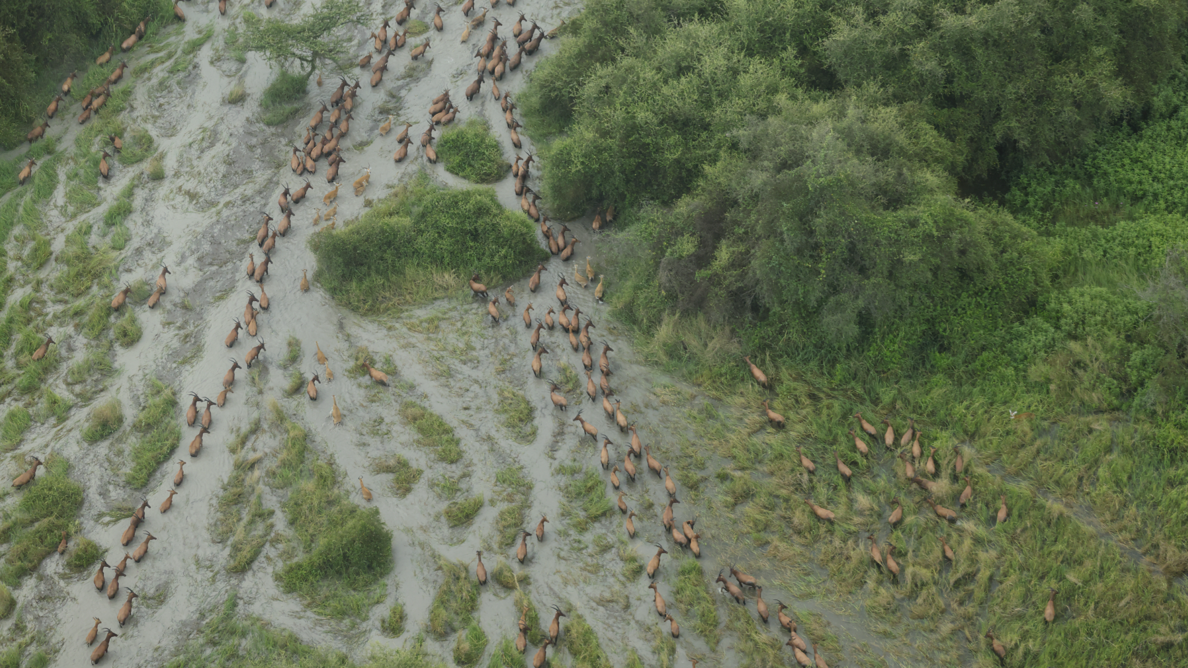
Wildlife also migrates under climate hazards - Preserve wildlife corridors & habitats
Migration is indispensable for adaptation
Notes:
Wildlife are crucial in boosting the local economy through tourism etc.

Slide 17
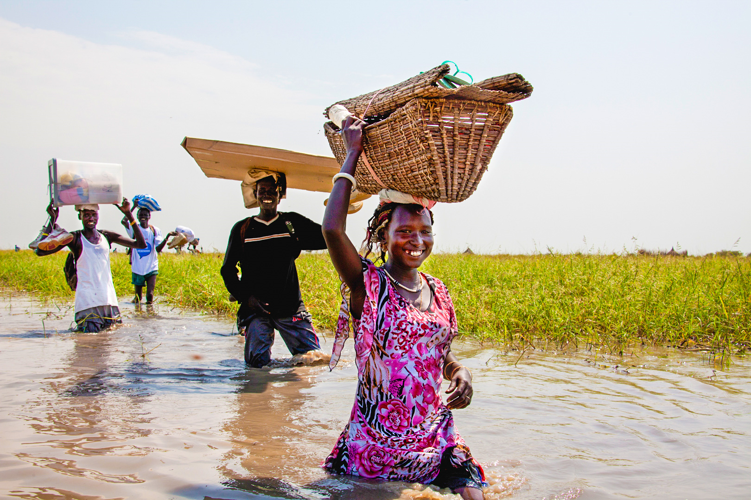
Forced Migration
83% affected by climate disaster in 2022, 63% by flooding, and 20% by drought;
85% received humanitarian support from the UN (UN Women CGEP 2022)
2 million people internally displaced in 2021, 55% were women (OCHA 2021)
Notes:
Presently, 1,200,000 have been impacted by the flood, and 300,000 people displaced.

Slide 18
4. Climate, Peace, and Security in the UNMISS Mandate

Slide 19
Climate, peace and security in the UNMISS Mandate
Renewed for one year, adopting Resolution 2729 (2024) until 30 April 2025
Preamble: “recognizing the adverse effects of climate change, ecological changes, land degradation, food insecurity, and natural disasters, among other factors, on humanitarian and stability in South Sudan”.
Mandate: 3(v)(b)(i) among others …“providing gender-sensitive risks assessments on the adverse effects of climate change”
Reporting: Requests the Secretary-General to report to the Security Council on implementation of the UNMISS mandate and the obstructions UNMISS encounters in doing so in a comprehensive written report to be submitted within 90 days…
Includes:
    “Analysis of risks associated with climate change that may adversely impact peace and security in South Sudan, and implementation of the UNMISS mandate”

Slide 20
UN Mission in South Sudan (UNMISS)
Largest UN Peace Operation with some 18,000 total deployed personnel (about 13,500 troops and military personnel; 1,500 police personnel; 2,500 civilian personnel)
Established in 2011 after South Sudanese independence
Mandate tasks:
  Protection of civilians
  Creating conditions conducive to the delivery of humanitarian assistance
  Supporting the implementation of the Revitalised Agreement and the peace process
  Monitoring, investigating, and reporting on violations of humanitarian and human rights law
Notes:
The renewed mandate of UNMISS in March 2023, largely defined the activities on climate security in the mission. This required engagement with relevant teams, divisions to address all aspects embodied in the mandate on climate security. There were also other activities with UNCT and the government.

Slide 21
5. Operationalization of the Mandate

Slide 22
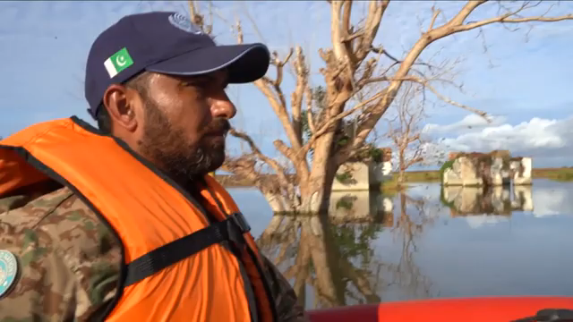
UNMISS role in flood response and disaster risk management
Reportage: https://www.youtube.com/watch?v=MVQciiaEHxg

Slide 23
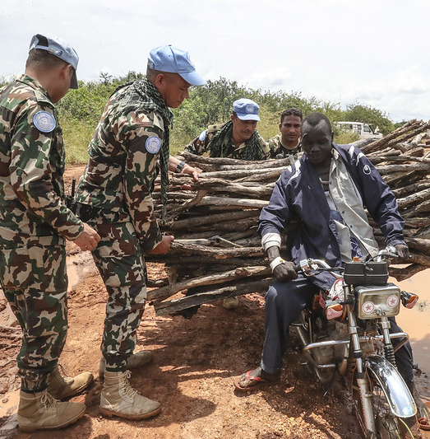
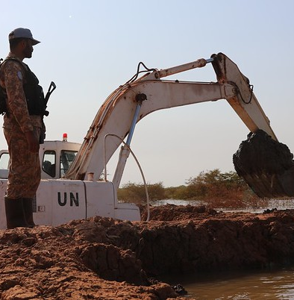
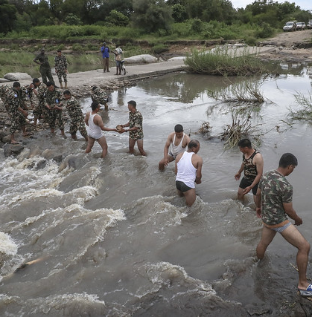
UN Peacekeeping adapting to changing environment

Slide 24
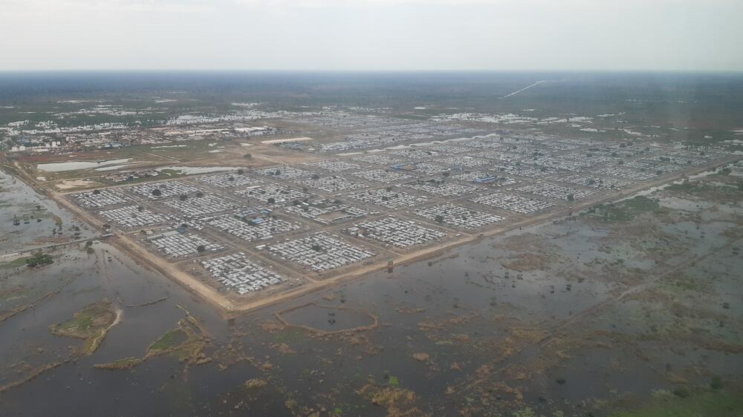
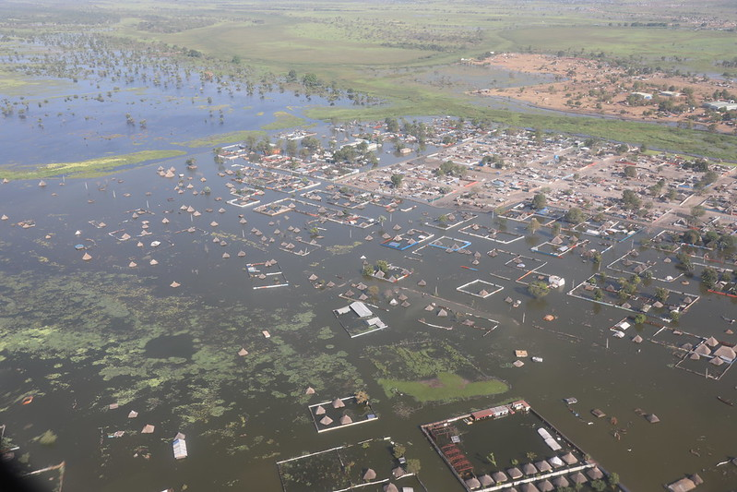
Bentiu IDP Camp surrounded by floodwater since 2020
Bentiu town in 2021

Slide 25
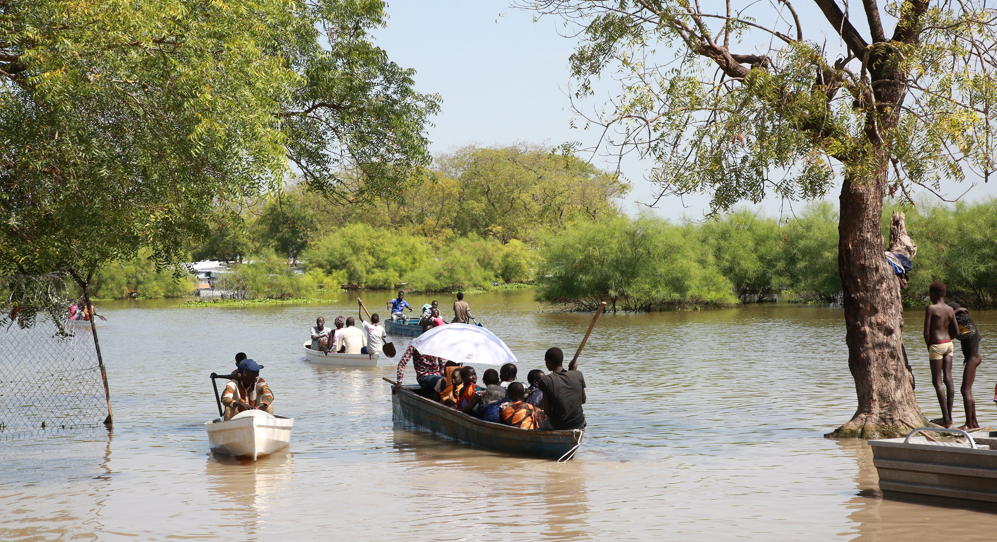
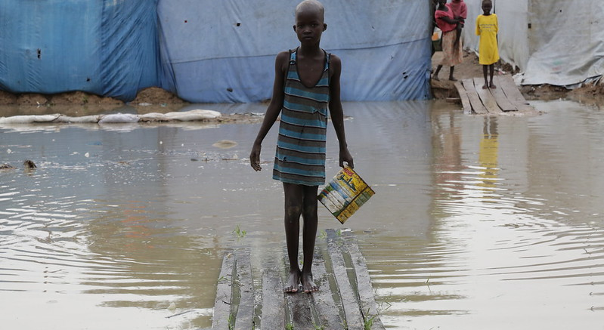
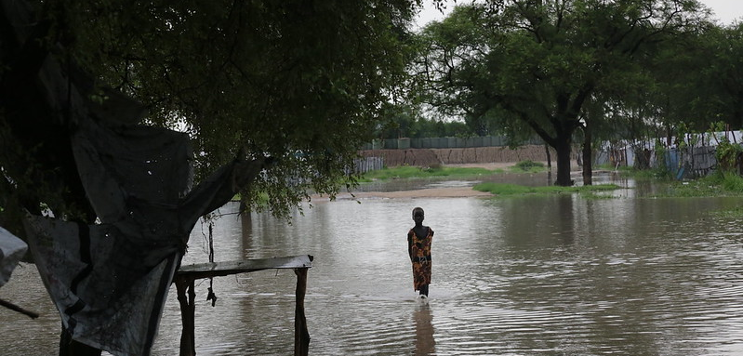
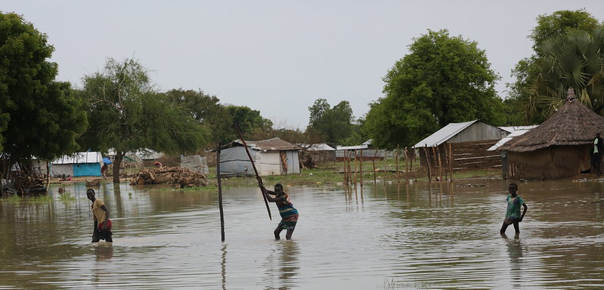
Flooding in Jonglei

Slide 26
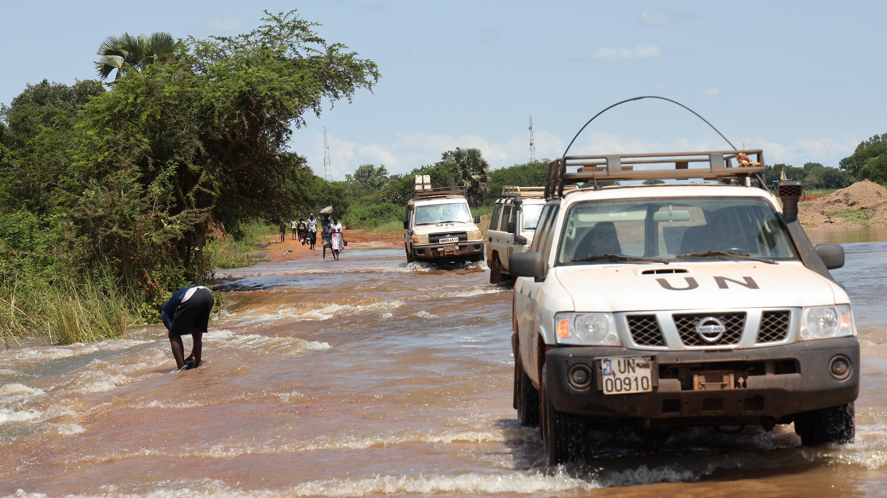
Activities of the UNMISS Climate, Peace and Security Unit (CPSU)
Preventing and Acting on Environment and Climate Change Challenges
Geo-Spatial mapping for preparedness and early action
Spatial Analysis - generation of maps
Data and information gathering - eg floods database, conflict-related sexual violence
Notes:
There are other opportunities to expand our analysis especially spatial analysis.
It is important to keep in mind that hotspot changes and we should always have a reference or baseline in declaring or designating a place as hotspot.
Collaboration with the Women Protection Advisor to understandithe linkages between climate security and conflict-related sexual violence in South Sudan

Slide 27
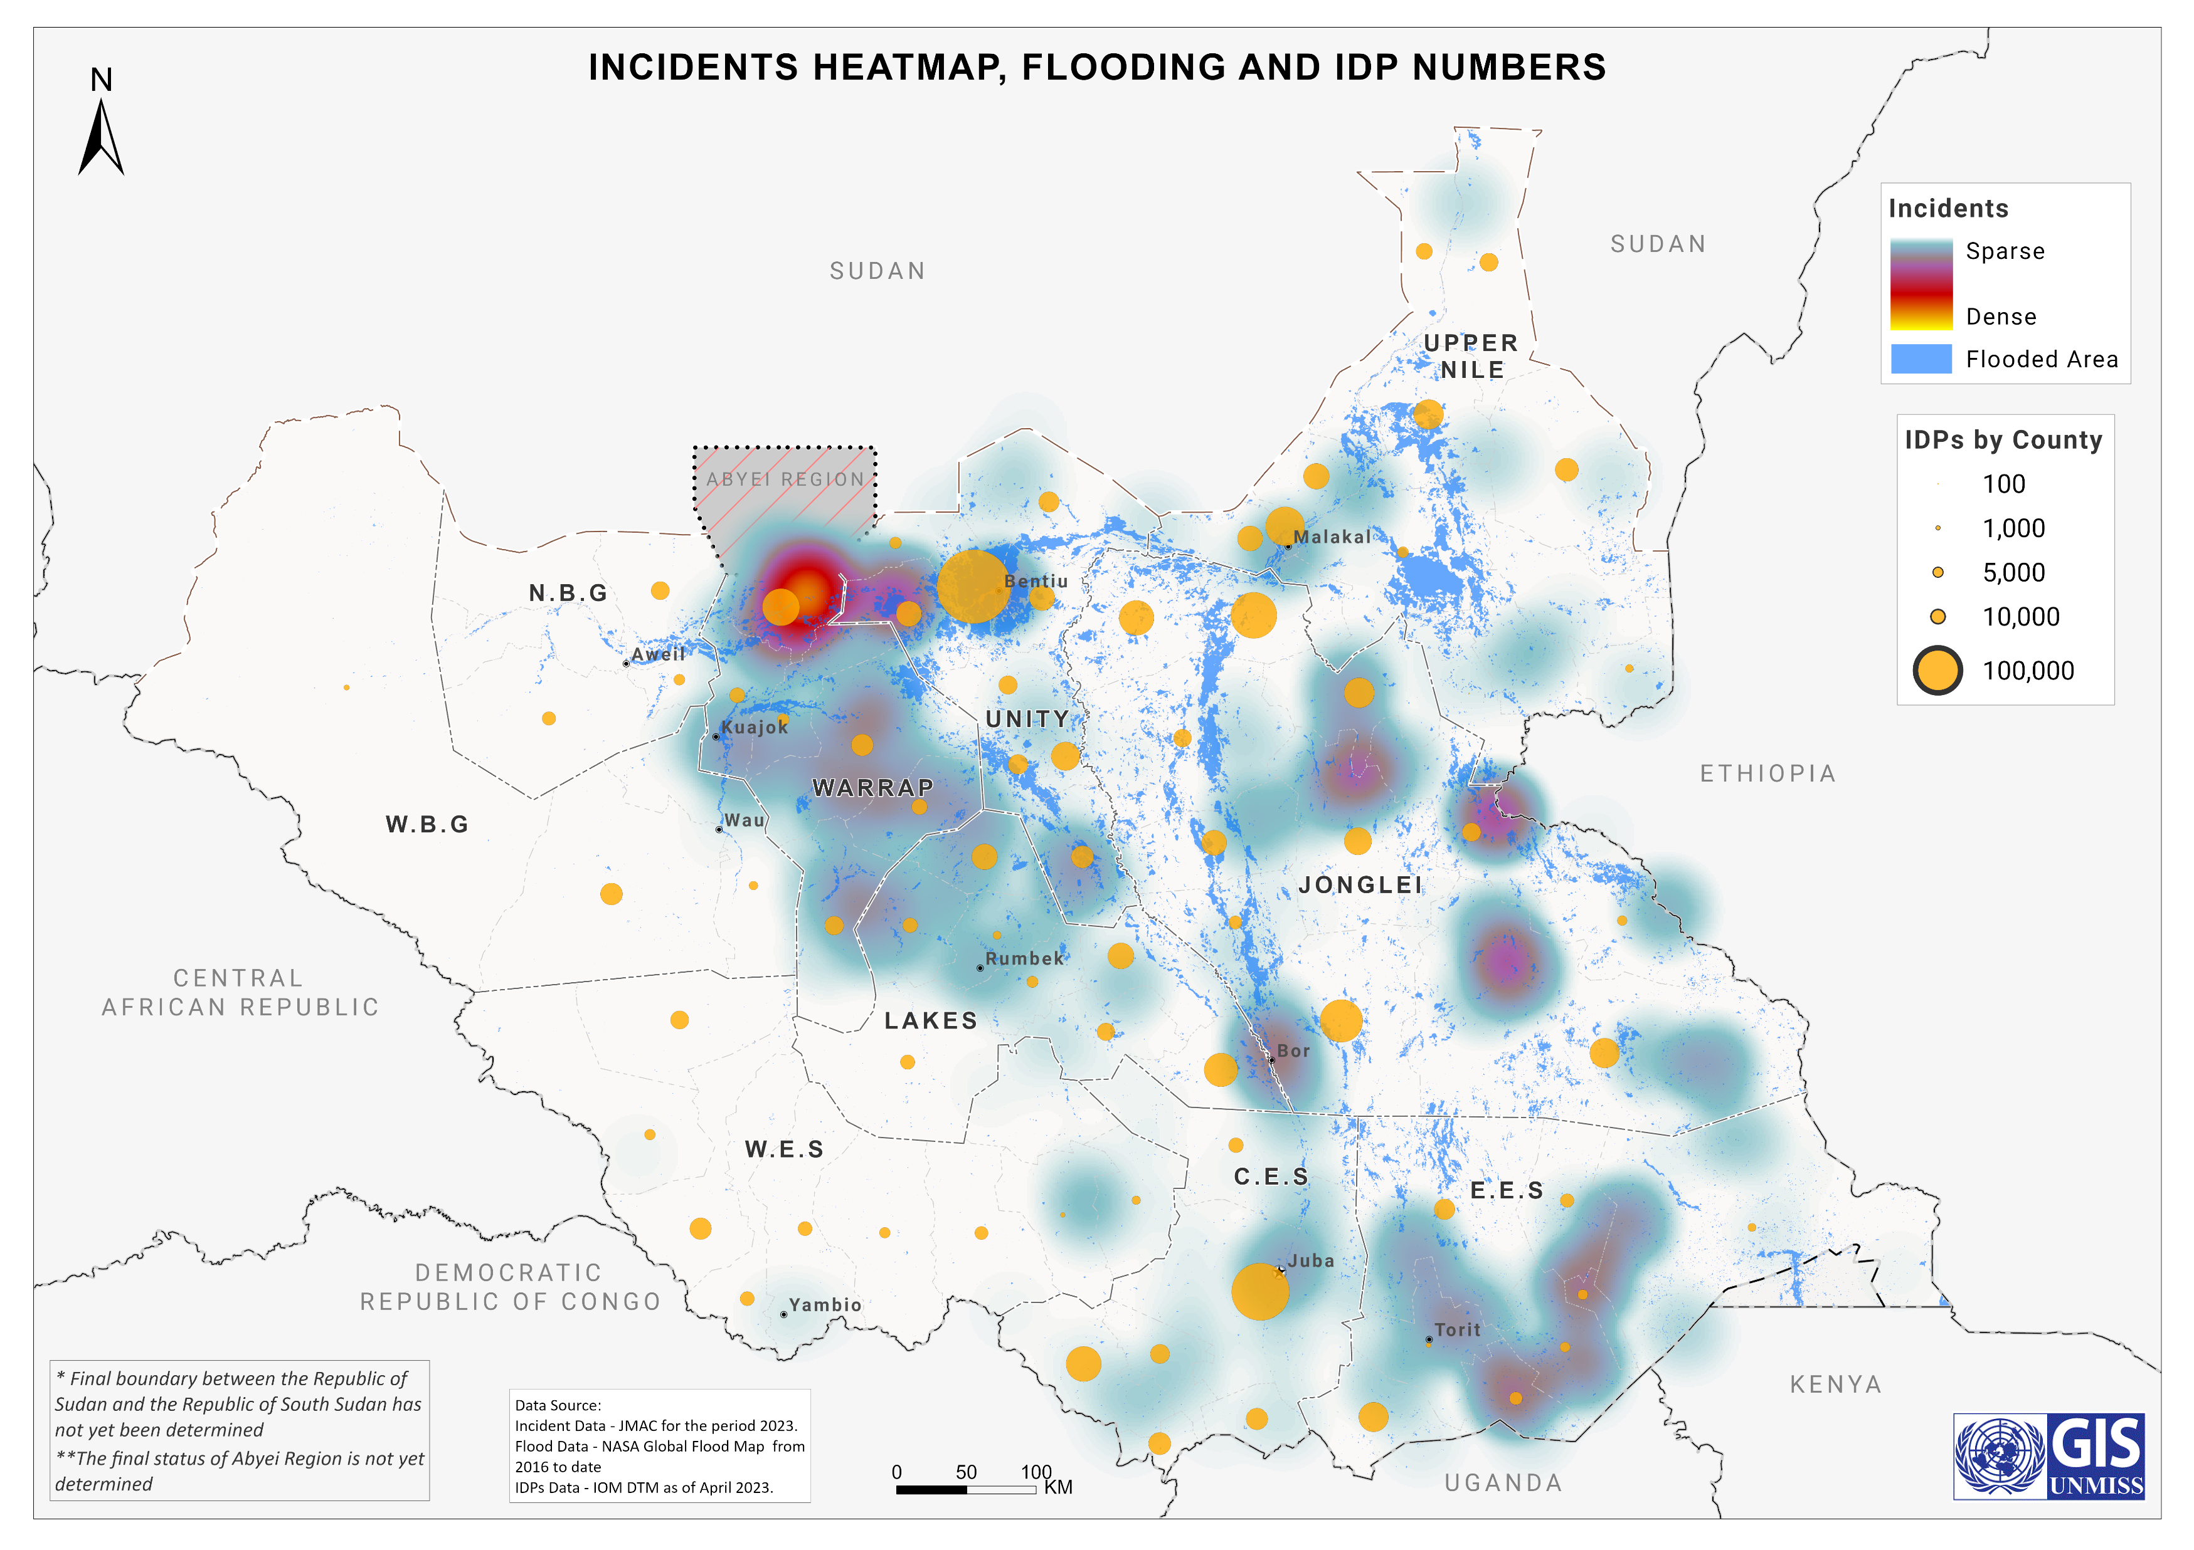
Neighborhood Analysis
The distribution of conflict hotspots, flooding and IDP Settlements in South Sudan
Key Findings:
There are prominent hotspots of conflicts within the perimeter of climate shocks/impacts, such as flooding.
IDPs congregate in shared spaces, which can easily result in conflict, especially where there are underlying tensions and grievances.
Notes:
The neighbourhood analysis is an integrated assessment of the spatial relationships of conflict hotspots, flood impacts, and the distribution of IDP Settlements. It involves stagging different maps to evaluate the proximities and the types of relationships they have.
You will notice that there are some prominent conflict hotspots within the perimeters of flood-impacted areas. This does not necessarily indicate correlations or causalities but demonstrates some association in the neighbourhood. When floods forcefully displace people, they easily seek refuge within a certain radius away from the flood-affected areas. Such a congregation could easily result in conflict, as we do know.
Similarly, when you overlay the distribution of IDP Settlements, you can also explore the type of symmetric relationship between flood, conflict hotspots and IDP settlements within a neighbourhood. It is also easy to see where other conflict hotspots are not linked to flooding. Neighbourhood Analysis – The distribution of conflict hotspots, flooding and IDP Settlements in South Sudan

Slide 28
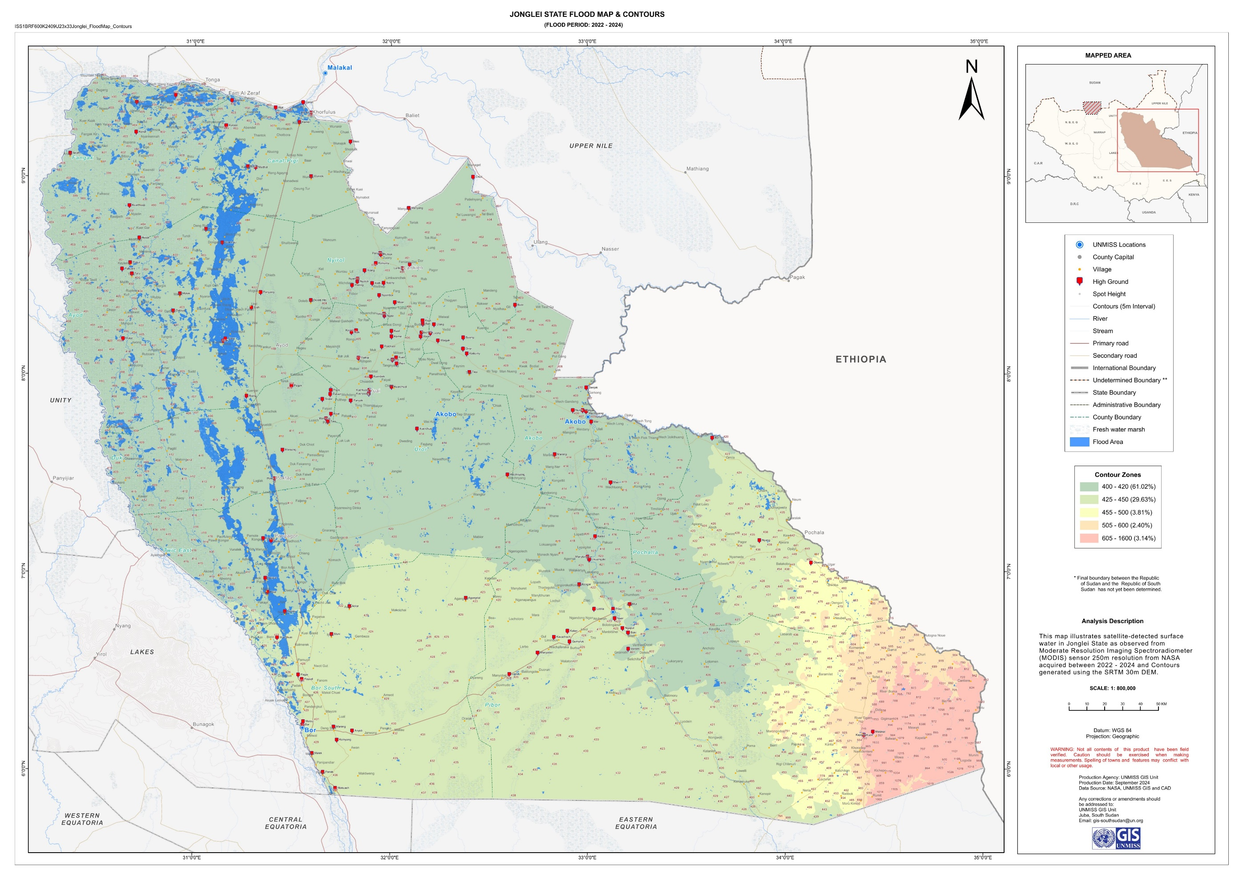
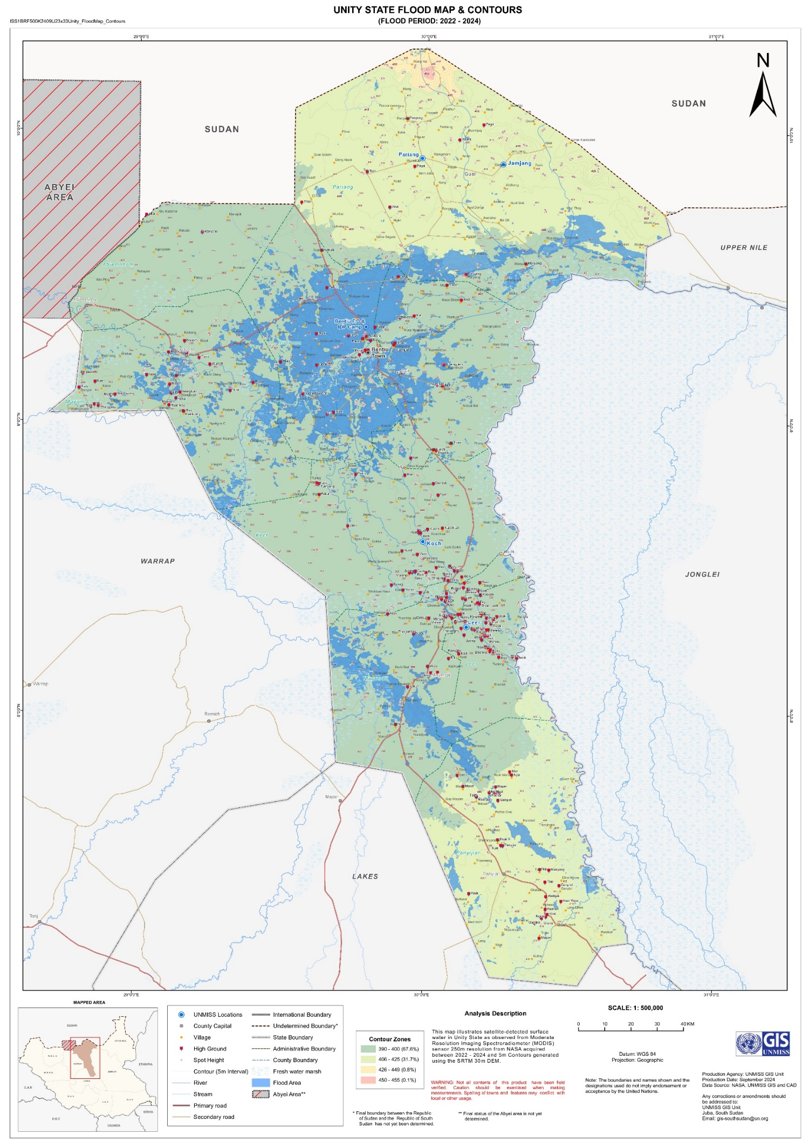
Mapping of high grounds and related security risks (2024 flooding season)

Slide 29
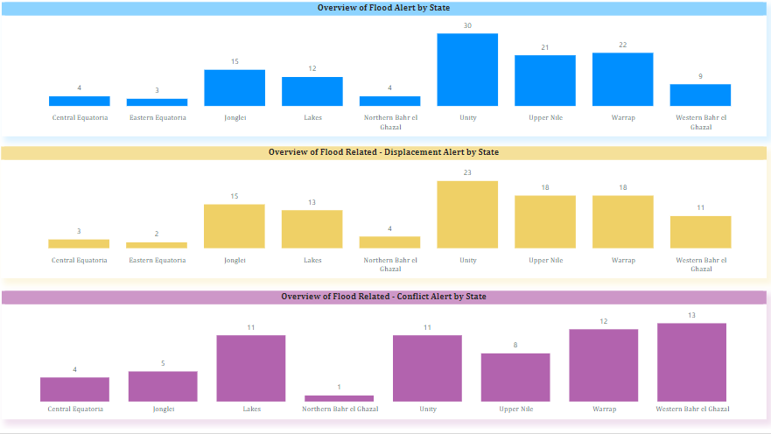
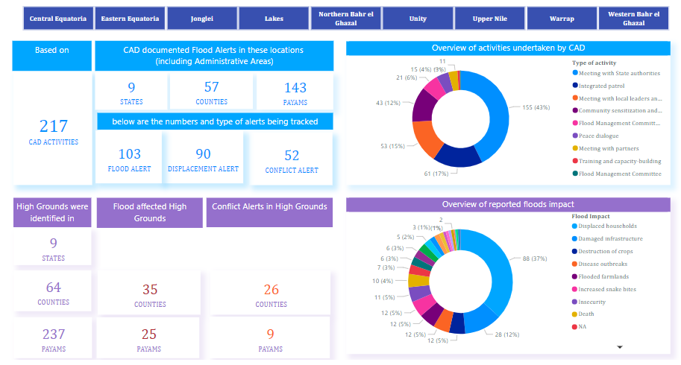
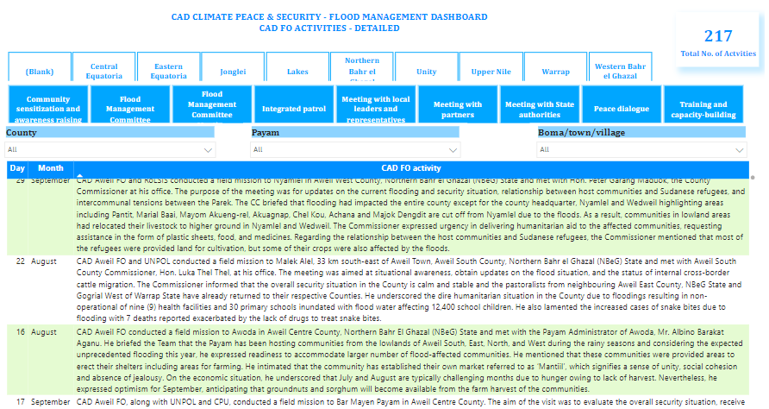
Flood Management Dashboard (2024 flooding season)
Early warnings on flood alerts, flood-related displacement alerts, and flood-related insecurity alerts
Monitoring tool for flood responses and activities
Mapping of high ground areas and related security risks

Slide 30
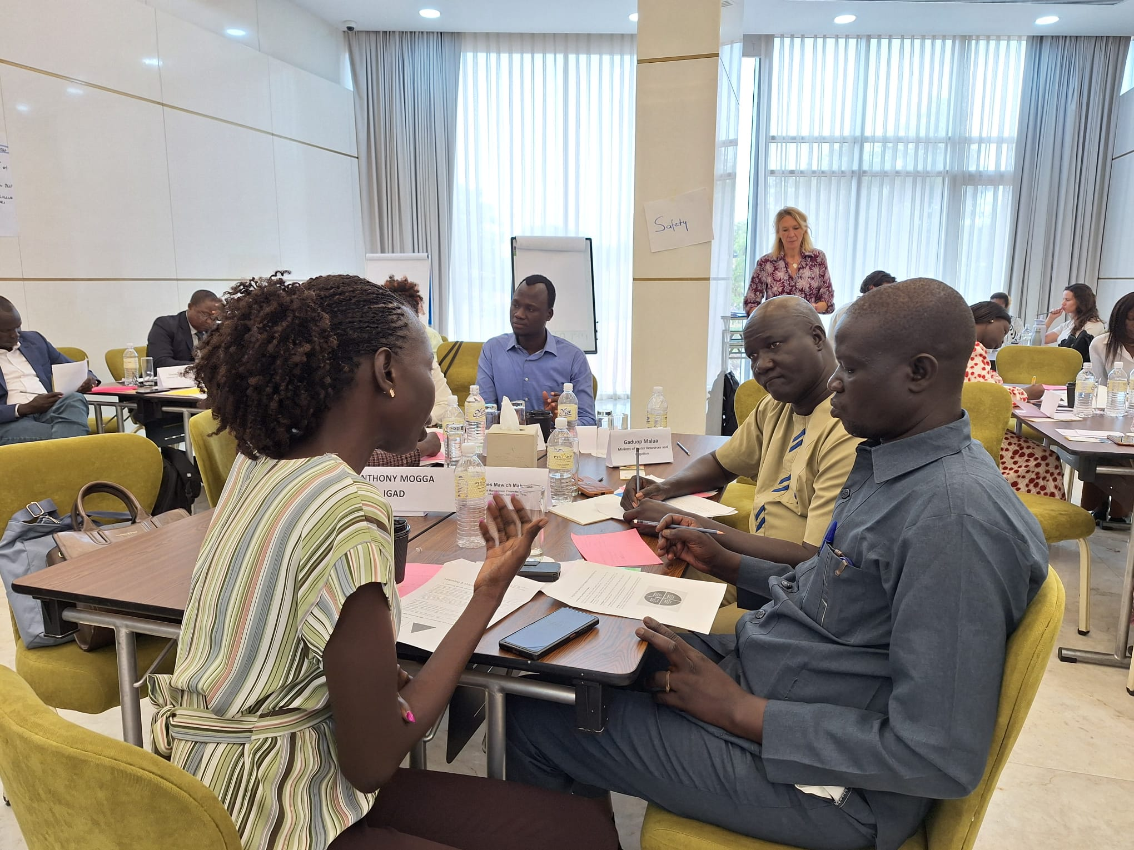
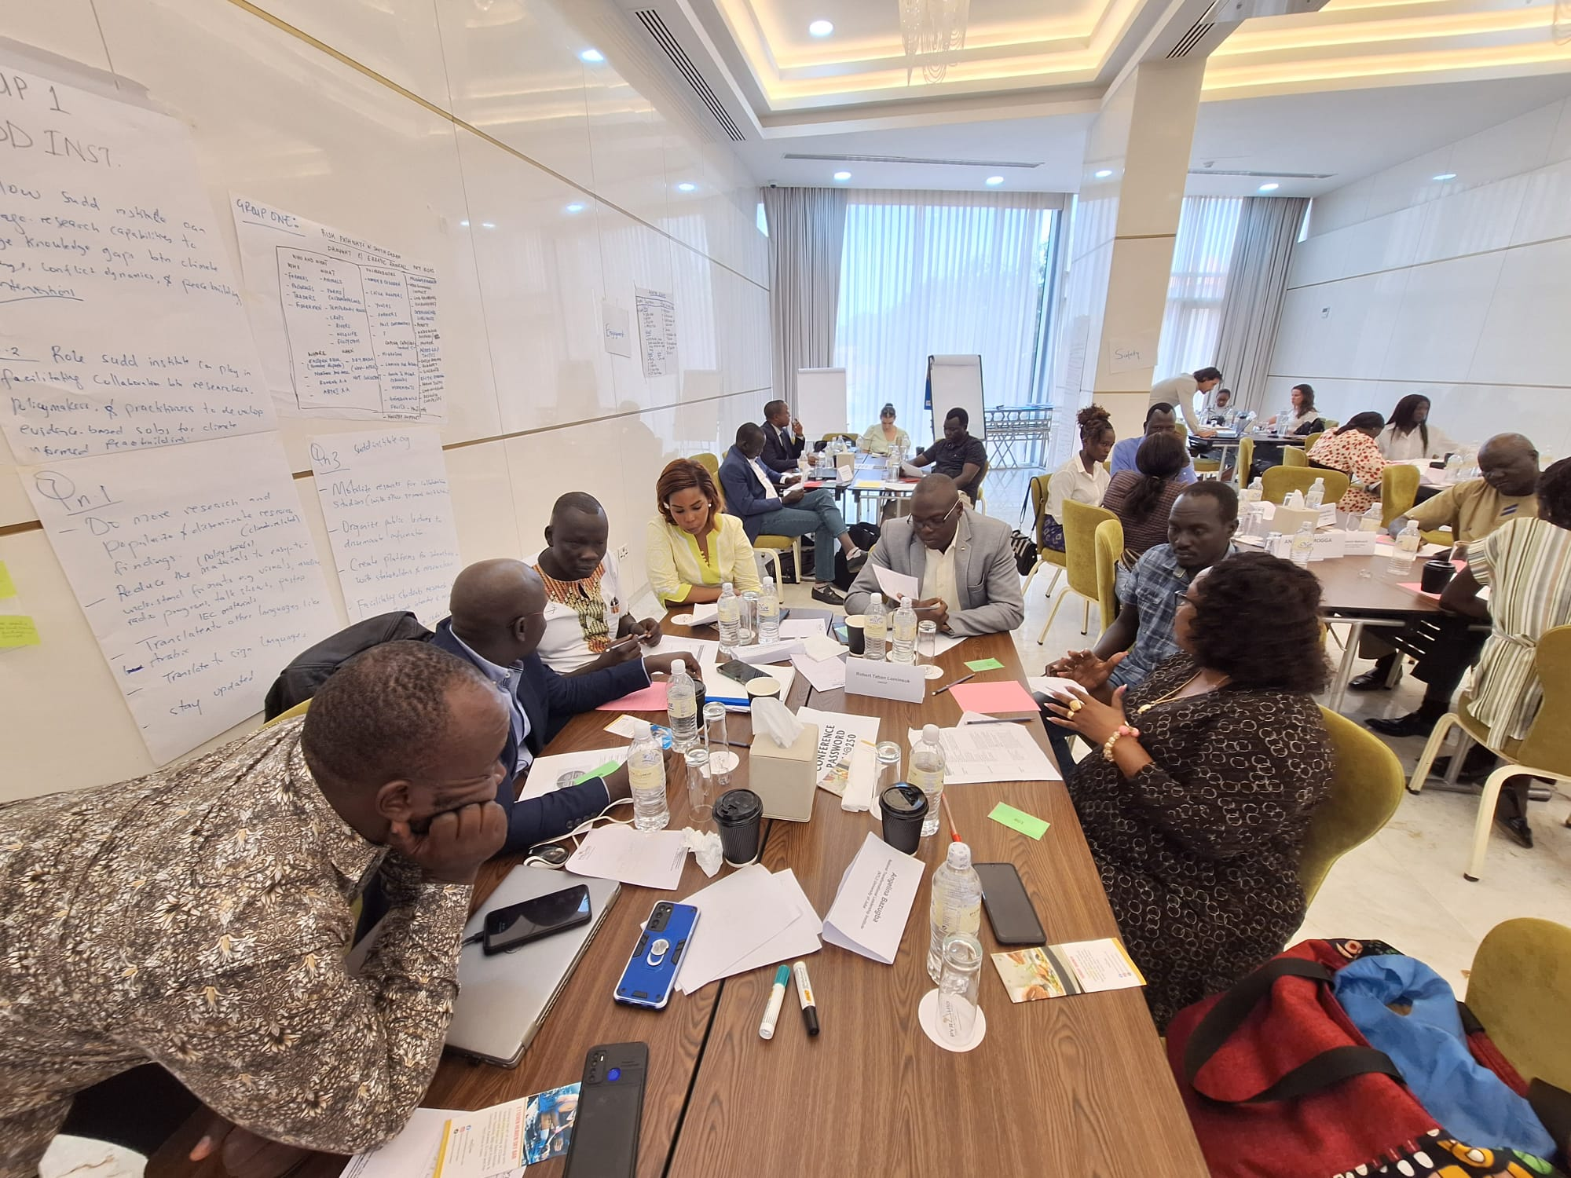
2. Training, capacity building and awareness raising
Internal trainings, e.g. (1) rollout of ToT with UN Police; (2) workshop on integrated climate security analysis; (3) during annual retreats of Mission sections; (4) UN Peacebuilding Fund training, etc.
Capacity building of government agencies, development partners, NGOs, CSOs, academia and research institutions on climate security
Training on climate security and gender, in collaboration with UNMISS Gender Affairs Unit (GAU)
UN Climate, Peace and Security Working Group in South Sudan
Strengthening Community of Practice on Climate, Peace and Security in South Sudan
Notes:
This was the first UN climate, peace and security training ever offered to government and civil society in response to civil society and government demands for capacity building in this area.

Slide 31
THANK YOU

Slide 32
Contact information
UNMISS Climate, Peace and Security Unit (CPSU) team members
Johnson N. Nkem (PhD)
Senior Climate and Security Advisor
United Nations Mission in South Sudan (UNMISS)
nkem@un.org
Ratia Tekenet
Climate Security Expert
Civil Affairs Division (CAD), United Nations Mission in South Sudan (UNMISS)
ratia.tekenet@un.org
Lucas Destrijcker
Climate Security Expert
Civil Affairs Division (CAD), United Nations Mission in South Sudan (UNMISS)
destrijcker@un.org

Slide 33
Climate-related activities of UNMISS
Disaster response and management (e.g. logistical support, engineering, etc.)
“Greening” mission operations and planning (Environmental Affairs Unit)
Gaining a better understanding of the linkages between climate impacts and peace and security
Developing responses to address peace and security risks emerging from climate impacts

Slide 34
3. High level reporting, information sharing and data informed advocacy
SG quarterly Report to the Security Council with a Climate, Peace & Security Section
Developing analytical products and tailored briefings, e.g. (1) Climate Security Hotspots Mapping; (2) Flood Risks and Conflict Analysis; (3) senior leadership briefings, UNSC and UN Expert Group presentations, etc.
Supporting UNMISS Public Information Office (PIO) and DPO Strategic Communications in media reports and stories (video, written, radio, etc.)
Media engagements, e.g. with Radio Miraya
Collaboration with other Mission sections, e.g. JMAC, JOC, GIS, and Women Protection Unit
CPSU part of the National Flood Preparedness and Response Task Force and supporting state-level flood task forces
  Developing conflict analysis
  Providing key messages for flood preparedness and conflict prevention
  Advising in climate-informed peacebuilding activities for flood-affected communities
NORCAP-NUPI study on role of UNMISS in addressing climate, peace and security in South Sudan: Lessons-learned and experience sharing
Notes:
This was the first UN climate, peace and security training ever offered to government and civil society in response to civil society and government demands for capacity building in this area.

Slide 35
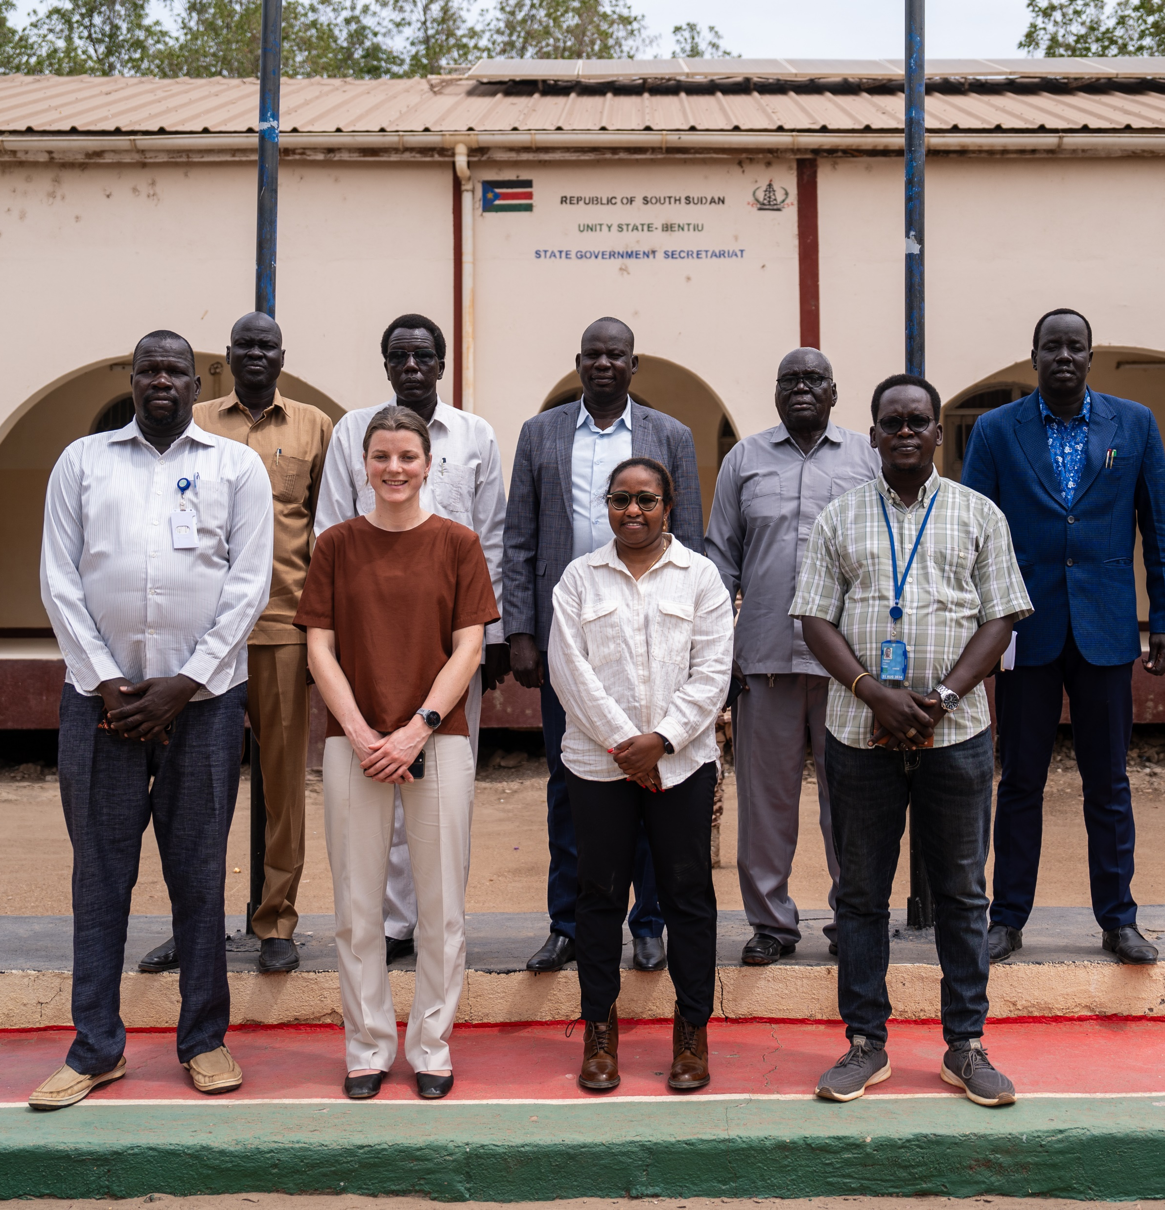
4. Strategic Advisory role to the Government
Integrate climate security perspectives into key national documents and strategies:
  Second Nationally Determined Contribution (NDC)
  Draft strategy for Peacebuilding in South Sudan
  South Sudan Voluntary National Review (VNR)
Technical support on land tenure and stakeholder consultations in land tenure in the context of the permanent constitution making process
National-led Flood management taskforce
Flood Management Committees at the state level

Slide 36
5. Strengthening the science, policy and programmatic linkages:
CPS Expert led research and knowledge generation - analysis of high grounds during the 2024 flooding season
Peacebuilding Fund (PBF) project, “Borderlands community Security and Conflict Resolution Initiative in South Sudan”
UN Climate, Peace and Security Working Group in South Sudan
Strengthening Community of Practice on Climate, Peace and Security in South Sudan
Notes:
This was the first UN climate, peace and security training ever offered to government and civil society in response to civil society and government demands for capacity building in this area.

Slide 37
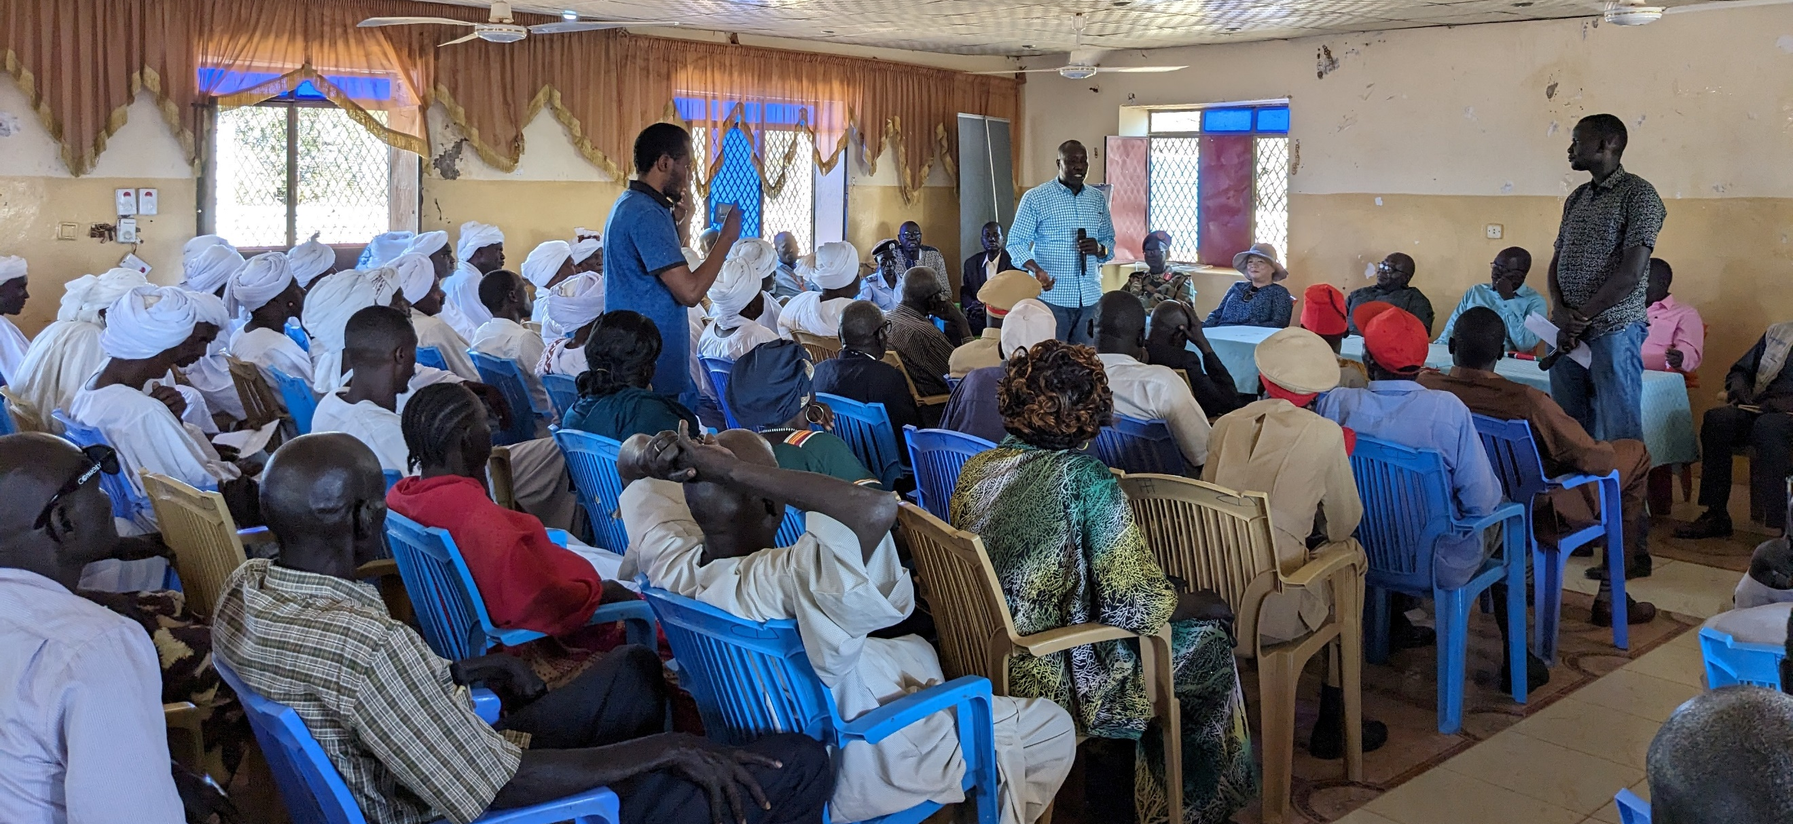
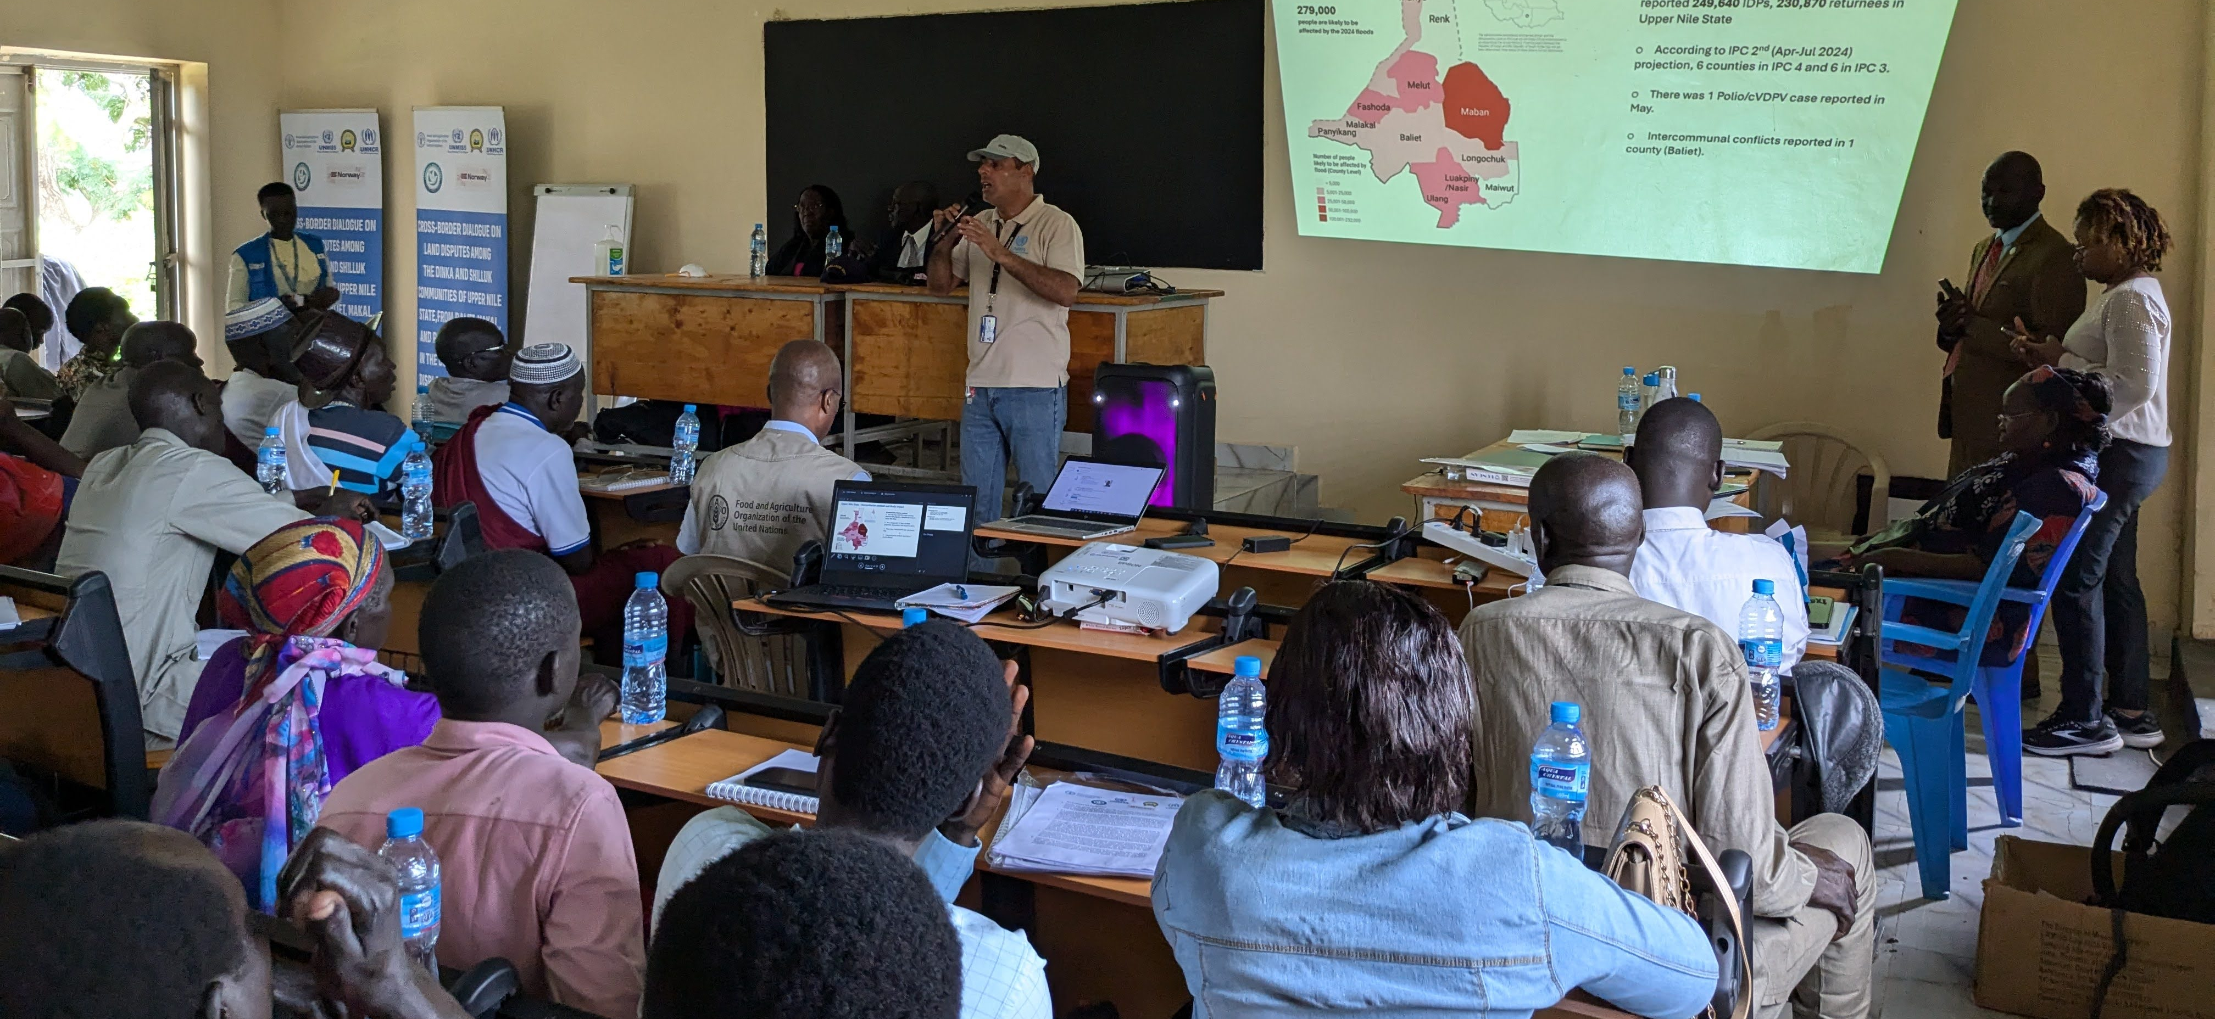
6. Mainstreaming climate security in programmatic activities and Mission operations
Flood sensitization and conflict prevention campaigns
Integrating climate security lens in peace dialogues with UNMISS Civil Affairs Division (CAD) and partners
Examples:
  Peace conferences related to seasonal cattle migration
  Inter-communal dialogues for peace, with climate change discussion
  Dialogues between flood-affected populations, e.g. across state borders and in high ground areas
  Dialogues on land disputes in the context of climate impacts
Notes:
This was the first UN climate, peace and security training ever offered to government and civil society in response to civil society and government demands for capacity building in this area.

Slide 38
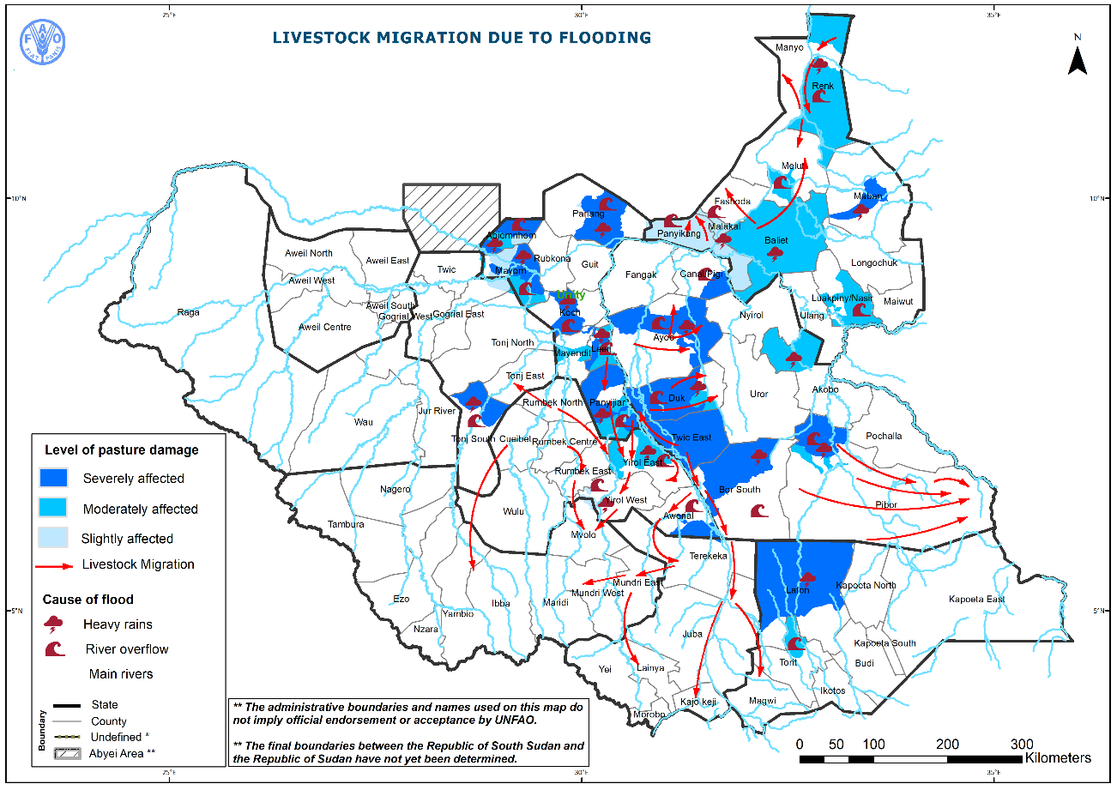
Flooding and changing migration patterns in South Sudan
Traditional transhumance corridors have shifted due to severe flooding, pushing herders with their cattle into regions where they would usually not migrate to or reside in
Example: Dinka Bor in Greater Equatoria Region and Warrap herders moving into Jur River County in WBeG
Example: Nuer from Panyijiar (Nuer) moving into Yirol East (lakes)

Slide 39
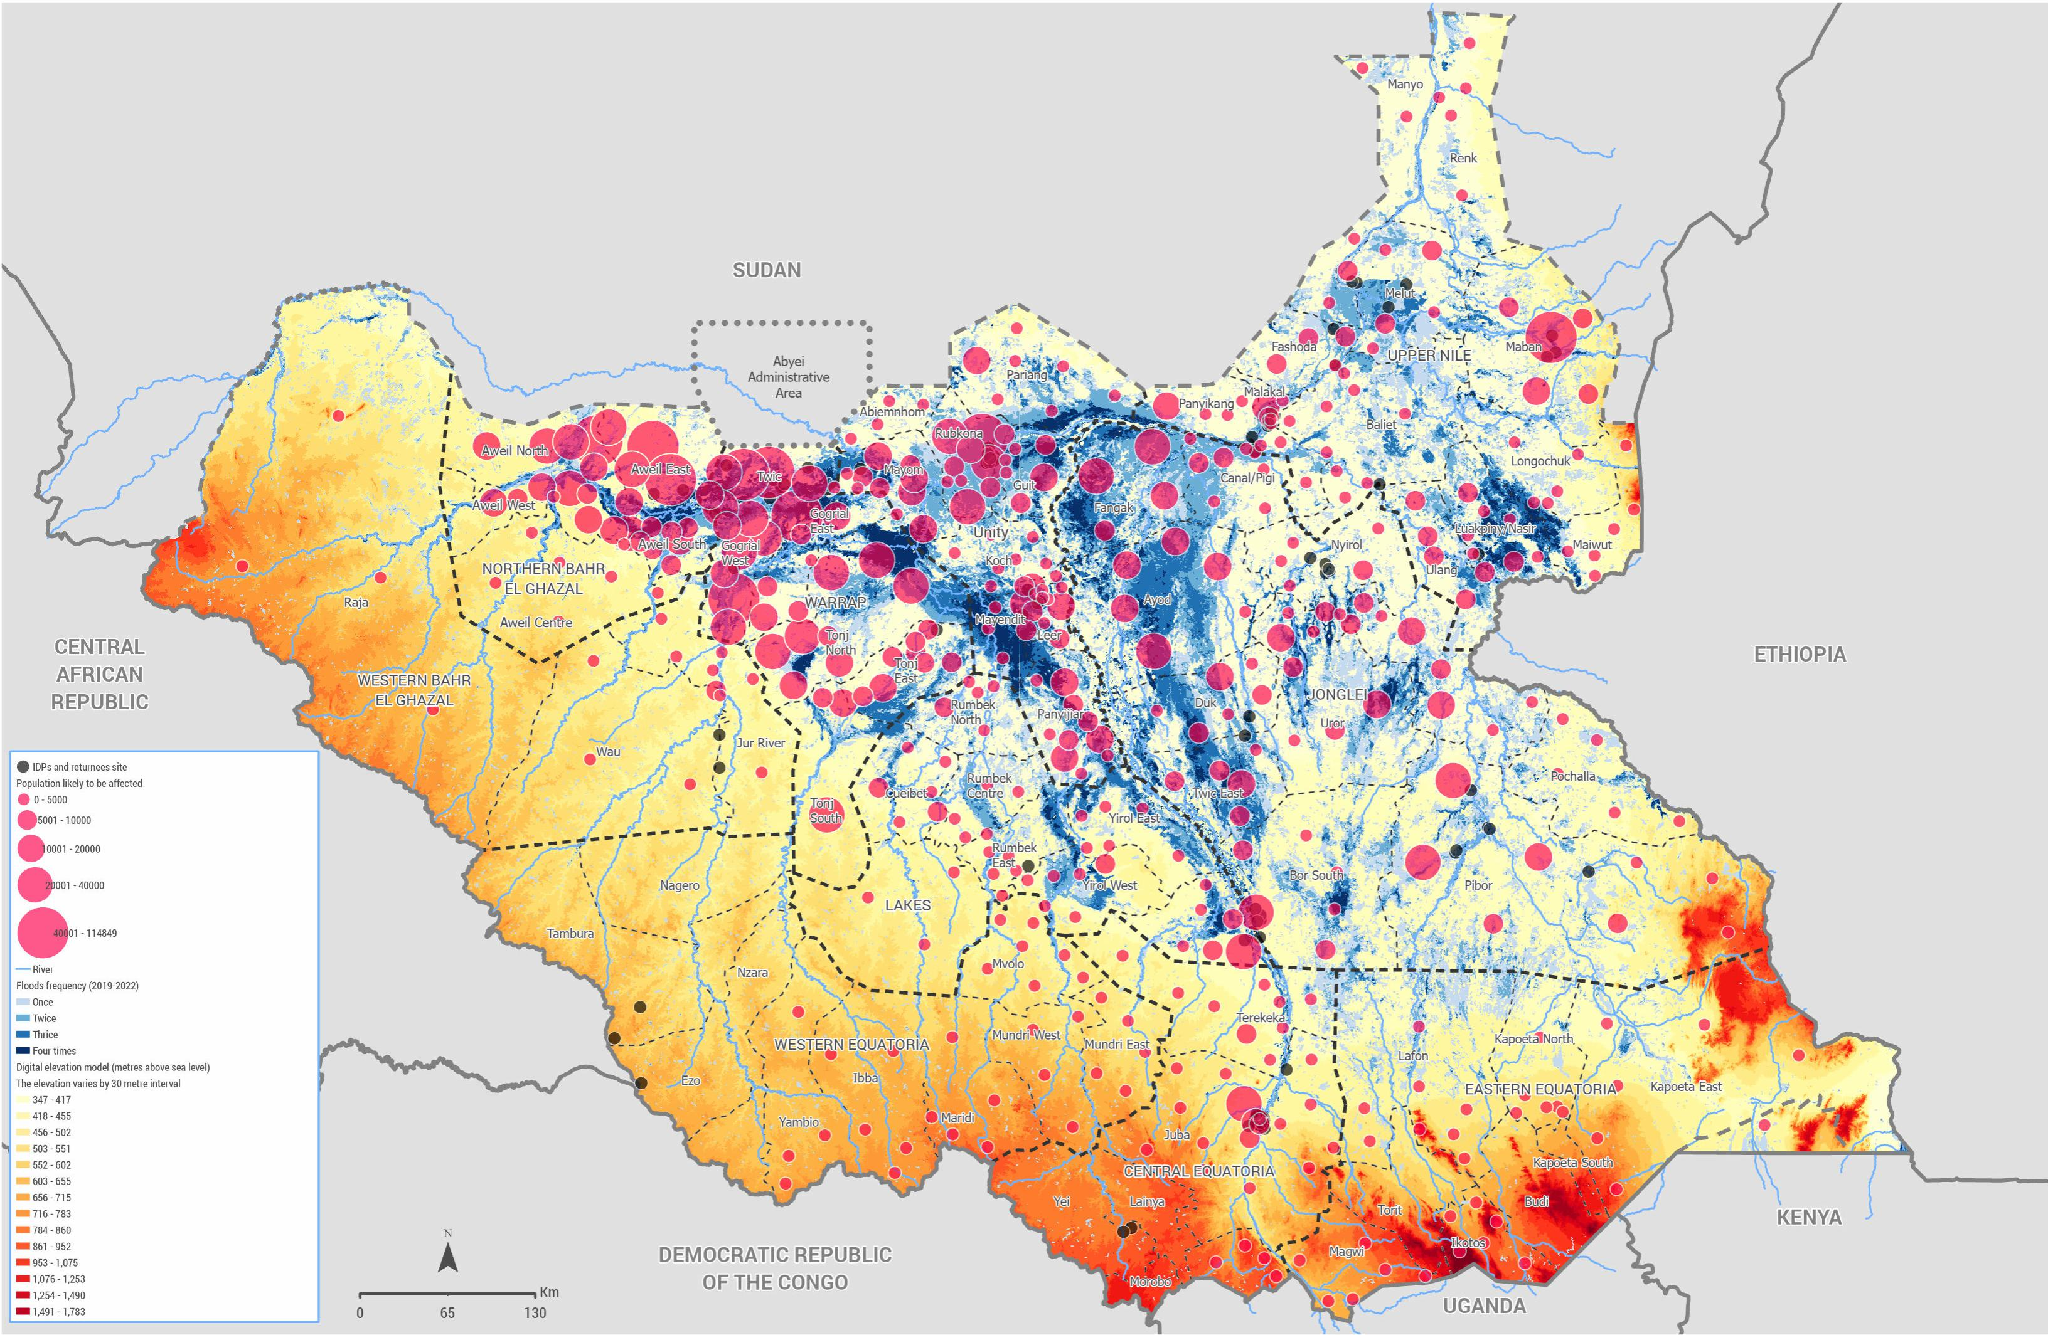
Flood frequency and affected populations
Source: OCHA (2024)

Slide 40

Types of flood-related activities
Joining integrated patrols focusing on flood extent and conflict risks
Participation in national, state- and county-level flood management committees
Peace dialogues focusing on flood-related conflict risks
Community sensitization and awareness raising
Centralized flood management and conflict sensitivity database and dashboard
Assessing flood extent and monitoring impacted high grounds and other flooded areas

Slide 41
Examples of intra- and inter-state peace dialogues focusing on flood-related security risks
20-22 August: Peace dialogue on land disputes between Shilluk and Dinka communities in Malakal, during which UNMISS CAD organized a session on climate security and flood sensitization. Intercommunal conflicts around land in Panyikang, Baliet and Makal counties are worsening due to the flooding.
4-6 September: Inter-state peace dialogue between communities from Lakes and Unity. The focus was on conflict prevention and peaceful coexistence between people displaced by flood (mostly from Panyijiar) and host communities in Lakes (Yirol East, Rumbek East, Rumbek Centre).
.

Slide 42
Examples of signed resolutions on flood-related conflict risks
“Implement strategic plans to enhance land governance and natural resource management, including by creating mutual benefits for both host communities and displaced persons.” (Malakal 20-22 August dialogue)
“Implement participatory climate-sensitive training for farmers and promote climate-smart agriculture practices that also contribute to peaceful coexistence and enhanced social cohesion between communities.” (Malakal 20-22 August dialogue)
“Communities affected by Flooding in Unity State, Rumbek East and North to be granted access to grazing, Bar (salt areas), and temporary settlement in the territories of Lakes State counties.” (Lakes-Unity 4-6 September dialogue)
“The formation of Joint Border Courts and Joint Border Police Patrols between Lakes and Unity” (Lakes-Unity 4-6 September dialogue)

Slide 43
Flood Management and Conflict Sensitivity Database
Established a database and baseline for flood-induced disruption for monitoring
Track the changing dynamics of flood-induced disruptions spatially and temporally
Assess cascading effects of floods on communities and infrastructure
Inform strategic decision-making for flood management
Notes:
This is the first time that we are tracking and cataloguing the flood situation closely. We have established a database and baseline for flood-induced disruption.

Slide 44
Flood Management and Conflict Sensitivity Database: High Grounds
Profiling High Grounds:
Assess whether communities are moving to the identified high grounds
Assess conflict profiles of identified high grounds for early action/intervention
Consider resource-based conflicts and their potential impact on flood-affected communities
Notes:
High grounds play a critical role in providing refuge and safety during floods. Profiling them enables us understand their suitability and potential challenges in accommodating communities impacted.
Are there specific resources that are most likely to be at the center of conflicts?
For example in Warrap, Kuajok town is accommodating displaced communities from Ayok, Mathiang Lac, Riang Lac and Mangolgolkou in Kuac North.
Yienlieth is accommodating displaced communities from Kuac South payam.
In Koch, Gany and Ngony payams identified as high grounds are accommodating displaced communities from Dhor-Jaak, Guang, Guhar, Jaak, Jaguar and Petpet.

Slide 45
Distribution of high grounds across the States
States | High grounds in Counties | High grounds in Payams
Central Equatoria | 5 | 21
Eastern Equatoria | 8 | 11
Jonglei | 7 | 41
Lakes | 8 | 31
Northern Bahr el Ghazal | 5 | 13
Pibor | 6 | 12
Unity & Ruweng AA | 7 | 53
Upper Nile | 8 | 37
Warrap | 6 | 13
Western Bahr el Ghazal | 0 | 0
Western Equatoria | 4 | 11
Grand Total | 64 | 237

Slide 46
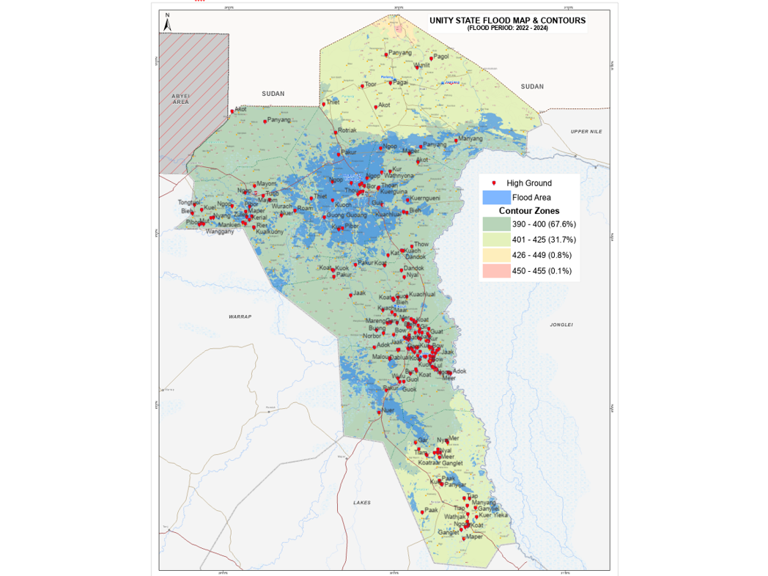
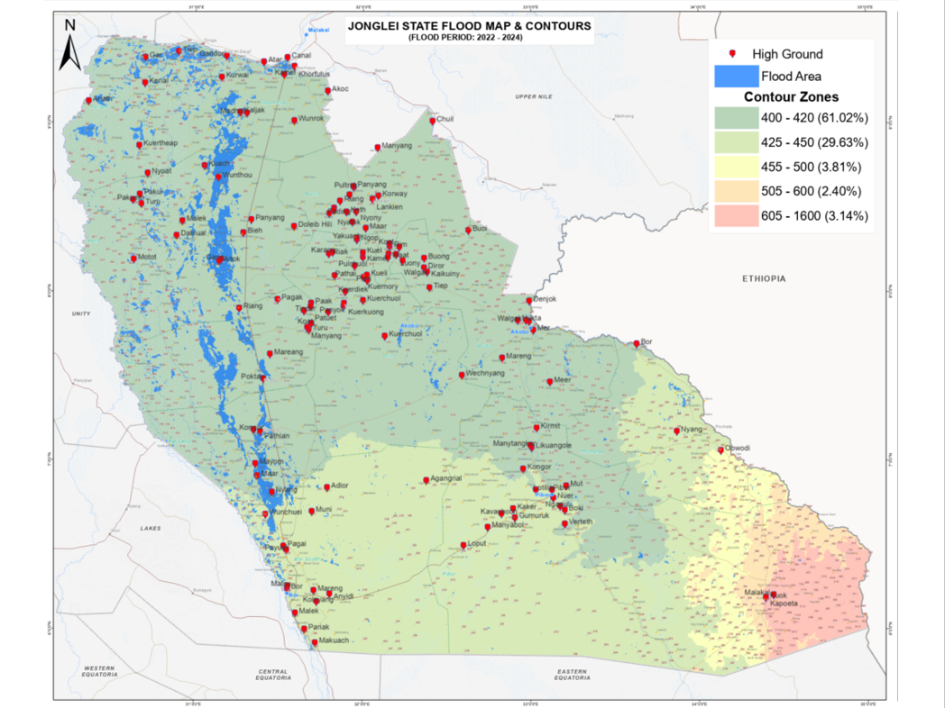
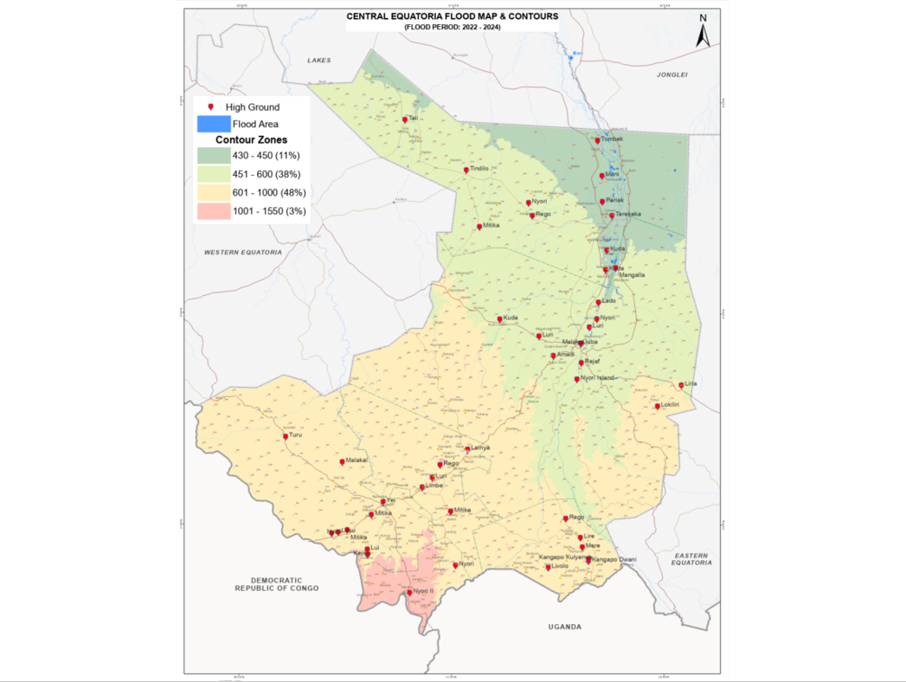
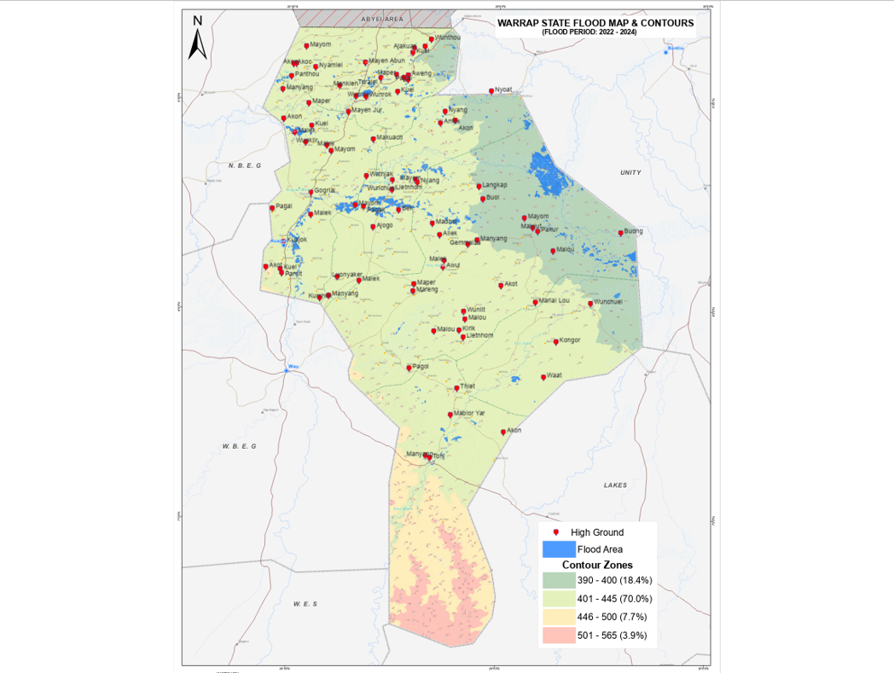
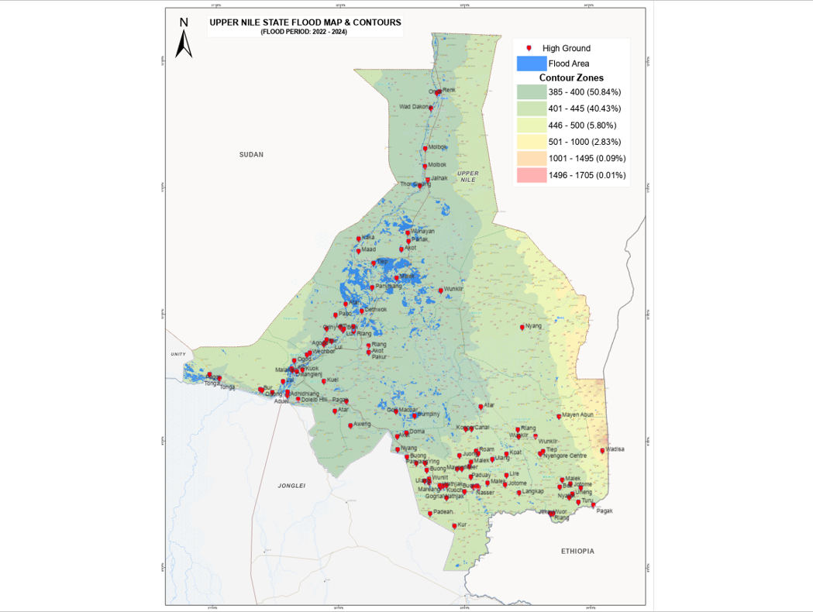
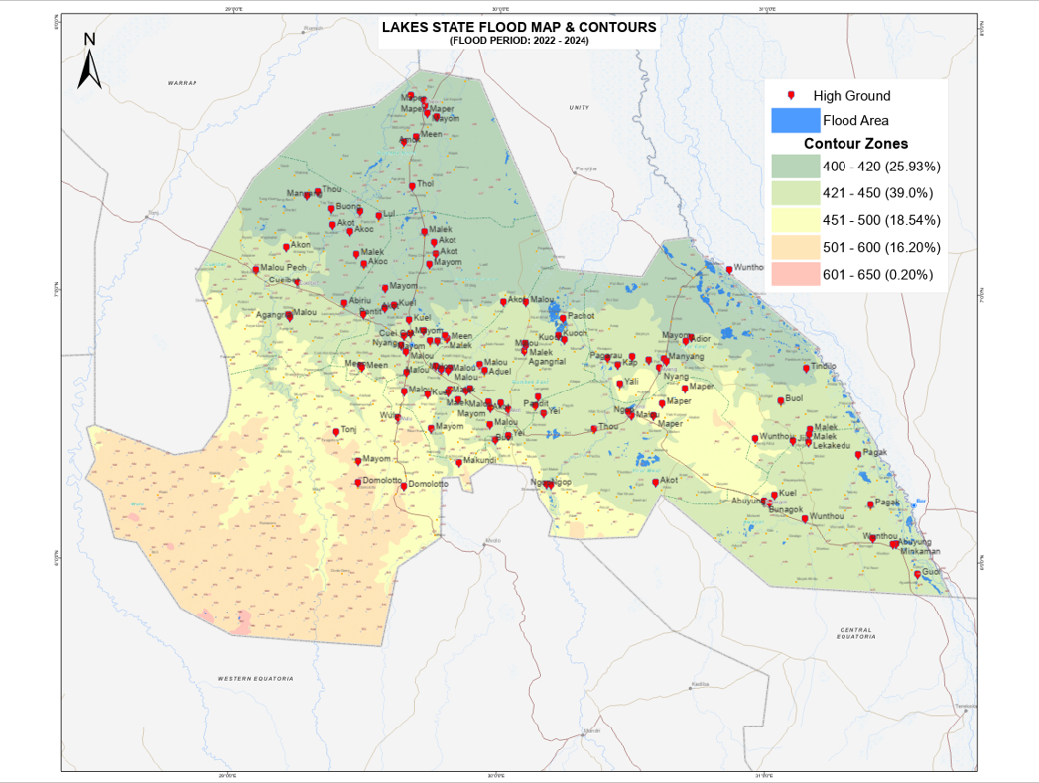
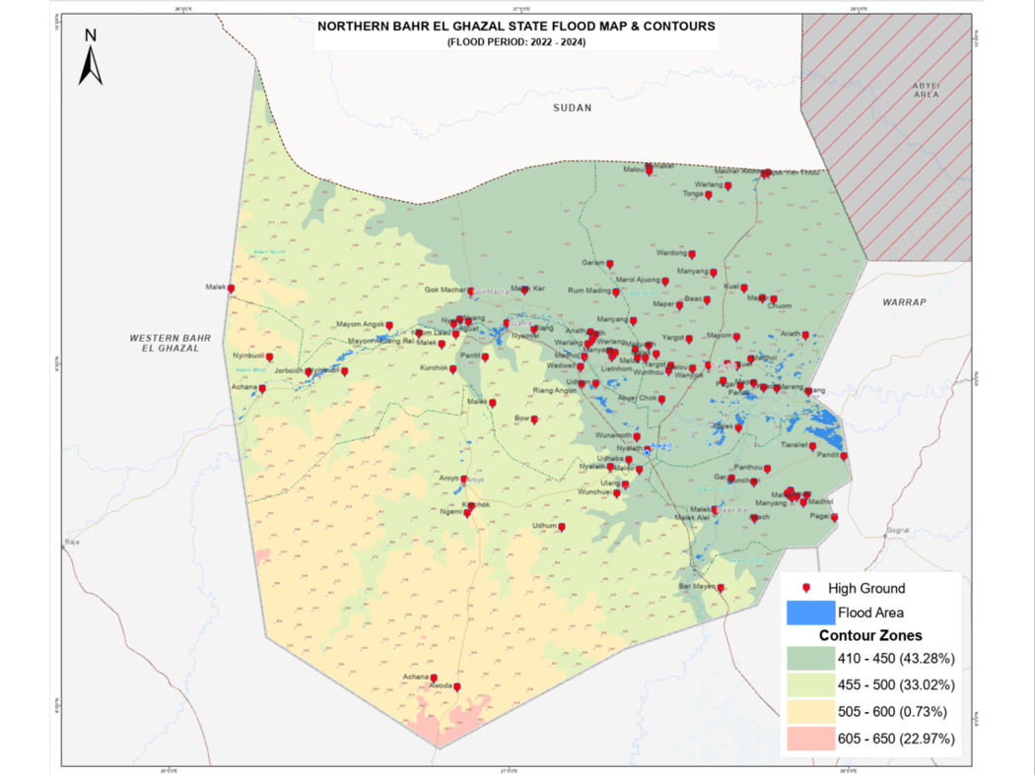
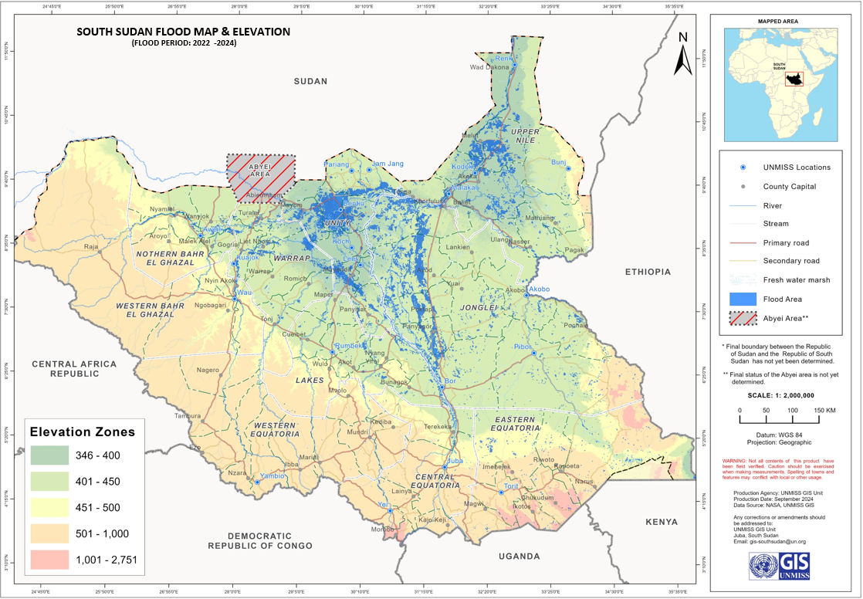
Mapping of high grounds and related security risks (2024 flooding season)

Slide 47
Distribution of high grounds across the States
Observations
Increasingly Submerged High Grounds:
Initial safe havens (e.g., in Lakes, Unity, Warrap) are becoming inundated
Rising water levels are rendering previously identified high grounds less effective
Newly Identified High Grounds:
States are sharing information about newly identified safe areas (e.g., in Malakal)
Tracking and monitoring these emerging high grounds
Impact of Flooding in High Grounds:
Analyze the effects of flooding on communities located in high ground areas
Assess the impact on infrastructure, livelihoods, and access to basic services
Conflict dynamics in high grounds

Slide 48
THANK YOU

