Slide 1
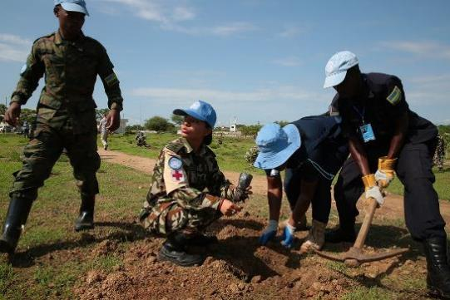
Understanding and addressing the effects of environment and climate challenges in PKO
- operational support perspective
6 November 2024
Harinder Sood – Chief, Integrated Training Service
Department of Peace Operations

Slide 2
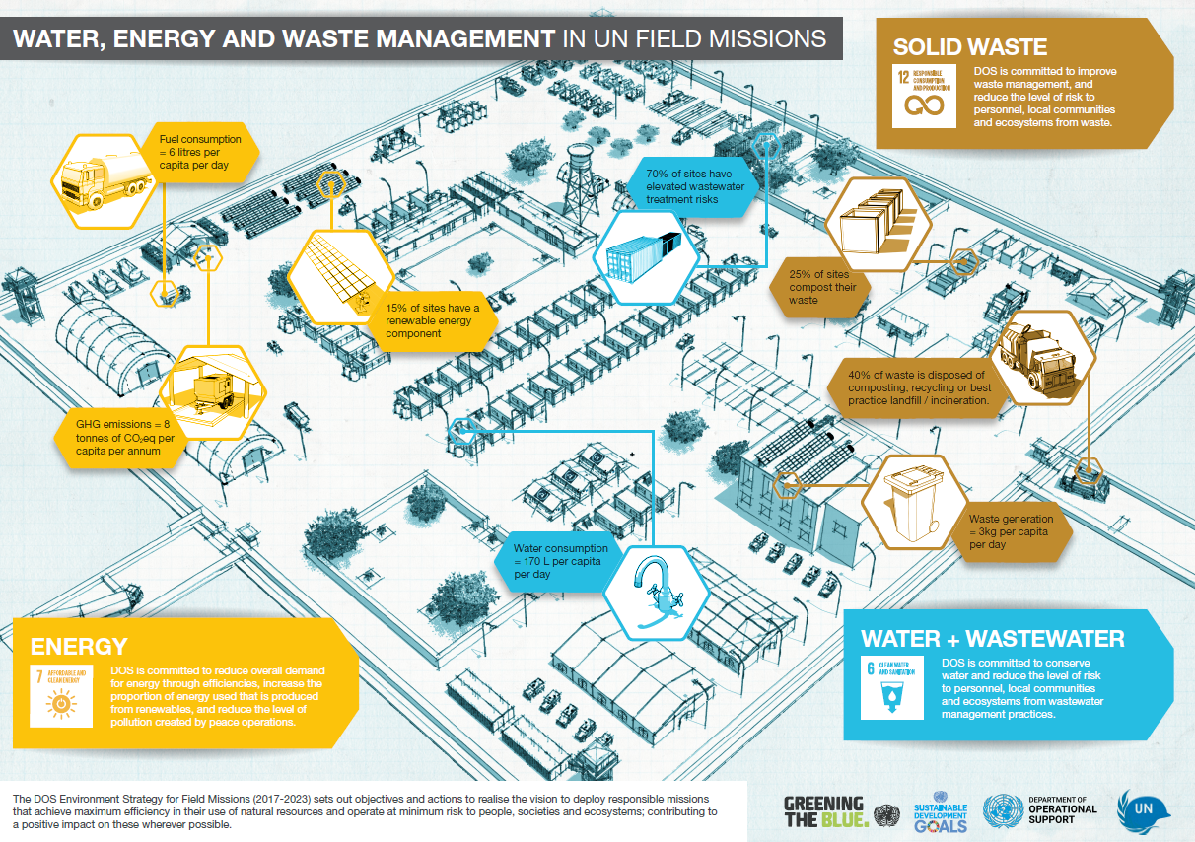
Environmental considerations in UN Peace Operations
Energy supply & use
Water supply, treatment & use
Wastewater generation, treatment, disposal & reuse
Solid waste generation, treatment, disposal & recycle/reuse
Hazardous material generation, storage, handling & disposal
  Petroleum, oil and lubricant (POL) waste
  Chemicals
  Biomedical waste
  Electronic -waste
Natural resources use
Wider impact / benefits for the host community

Slide 3

Why peace operations
The Department of Operational Support (DOS) provides operational support to all UN Secretariat entities, including advisory, operational and transactional support services and, where needed, exercises delegated authority on behalf of clients. DOS supports the entire UN Secretariat, consisting of almost 100 entities located around the globe.
Peace operations = 82% of UN Secretariat carbon footprint and effectively 100% of environmental risk drivers
64,000+ peacekeepers
461 operational sites
300 GW of electricity p/a
47,000 T of solid waste p/a

Slide 4
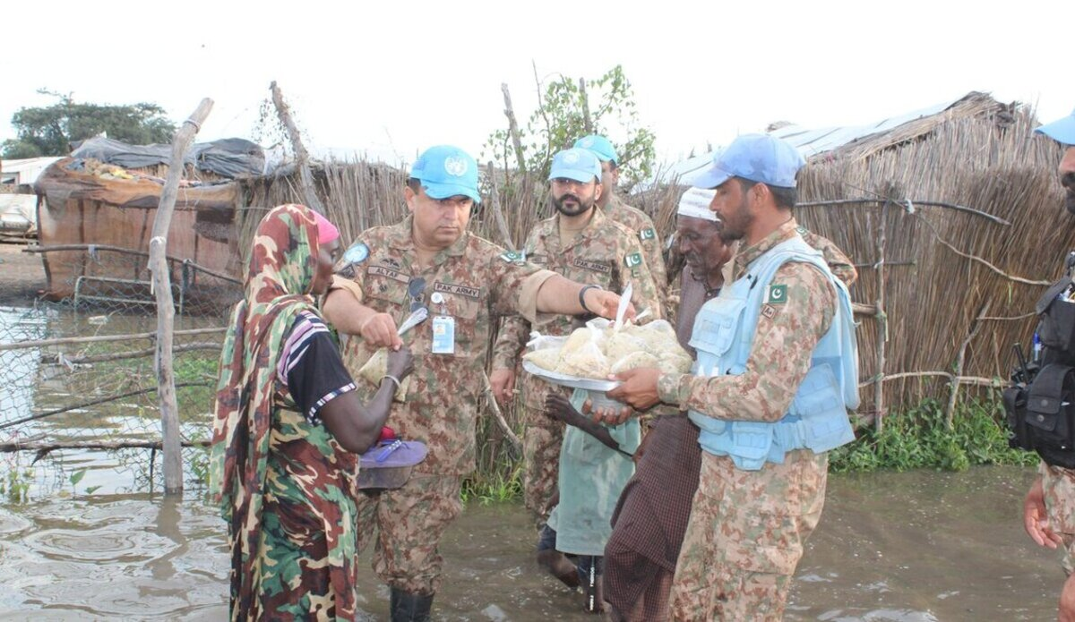
Climate challenges in peacekeeping operations
More frequent climate extremes (e.g., floods) are expected to increasingly impact peace operations; posing challenges and multiplying risks for peacekeepers – and demanding vigilant responses.
Institutionalized environmental training and practices (such as proper waste disposal) can mitigate the impacts of climate change on missions and peacekeepers.
DOS is investigating how the challenges posed by climate change will influence peacekeeping facilities, with a focus on wastewater, solid waste, water and energy management infrastructure.
Notes:
Image: UNISFA peacekeepers assist flood-affected communities in Abyei (Credit: UNISFA Peacekeepers assist Flood-Affected Communities in Abyei | UNISFA)

Slide 5

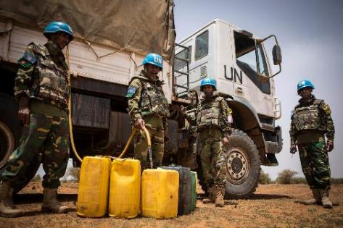
Environmental management – a risk management tool
Implement the “Do no harm” principle in the field
Minimize risk for the host community, ecosystems, and community livelihoods
Minimize risk for the health and safety of peacekeepers
Protect the reputation of the UN as a responsible organization
Key risks to manage in the field
  Wastewater
  Solid waste, including hazardous waste

Slide 6
Environment Strategy for Peace Operations
(2017 - 2023)
Five Strategy Pillars
Energy
Water &
Wastewater
Solid
waste
Wider
impact
EMS*
* EMS – environmental management system

Slide 7
Sites where wastewater assessed to pose a minimum risk
This indicator represents the proportion of sites that meet best practice standards for wastewater management. This includes the absence of any leaks or uncontrolled discharges, fully operational and well maintained infrastructure (adequate treatment capacity, watertight with no infiltration of stormwater, grease traps, oil water separators).

Slide 8
Share of waste with preferred disposal methods
This indicator represents the proportion of waste that is re-used (e.g. composted), recycled, incinerated to required emissions standards, or disposed of in a best practice landfill (fenced, lined, surface water managed and leachate / gases controlled).

Slide 9

More recent mandates and resolutions
General Assembly
A/RES/76/274; 2022
“minimize risks”
“intensify the efforts aimed at reducing the overall environmental footprint”
“working towards a potential positive legacy for host communities”
A/78/19 (Report of the Special Committee on Peacekeeping Operations); 2024
“sound use of renewable resources”
“achieve more efficient use of energy and water, reduce waste production”
Security Council
South Sudan (S/RES/2729; 2024)
“emphasizes good stewardship of resources and a positive legacy of the mission”
“identifies the goal of transition to renewable energy”
“contribute to positive infrastructure legacy for host communities”
Cyprus (2024)*, CAR (2023)*, DRC (2023)*, Somalia (2023)*
“emphasizes good stewardship of resources and a positive legacy of the mission”
“identifies the goal of expanded renewable energy use in missions”
* Cyprus (S/RES/2723; 2024), CAR (S/RES/2709; 2023), DRC (S/RES/2717; 2023), Somalia (S/RES/2705; 2023)

Slide 10

The Way Forward: Environment Strategy for Peace Operations 2023-2030
Responsibility Ambition Legacy
Energy
Water &
Wastewater
Solid
waste
EMS
Wider impact

Slide 11
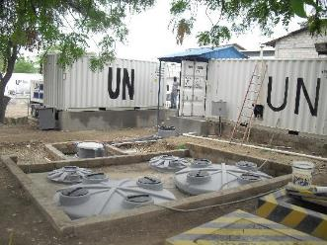
Key theme 1 – Responsibility: “Do no harm”
Ongoing vigilance on risk
  Wastewater and hazardous waste
  Oversight and technical assistance
Responsible liquidation processes
  Planning and preparation during sustainment phase

Slide 12
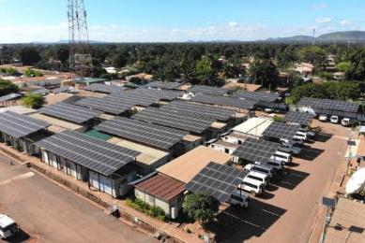
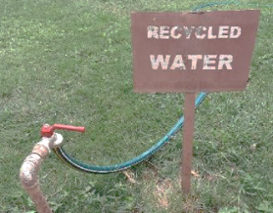
Key theme 2 – Increase ambition
Accelerated renewables transition
  UNOE: outsourcing, inside the fence, grid connections
  COE: deployment of solar photovoltaic
Reduced consumption
  Energy efficiency
  Energy and water conservation
  Reduction of waste generation – including single-use plastics
  Stock management
Mission-set targets
  Based on multi-year plans
  Agreed with Member States through budgetary process

Slide 13

Key theme 3 – Leave a positive legacy
  Leverage ~360 million USD spent by peace operations on infrastructure and facilities annually
  Put in place concrete measures to enable the progressive handover and knowledge transfer
  Develop operational guidance and training
  Focus on physical footprint: construction, accommodation, wastewater treatment, energy and waste management facilities etc.
Partner with host countries
  Build capacity of the host community to operate and maintain infrastructure and facilities, and encourage home-grown solutions

Slide 14
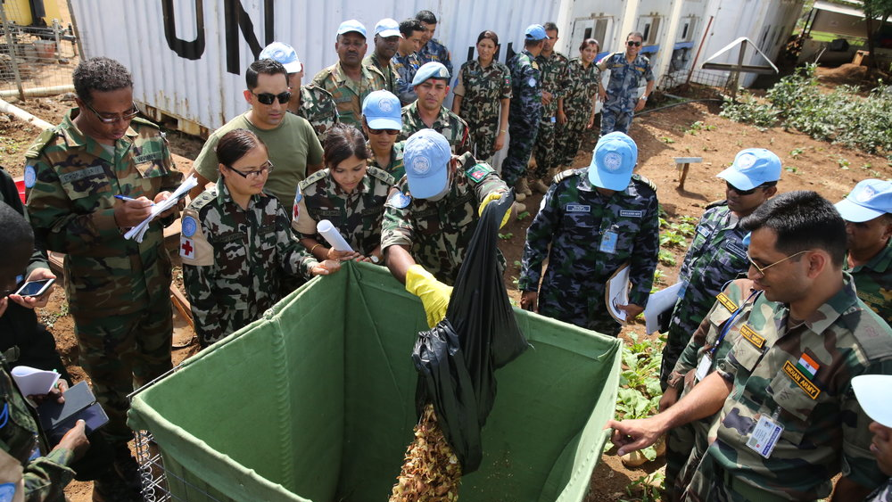
Responsible environmental management practices
Military unit level
√
Environmental focal point
Nominate a unit environmental focal point
Environmental awareness and induction
Provide environmental induction session and regular environmental awareness sessions
√
Compliance with UN environmental guidance
Ensure compliance with UN Env guidance in operations, and facilities management practices
Promptly implement corrective and preventive measures
√
Environmental footprint reduction
Minimize the unit environmental footprint, through water and energy conservation measures, transition to renewable energy, minimizing waste generation, revegetation and other initiatives
√

Slide 15

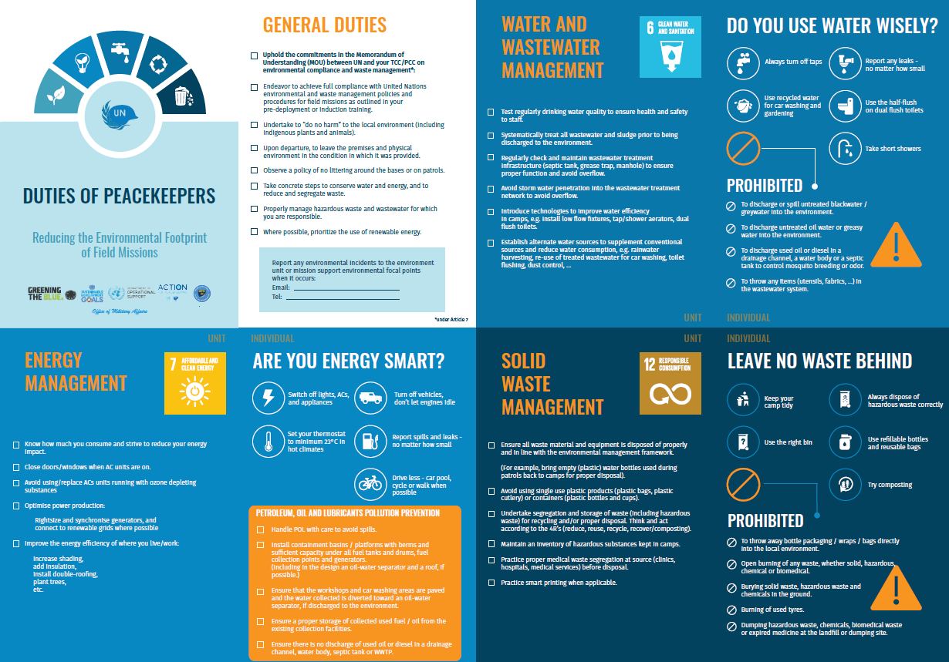
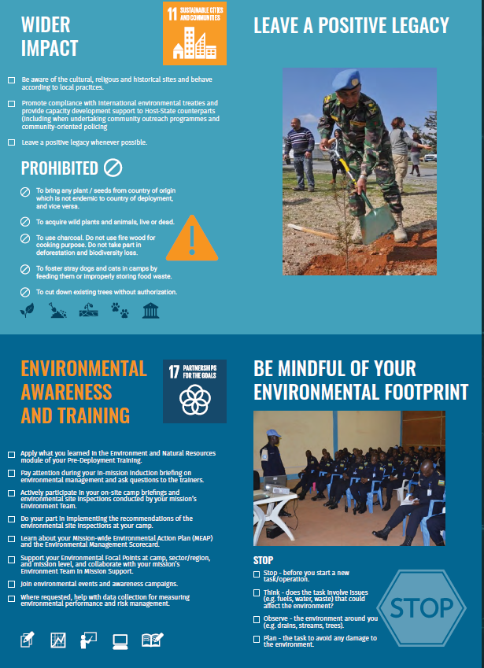
T/PCC – Environmental Awareness Generation
Core Pre-Deployment Program – Environment and Natural Resources module
Mission-level training for environmental focal points from military / police formed units
Environmental awareness generation briefing pack – translated in command languages
Duties of peacekeepers pocket card – Reducing the environmental footprint of field missions

Slide 16
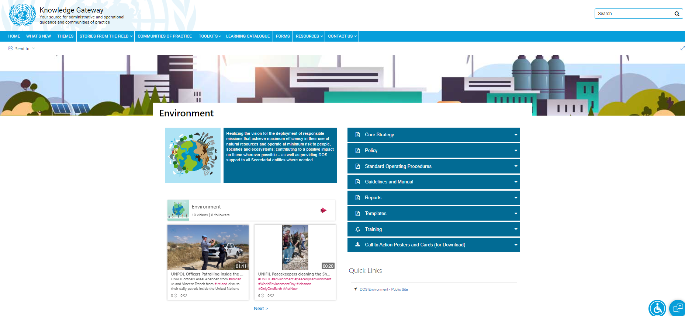
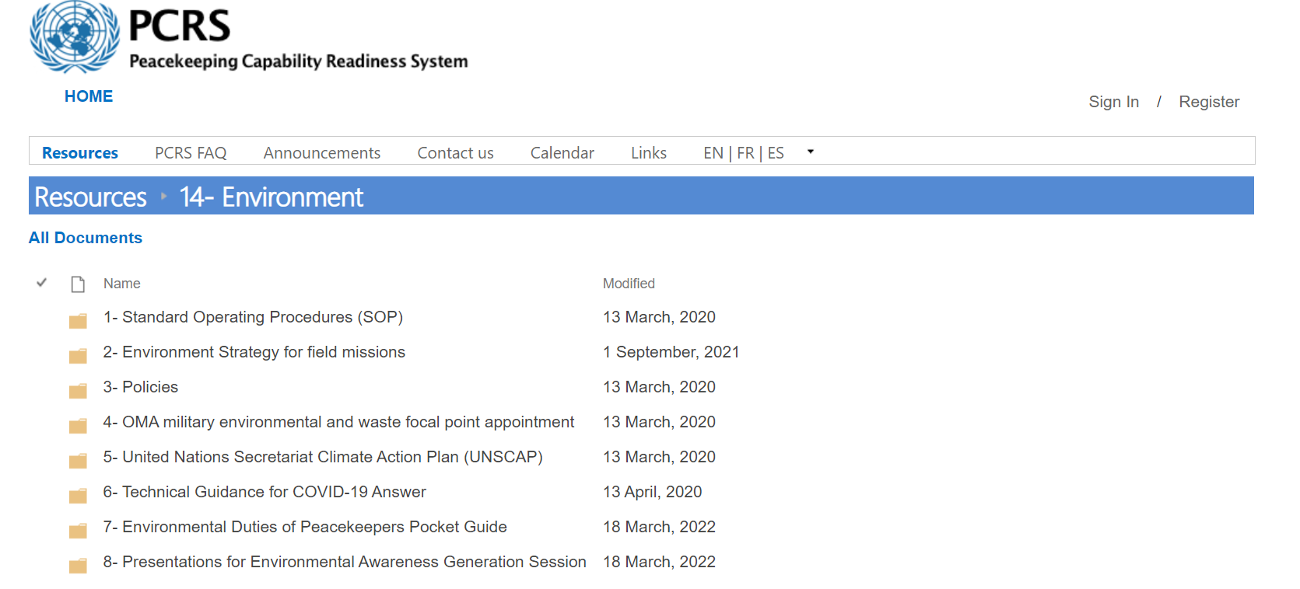
Further UN Environmental Resources
Environmental Management Handbook for Military Commanders in UN Peace Operations
Community of Practice for Military Environmental Focal Points
Military Engineering Unit Manual
Environmental awareness generation briefing pack
Range of technical manuals and standard operating procedures, e.g., SOP on Wastewater Risk Assessment and Reporting (2024), Camp Military Environmental and Waste Focal Point Sample Terms of Reference (TOR)
Capacity building framework for T/PCC Environmental Focal Points (under development)
Environment (sharepoint.com)
14- Environment - All Documents (un.org)

Slide 17
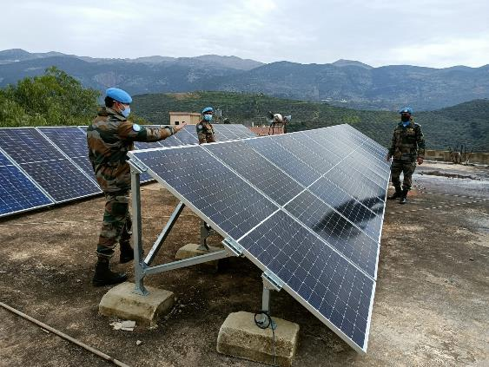
Thank you
Contact information
UN DOS - Environment Section
dos-ousg-envs@un.org

