Slide 1
MDMH
How to deal with it…
…or even better, make it someone else’s problem.
Notes:
Identifying Mis- Dis- and Mal-Information and Hate Speech is newly embraced by the United Nations, and a pilot training programme has been issued to prepare deploying individuals, formations and units.
The UN training programme clearly lays out definitions of MDMH and describes how they can impact a mission, disrupt its functionality and reduce its chances of success.
MDMH is used by State and non-State actors to achieve specific objectives.
It is relatively easy to define, and if it occurs in theatre then the effects will quickly be felt.
A number of UN missions have been victims of MDMH in the past twelve months.

Slide 2
Scope
What it is
Why you should worry
What you do
What we do

Slide 3
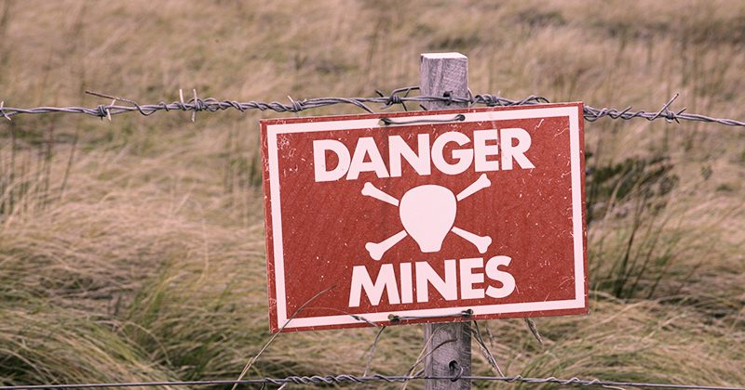
MINES
MDMH
Notes:
It is a bit like IED or Mines Awareness
Understanding what a Mine looks like, how it works and what the outcomes of a Mine can be important.
But what can actually be done about it?
Mines are best dealt with by trained experts.
MDMH is no different.
Understanding it, identifying it, passing it up the chain of command are all great. But if you are sitting on the unit or formation or Force HQ, what can be done about it?

Slide 4
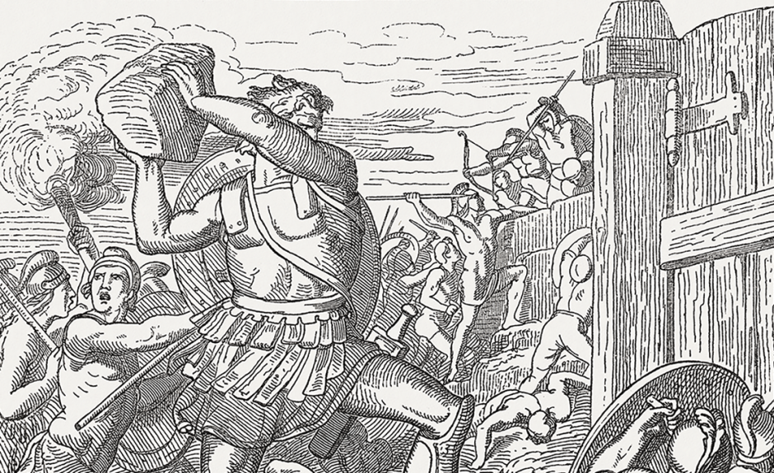
How do you (your HQ) currently deal with MDMH?
Notes:
How do you identify it?
How do you analyse it?
How could you mitigate against it?
How could you respond to it?
If you are from a training establishment, how do you prepare deploying troops to deal with and handle MDMH?
What innovative ways can we imagine to get plugged into the communications environment in the host country?
Inside the wire:
LECs will be exposed to the communications environment outside your base but be aware of certain biases: they will not want to risk their job by being controversial, nor may they be ready to risk their existence outside the base by exposing hostile narratives to the soldiers.
Youngest people are more plugged into digital channels and adept at navigating the online media landscape. It may be that a more junior team member is better suited to being the initial sensor for MDMH. Pick the right ones to monitor the different channels.
Outside the wire:
Collection tasks for patrols. What information is a patrol exposed to? Absence of the normal, or presence of the abnormal are always good indicators, and this can include MDMH. If a hostile narrative is circulating, people will behave differently to patrols. But be aware that a guy with a gun doesn’t hear the same stories that the general population will be hearing.
Ideally you will pick up rumour and conjecture before it delivers an angry mob to your front gate.

Slide 5
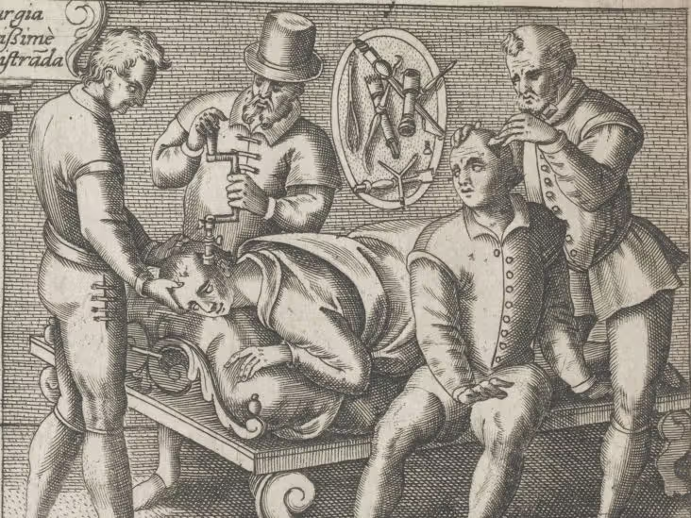
Building resilience against MDMH
Notes:
M&C Saatchi has run a number of successful MDMH awareness campaigns. By informing a population what MDMH is, why it is perpetrated and how it is used to seek malign goals it is possible to armour the population against it.
This does, however, need to be delivered in a subtle manner and well before an MDMH attack is anticipated.
MDMH works well in echo-chambers, in the absence of solid facts, and when the target population has distinct vulnerabilities.
You can counter these by;
Identifying echo chambers and getting your message into them
Explaining to your host population how to identify MDMH and not be tricked by it.
Sharing as much as you can about Mission and goals: have a busy comms plan that fills information space.
Identifying who your adversaries may be, what their aims are and how they might go about using comms to achieve them. Consider pre-bunking their potential approaches.

Slide 6
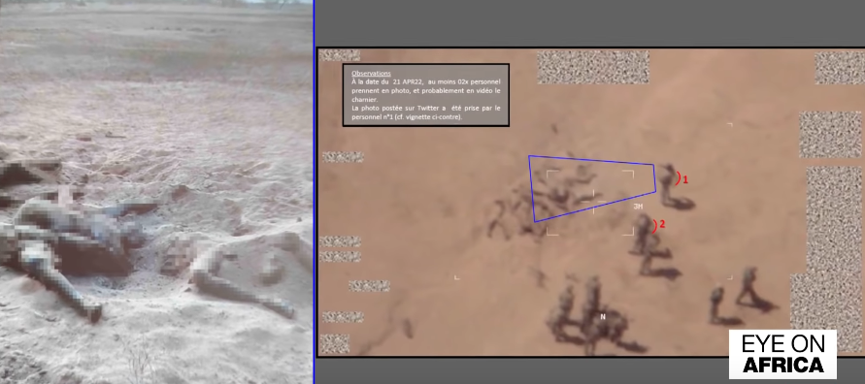
Notes:
Apr 2022
Russian mercenaries buried bodies near a Malian military base to falsely accuse France’s departing forces of leaving behind mass graves, the French military has claimed.
The French army said it used a drone to film what appeared to be white soldiers covering bodies with sand near the Gossi base in northern Mali.
The video was shown to reporters from Agence France Presse on Thursday after a Twitter account using the name Dia Diarra, who describes himself as a “former soldier” and “Malian patriot”, posted pixelated images of corpses buried in sand and accused France of atrocities.
“This is what the French left behind them when they left the base in Gossi … We cannot keep silent!” the account wrote.

Slide 7


Notes:
PARIS, March 1 (Reuters) - A bedbug scare in Paris last autumn that grabbed headlines across the globe was artificially amplified by social media accounts linked to Russian "disinformation" activities, a French minister said on Friday.
"The bedbug polemic was in a very large part amplified by accounts linked to the Kremlin, and they even created a false link between the arrival of Ukrainian refuges and the spread of bedbugs," French European affairs minister Jean-Noel Barrot told TF1 television.

Slide 8
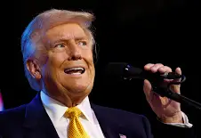
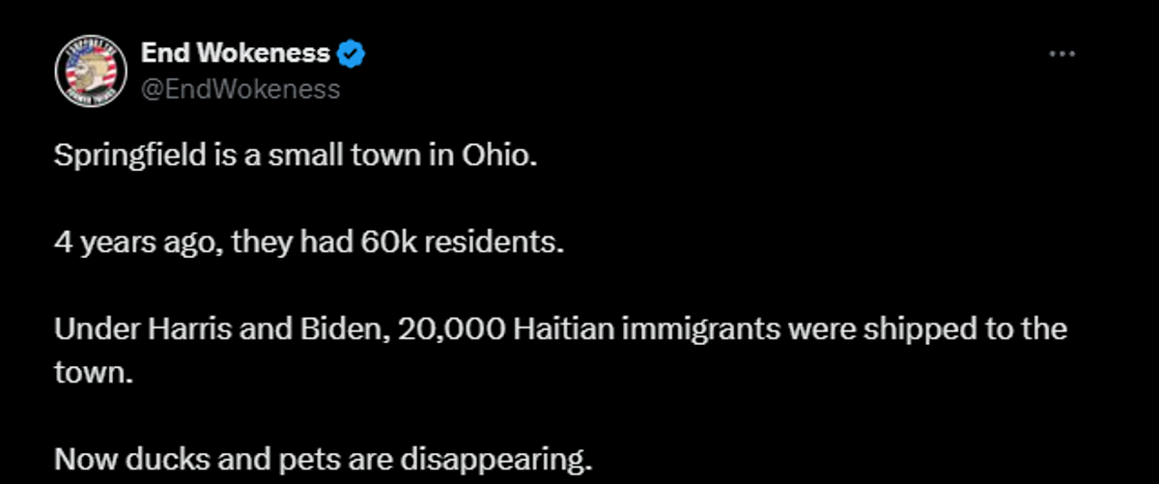

Notes:
Springfield Ohio
WASHINGTON, Sept 10 During a Presidential debate, candidate and former president Donald Trump said “In Springfield, they’re eating the dogs, the people that came in, they’re eating the cats. They’re eating the pets of the people that live there.”
This set off a swirl of rumours about the Haitian population of Springfield that were debunked by the US national and international press.

Slide 9
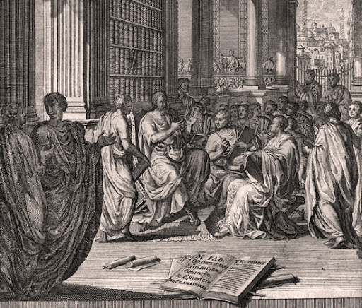
Leading the narrative – considerations for communicators
Notes:
Effective Target Audience Analysis – understand your host nation population and the groups within it. Determine what motivates them, excites them, and what depresses or pacifies them. What critical vulnerabilities might they have to MDMH?
Media analysis: understand how information moves around your Area of Operations. What channels are prevalent, which ones are trusted to impart the truth, and which ones are more used for rumour and conjecture.
Understanding context: how does the population interpret messages.
Credible voices
Stakeholder engagement
Correct channels
Red-teaming
Contingency plans
Measurement

Slide 10




M&C Saatchi
Detect
  Existing open-market proprietary tools
Measure
Assess
  In-house proprietary technology
  Human analysis
Act
Notes:
On- and off-line media monitoring as an early warning system
Digital tools to track-back to source
Identification of key-nodes and witting and unwitting propagators

Slide 11











Early Warning – network analysis
Notes:
We listen across all the platforms that our audience as exposed to and pull insights and develop analysis of what we are seeing.
By building an understanding of the potential goals that our adversaries are seeking to achieve we can better understand their routes and approaches.
This gives us a clear indication of what potential MDMH threats might look like and lay down preventative or mitigating actions.
By placing ourselves in the information flow and applying filters and analysis we are able to identify trends and themes that may lead to hostile acts of MDMH.
Our digital technologies also allow us to track back to source: running a reverse timeline on digital messaging to identify the source and by association give us an idea of where the message has come from. We are also able to identify and monitor witting and un-witting propagators, key influencers and communications nodes.

Slide 12


Early Warning – sensor probes
Notes:
Having looked briefly at digital capabilities, let’s have a quick chat about the human network side of things
We use our human network to draw locally pertinent information and build an off-line picture of what communities are talking about and how they are receiving and processing news and information.
This gives us a ground-truth read-out on what is happening right outside our clients’ gates.
Once we have built the picture we have technologies and techniques that allow us to launch targeted disruption to defeat MDMH. This may be to disrupt the message, the means, the network or even the source.

Slide 13
Advice
Prepare for it to happen
Ensure your team know what to look for
Plan courses of action for response
Notes:
Not shown on this slide, but we would also advise you to talk to us about your deployment or training.
We can support you in delivering MDMH awareness and response training. We can run exercise packages to practice the techniques learned during academic study, and of course we can accompany you on operations and deployments and deliver live analysis and effect.

Slide 14
Questions?
liam.webber@mcsaatchi.com
matt.quinton@mcsaatchi.com

