Slide 1
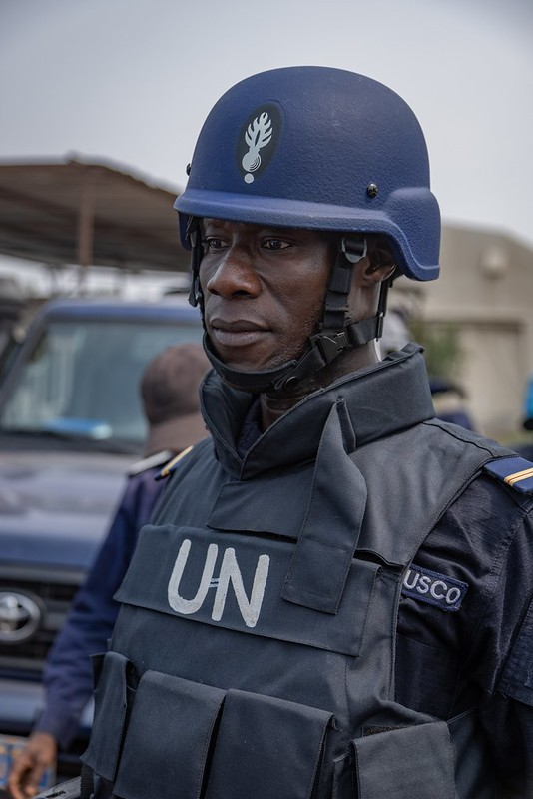
Reflection & Future
Advances & Issues in Training
Mark Pedersen

Slide 2
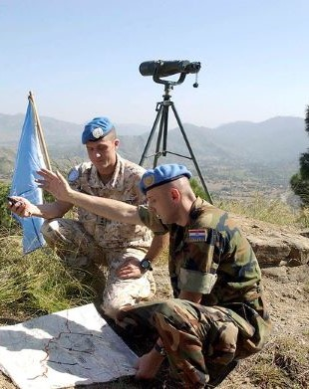
Reflection and Future
Milestones
Transformations
Challenges

Slide 3
The long view
Cruz report
A4P
A4P+
SGF
2014
2017
2018
2021
2015
2019
Triangular Partnership
High Level Panel
LCM

Slide 4
IAPTC attendance: T/PCCs

Slide 5
High Level Independent Panel on
Peace Operations
More POC training
Training partnership
Prevention of SEA
Selection & training of police
Better basic training and capabilities
Certification
Integration of human rights
Strengthened leadership trg & appointment of more women

Slide 6
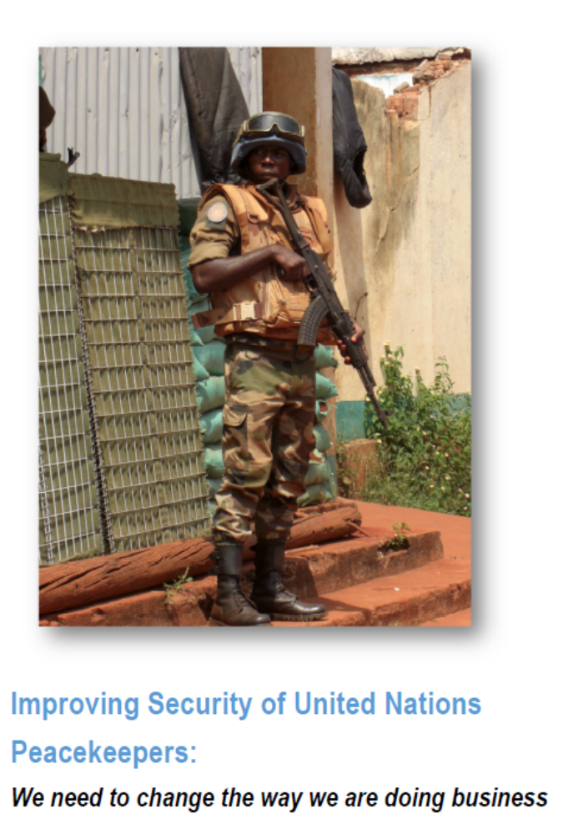
Gen. dos Santos Cruz, Dec 2017
“If the UN and T/PCCs
do not … change, we will continue to be an easy target.”
Secretary-General, Dec 2017
“I ask for the urgent preparation of a plan of action… [to review] our operational setup and all related aspects…”

Slide 7
dos Santos Cruz report
Mindset: proper mindset for operations
Capacity: equipment and training
Threat-oriented mission footprint: deployment for mandate and safety and security
Accountability: T/PCC performance and attacks on peacekeepers

Slide 8
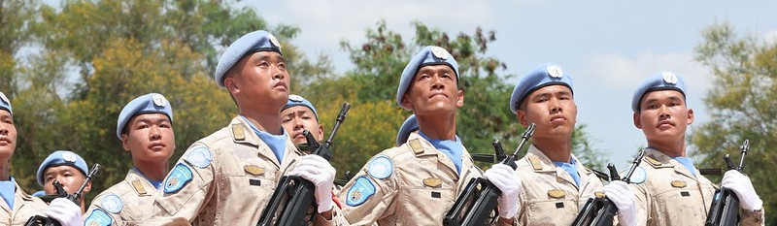
Training alone cannot create the right mindset
A product of leadership
Need same approach to peacekeeping as required for national defence & policing
Mindset

Slide 9
Capacity
Security Council actions reinforces progress
Peacekeeping-intelligence good advances
DPO & DOS training continues to expand
Medical training and mental health advances
Lessons identified/lessons learned needs more work, but tools are available

Slide 10
Accountability
Steady advances, but issues continue
Good progress on impunity for crimes against peacekeepers
Sexual exploitation and abuse remains a focus
New work on sexual harassment

Slide 11
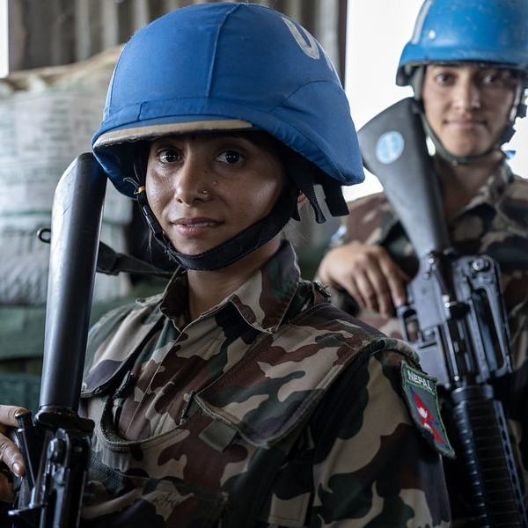
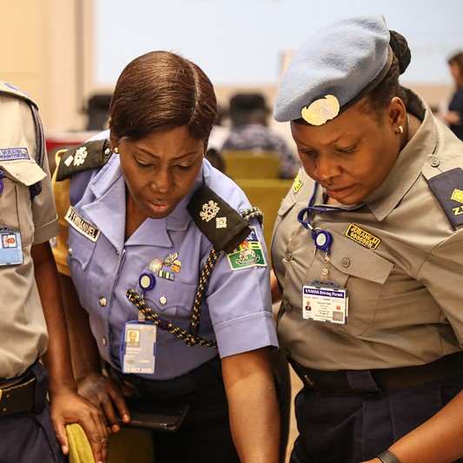
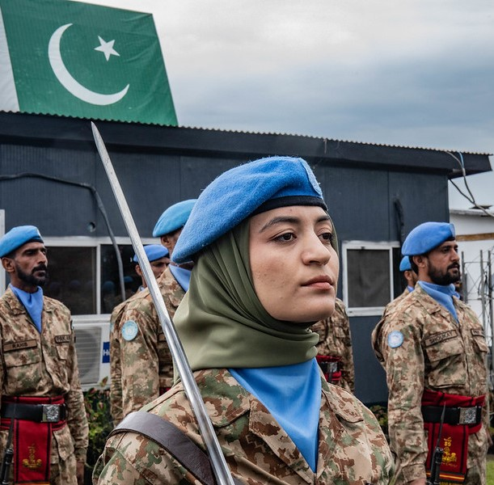
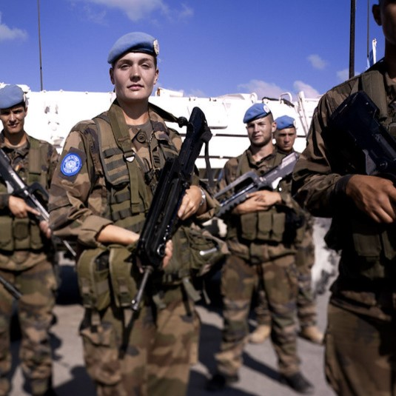
Gender
Strengthening the capacity for senior roles
Senior Women Talent Pipeline
Police Women’s Comd. Development Cadre
UN Women partnership with DPO

Slide 12
Priority issues
Counter UAS
Mis and disinformation
Integrated and scenario-based training
Crime intelligence & public order
Continued emphasis on gender parity
SEA and sexual harassment
New models – AU-led ops and MSS

Slide 13
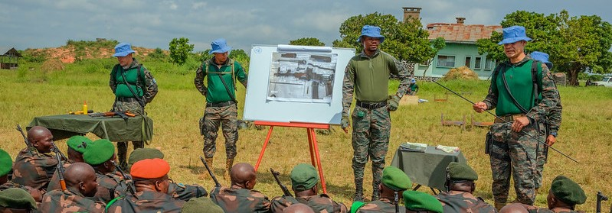
The Way Ahead
Partnerships

Slide 14
